Slide 1



Staffing Challenges in Long-Term Care and Assisted Living Facilities
Overview of Issues, Impacts, and Solutions
WAVES
Fall Conference
September 9-10, 2025
Embassy Suites Noblesville | Indianapolis, IN

Slide 2
Agenda
Introductions
Survey
Overview of Current Staffing Challenges
Key Contributing Factors
Impacts on Patient Care
Proposed Solutions
WAVES
Fall Conference

Slide 3



Introduction
Amergis Healthcare Staffing
Why Us?
  Long-term care and assisted living facilities are facing a critical staffing crisis. This presentation outlines the causes, impacts, and potential solutions to this issue.
Clark Green
Director of Business Operations
WAVES
Jeremy Richey
Business Development Manager
Fall Conference
Notes:
Clark and Jeremy

Slide 4
Use of Contingency Labor
How many facilities are fully staffed?
  Only 59% of U.S. Nursing Homes met or exceeded staffing minimums (3.48 Hours per resident day (HPRD)
  Only 30% of U.S. Nursing Homes met the Certified Nurse Aide minimum (2.45 HPRD)
When was the last time you worked with a Labor Partner?
  50% of Nursing Homes in the U.S. used agency care in 2022
  96% of Assisted Living and 99% of Nursing Homes report experiencing staffing shortages in some capacity
How did you utilize your Labor Partners?
  Contract
  Per Diem
  Online or Direct Relationship
How many Labor Partners do you use?
WAVES
Fall Conference

Slide 5
Causes of Staffing Challenges​
WAVES
Fall Conference

Slide 6
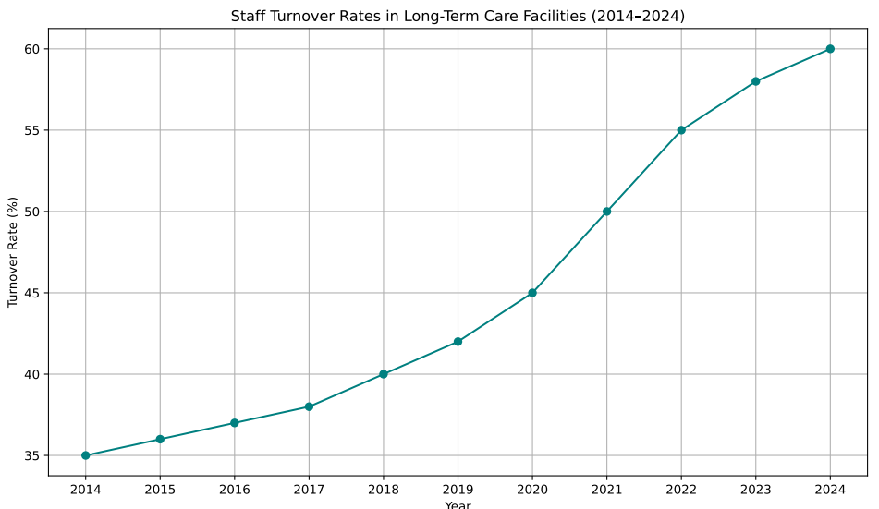
Causes of Staffing Challenges
Burnout and Emotional Toll
Competitive Job Markets with Better Wages
Aging Population Increasing Demand
Pandemic-related Evaluations of Work-Life Balance
Limited Internal Resources
Negative Perception of LTC Work
WAVES
Fall Conference
Notes:
Jeremy

Slide 7
The Indiana Hospital Association projects that by 2031, the state will require an additional 5,000 nurses to meet the healthcare demands of its aging population
  https://wjts.tv/2025/05/indianas-nursing-shortage-prompts-statewide-response-and-legislative-reform/
“Long-term care facilities continue to grapple with staffing problems, which limits the available spots for a hospital to discharge to.”
  https://www.ahcancal.org/News-and-Communications/Press-Releases/Pages/ICYMI-Nursing-Home-Staffing-Shortages-Cause-Ripple-Effects-in-Rural-Communities,-Throughout-Health-Care-Industry.aspx
The workforce shortages in long-term care are also hurting the quality of care. When facilities are short-staffed, workers may have to work longer hours and take on more responsibilities, leading to burnout and decreased quality of care
  https://www.ltcnews.com/articles/workforce-shortages-long-term-care-driving-up-costs-delaying-care
Staggering mean turnover rates included 140.7% among registered nurses, 129.1% for certified nursing aides and 114.1% among licensed practical nurses.
  https://www.mcknights.com/news/cms-going-public-with-facility-turnover-weekend-staffing-data/
WAVES
Fall Conference
Notes:
Jeremy

Slide 8
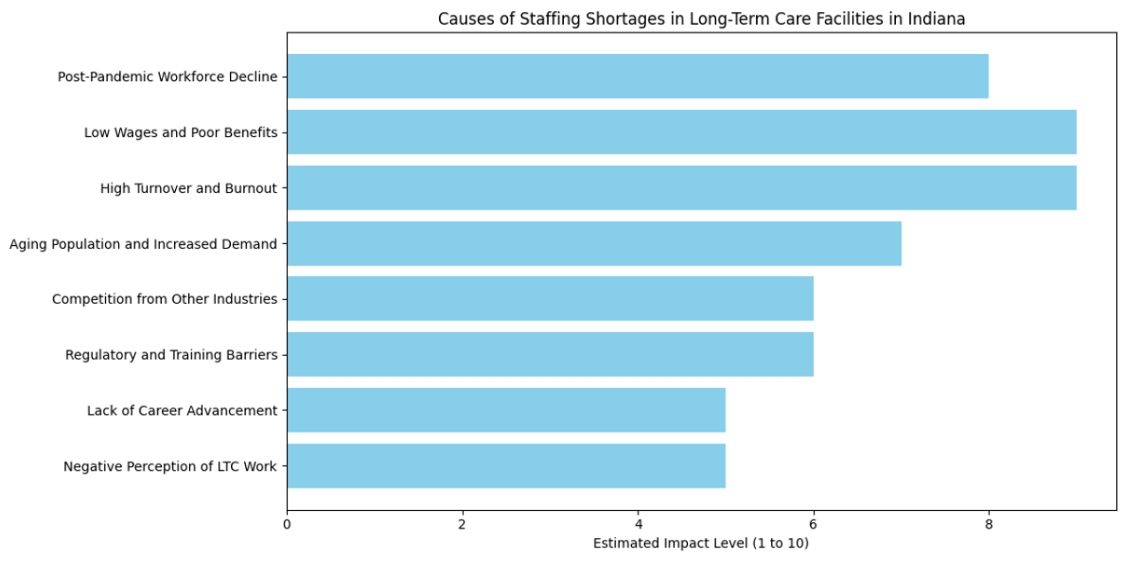
http://efaidnbmnnnibpcajpcglclefindmkaj/https://www.in.gov/fssa/ompp/files/2022DSWReport_FINAL.pdf
WAVES
Fall Conference
Notes:
Clark --- transition slide

Slide 9
Impacts of Staffing Challenges
WAVES
Fall Conference
Notes:
Clark --- transition slide

Slide 10
Impacts of Staffing Shortages
Higher Internal Costs for Wages, Retention, and Hiring
Increased Turnover and Costs
Quality of Care Risks
Limited Resources to Increase Admissions
Potential Facility Closures
WAVES
Fall Conference
Notes:
Clark

Slide 11
Higher Wages, Retention, and Hiring Costs
Wage increases competing with other facilities and outside industry organizations
Wage Increases for Nursing Staff
Role | 2022 Avg Salary | 2025 Avg Salary | % Increase
RN | $68,000 | $88,452 | +30%
LPN | $54,000 | $62,990 | +17%
CNA | $28,000 | $33,375 | +19%
Landscape of LTC Staffing
Role | % working in LTC | Hiring Costs Yearly | Avg Hourly Wage in Indiana | Key Retention Factors
RN | 6% | $40k-$60k | $39.76 | Staffing ratios, Pay, Burnout
LPN | 38% | $10K-$20k | $30.28 | Flexibility, Pay, Burnout
CNA | 48% | $3K–$6K | $18.96 | Empowerment, Training and Culture
​According to the BLS and Indiana Specific Data
WAVES
Fall Conference
Notes:
Clark

Slide 12
Increased Turnover Costs
Financial
Costs of Hiring New Staff
Costs of Training New Staff
Costs of Productivity Loss by employees increasing workloads
Non-Financial
Compromise Quality of Care
Mental Health of Employees
Job Satisfaction and Employee Morale
More Time Spent Training
Reputation of Workplace in Community
WAVES
Fall Conference
Notes:
Clark

Slide 13
Quality of Clinical Outcomes
Falls
    Falls are the leading cause of fatal and non-fatal injuries among older adults in Indiana LTC settings
    1 in 4 Hoosiers aged 65+ experiences a fall each year.
    Risk factors include:
      Low staff-to-resident ratios
      Inadequate supervision during high-risk hours (e.g., early mornings)
      Poor enviornment safety measures
Infections & Safety Incidents
    The Indiana Department of Health (IDOH) tracks incidents such as:
      Pressure ulcers
      Urinary tract infections
      Medication errors
      Neglect or abuse reports
***Facilities must report these incidents to IDOH, and many are linked to staffing deficiencies
3. Quality of Care
    Understaffed facilities often struggle with:
      Timely medication administration
      Hygiene and mobility assistance
      Emotional and psychological support
    These gaps contribute to functional decline, hospital transfers, and lower resident satisfaction.
WAVES
Fall Conference
Notes:
Clark

Slide 14







Recruitment & Onboarding
Workforce Expansion Strategies
Solutions
to Staffing Shortages
Streamline the Hiring Process
Develop Robust Onboarding Programs
Partner with Local Nursing Schools
Temporary Nurse Assistant Programs
Create New Roles – Hallway Ambassadors
Utilize Retired or Semi-Retired Professionals
Scheduling Flexibility
Retention & Culture Building
Staggered Shifts and Flexible Scheduling
Alternative Care Models
Mentorship Programs
Recognitions and Appreciation Initiatives
Empathetic Leadership and Team-Building
Compensation & Benefits
Technology & Innovation
Offer Competitive Wages and Shift Differentials
Provide Meaningful Benefits
Implement Incentive Programs
Utlilize Scheduling and Staffing Software
Explore Telehealth and Remote Monitoring
Training & Career Development
Continuing Education and Leadership Development
Real-World Scenario Training
Clear Career Advancement Pathways
WAVES
Fall Conference

Slide 15

Amergis Solutions to Staffing Shortages
Large Candidate Network
Amergis Commitment Program
Shift Based Applications
Local Support with National Reach
Our Culture
Increased Speed to Market
True Partnership
Comprehensive Offerings
WAVES
Fall Conference

Slide 16
Open Discussion
WAVES
Fall Conference

Slide 17


https://www.ahcancal.org/News-and-Communications/Press-Releases/Pages/Staffing-Challenges-In-Long-Term-Care-Facilities-Continue-To-Threaten-Access-to-Care-for-Residents.aspx
https://www.careerstaff.com/healthcare-staffing-blog/biggest-challenges-of-long-term-care/
https://www.olooptech.com/post/long-term-care-facilities-suffering-severe-staffing-shortages-staffing-providers-can-help-them-overcome-this-crisis
https://www.qualityinsights.org/nursing-home-insights/tackling-the-long-term-care-workforce-crisis-lessons-from-the-staffing-solutions-for-nursing-homes-program#gsc.tab=0
https://www.ahcancal.org/News-and-Communications/Press-Releases/Pages/Staffing-Challenges-In-Long-Term-Care-Facilities-Continue-To-Threaten-Access-to-Care-for-Residents.aspx
WAVES
Fall Conference

