Slide 1

Be in the Know – SNF PPS Final Rule for FY2026, MDS 3.0 Changes, PDPM Update and More
Deborah Lake, RN, RAC-CTA
Senior Managing Consultant
September 10, 2025

Slide 2

Our Agenda for Today
Final SNF PPS FY2026 Rule
MDS 3.0 Changes
PDPM Update
5-Star/QM Updates
SNF Validation Program
Payroll Based Journal

Slide 3
Our Objectives for Today
Be aware of changes with the FY 2026 Final Rule in Medicare reimbursement, SNF Quality Reporting (SNF QRP) and SNF Value Based Purchasing (SNF VBP)
Be aware of upcoming changes to the MDS 3.0
Develop a clearer understanding of Payroll Based Journal (PBJ)
Identify areas affected in your facility and how to move forward

Slide 4

FY2026 SNF PPS Final Rule

Slide 5
FY 2026 Final Rule
SNF Payment Rates
  3.2% or $1.16 billion estimated increase
    Market Basket Increase (+3.3%) – Reflects the estimated changes in the cost of goods and services included in the covered services for the Medicare SNF benefit, e.g., wage-related costs, supplies, ancillary services, etc.​
    ​
    Forecast Error Adjustment (+0.6%) – Reflects the difference in the latest available fiscal year’s forecasted market basket increase and the actual market basket increase for the same period.​
    ​
    Productivity Adjustment (-0.7%) – To help ensure that rate adjustments reflect actual increases in costs versus gains in employee productivity.
Does not include the impact of VBP net reductions which is estimated to be $208.36 million

Slide 6
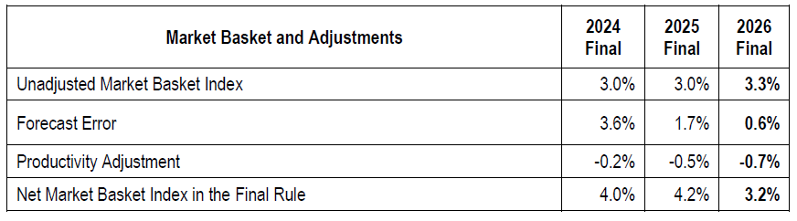
FY 2026 Final Rule

Slide 7
FY 2025 Unadjusted Federal Rate Per Diem - URBAN
Rate Component | PT | OT | SLP | Nursing | NTA | Non-Case-Mix
Per Diem Amount | $73.25 | $68.18 | $27.35 | $127.68 | $96.33 | $114.34
FY 2025 Unadjusted Federal Rate Per Diem - RURAL
Rate Component | PT | OT | SLP | Nursing | NTA | Non-Case-Mix
Per Diem Amount | $83.50 | $76.69 | $34.46 | $121.99 | $92.03 | $116.46

Slide 8
TABLE 4: FY 2026 Unadjusted Federal Rate Per Diem - URBAN
Rate Component | PT | OT | SLP | Nursing | NTA | Non-Case-Mix
Per Diem Amount | $75.73 | $70.49 | $28.28 | $132.00 | $99.59 | $118.21
TABLE 5: FY 2026 Unadjusted Federal Rate Per Diem - RURAL
Rate Component | PT | OT | SLP | Nursing | NTA | Non-Case-Mix
Per Diem Amount | $86.33 | $79.29 | $35.63 | $126.12 | $95.15 | $120.40

Slide 9
FY 2026 Final Rule
PDPM ICD-10 Updates
  Codes from the following categories will be re-assigned from Medical Management to Return to Provider for PDPM ICD-10 mapping:
      Diabetes Mellitus (Type 1)
      Hypoglycemia
      Obesity
      Anorexia Nervosa, Restricting Type
      Anorexia Nervosa, Binge Eating/Purging Type
      Bulimia Nervosa
      Binge Eating Disorder
      Pica and Rumination Disorder

Slide 10
FY 2026 Final Rule
PDPM ICD-10 Updates
  Coding for the following diagnosis will be re-assigned from Acute Neurological to Medical Management for PDPM ICD-10 mapping:
    Serotonin Syndrome (G90.81)

Slide 11
FY 2026 Final Rule
SNF Quality Reporting Program (SNF QRP)
  The SNF QRP requires SNFs to report on quality data on specific measures. The data is collected and submitted through three separate methods.
    Minimum Data Set (MDS 3.0)
    Centers for Disease Control and Prevention (CDC) National Healthcare Safety Network (NHSN)
    Medicare Fee-for-Service Claims
  Providers who fail to properly submit QRP data are subject to a 2% reduction in their overall Medicare reimbursement

Slide 12
SNF QRP Compliance
Effective January 1, 2024, facilities have been required to meet compliance thresholds for 2 measures for Quality Reporting:
  Annual MDS submission threshold
    90% of submitted MDS assessments with 100% of required SNF QRP data elements
  NHSN data submission requirement for Health Care Provider COVID-19 and Influenza Vaccination
    NHSN compliance rate is 100%

Slide 13
SNF QRP Compliance
NHSN data submission requirement for COVID-19 Vaccination
  Submission of all required data element for a minimum of one week per month each quarter
Influenza Vaccination Coverage Among Healthcare Personnel
  Data to be submitted through the CDC National Healthcare Safety Network (NHSN)
    To meet requirement, SNFs would enter a single influenza vaccination summary report at the conclusion of the measure reporting period
    May enter data more frequently – CMS/NHSN encourages monthly updates
  Summary data must be entered by May 15 of each year to avoid penalty

Slide 14
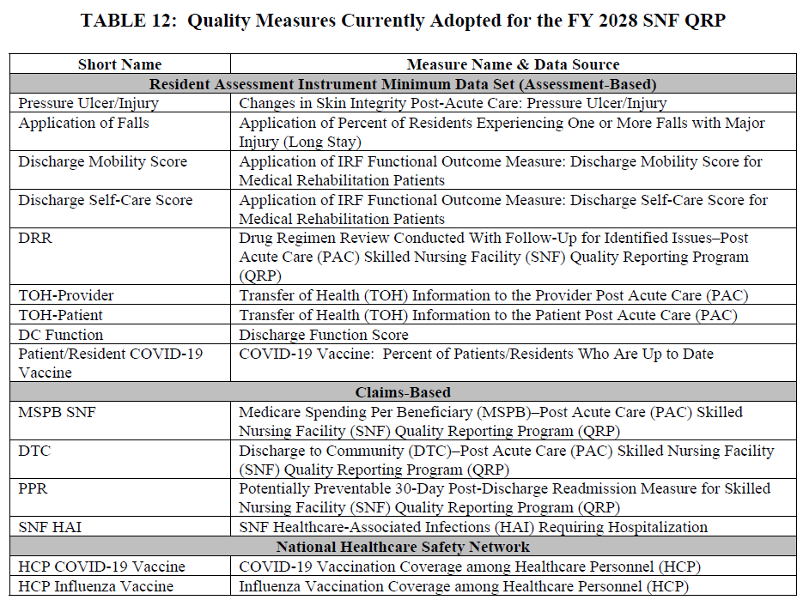
Table 12 from the FY 2026 Rule represents the measures in place for FY 2028 SNF QRP:
No changes to current measures for FY 2026

Slide 15
FY 2026 Final Rule
SNF Quality Reporting Program
  Removal of four standardized patient assessment data elements under Social Determinates of Health (SDOH)
    Living Situation (1)
    Food (2)
    Utilities (1)
  Amend reconsideration policies for non-compliance with QRP
    Allow SNF ability to file an extension to file a request for reconsideration
      Must file via e-mail within 30 days of the written notice of non-compliance
      Updated language from “Extenuating” to “Extraordinary” Circumstances
    Update basis on which CMS can grant a reconsideration request
      CMS must determine that SNF was in full compliance with SNF QRP requirements

Slide 16
FY 2026 Final Rule
SNF Quality Reporting Program
  Feedback is being requested on requests for information (RFI):
    Future measures
    Potential revision to data submission deadlines for assessment data collected for the SNF QRP
      From 4.5 months to 45 days
      Improve timeliness of public reporting
    Advancing digital quality measurement

Slide 17
SNF QRP Non-Compliance
Non-compliance Reports for FY2026 Penalties
  Posted on July 18, 2025
  Reconsideration requests were due by August 26, 2025

Slide 18
FY 2026 Final Rule
SNF Value Based Purchasing (VBP)
  No proposed changes for FY2026
  Overall impact is estimated saving to Medicare
    FY2026 = $208.36 million
    FY2027 = $207.99 million
  Removal of SNF VBP Health Equity Adjustment set to begin in FY2027
    Bonus points to high performing facilities that care for a high proportion of (20% or high) of dual eligible beneficiaries
    Increase payback percentage from 66% to 60%

Slide 19
FY 2026 Final Rule
SNF Value Based Purchasing (VBP)
  SNF With-in Stay Potentially Preventative Readmission (SNF WS PPR) set to begin with FY2028
    Replaces SNF 30-Day All Cause Re-Admission Measure (SNFRM)
  Additional reconsideration process
    All SNFs to appeal initial decision for Review and Correction

Slide 20
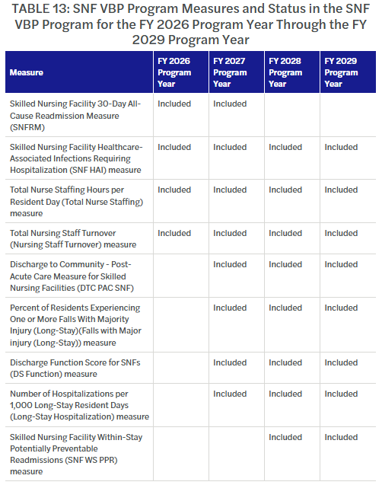
SNF Value Based Purchasing (VBP)
SNF Value Based Purchasing (VBP)
  For FY2026, VBP payment adjustments will be based on four measures
  Table for inclusion of programs

Slide 21
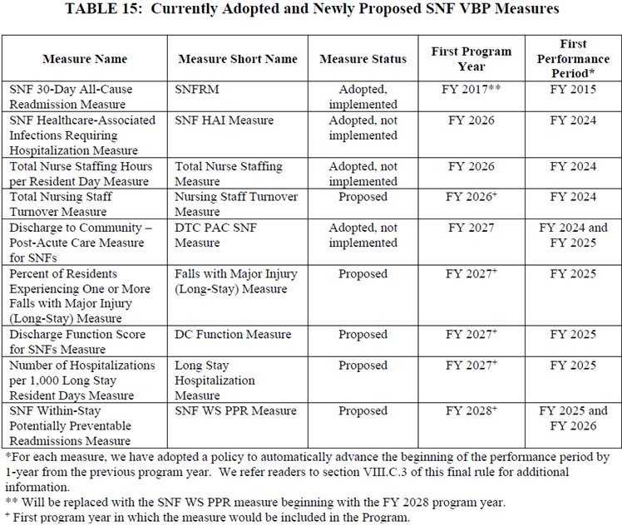
SNF Value Based Purchasing (VBP)
First Performance Year for inclusion of new measures

Slide 22
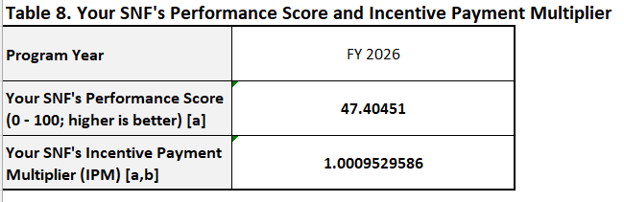
SNF Value Based Purchasing Reminder
SNF Value Based Purchasing Scores
  Posted on July 31, 2025
  Includes:
    SNF Measure Results
    SNF Measure Score
    Performance Score
    Incentive Payment Multiplier for FY 2026

Slide 23
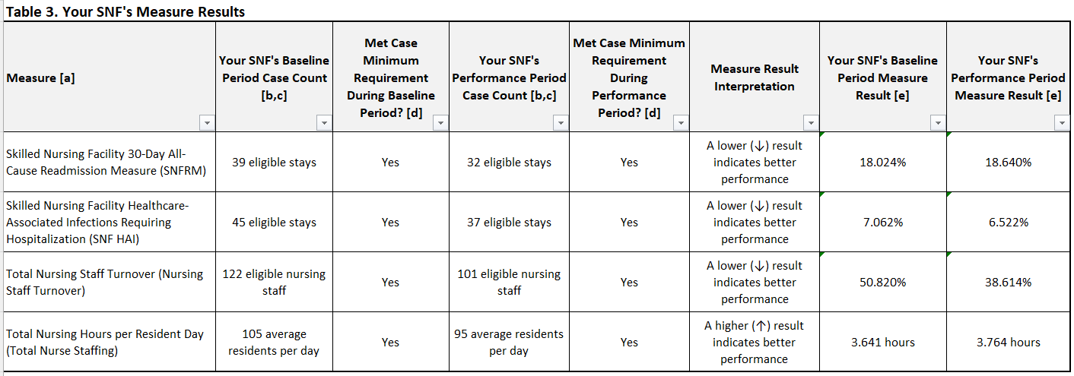
SNF Value Based Purchasing

Slide 24
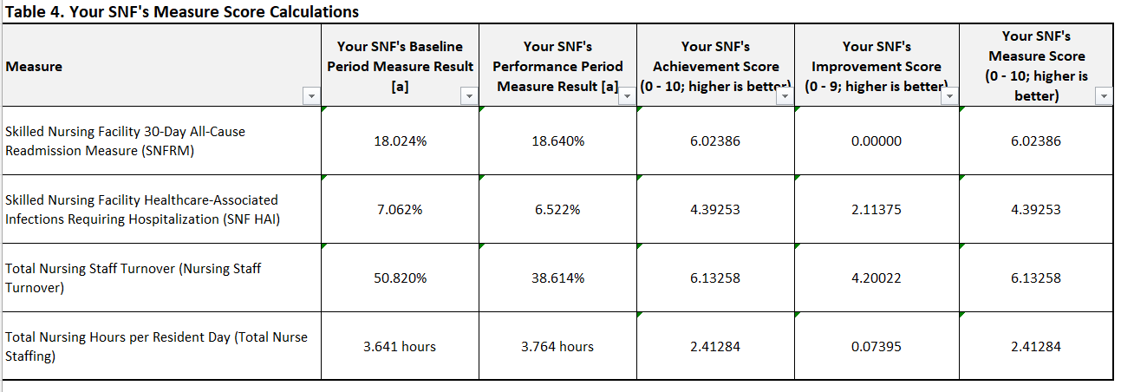
SNF Value Based Purchasing

Slide 25
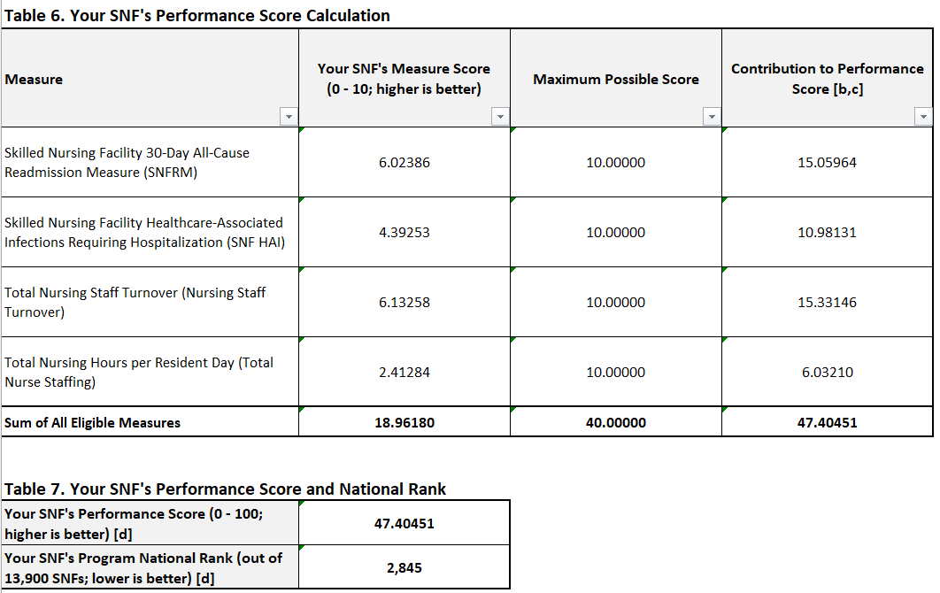
SNF Value Based Purchasing

Slide 26
FY2026 Final Rule
Administrative Presumption of Coverage
  Reflect an administrative presumption that those beneficiaries who are correctly assigned one of the designated case-mix classifier in their initial Medicare assessment (5-day) are automatically classified as meeting the SNF level of care definition up to and including the assessment date (ARD) of that assessment.
  For services furnished on or after October 1, 2019 the following are the designated case-mix classifiers:
    Nursing Component: Extensive Services, Special Care High, Special Care Low and Clinically Complex categories
    PT and OT Component: TA, TB, TC, TD, TE, TF, TG, TJ, TK, TN and TO
    SLP Component: SC, SE, SF, SH, SI, SJ, SK and SL
    NTA Component: Uppermost (12+) comorbidity group

Slide 27
MDS 3.0 Changes

Slide 28
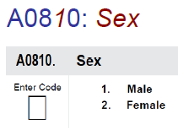
Draft MDS 3.0 RAI Manual
MDS 3.0 RAI Manual for October 2025
  Final version 1.20.1 posted on August 29, 2025
  Final Item Sets 1.20.1v3 posted on August 15, 2025 – Removing Section R
  Section A: Identification Information
    A0800 Gender has been changed to A0810 Sex
    Reminder that if resident declines to answer, Code Y, resident declines to respond and do not code based on other resources (family, medical records, etc.) for the following 2 items:
      A1005 Ethnicity
      A1010 Race

Slide 29
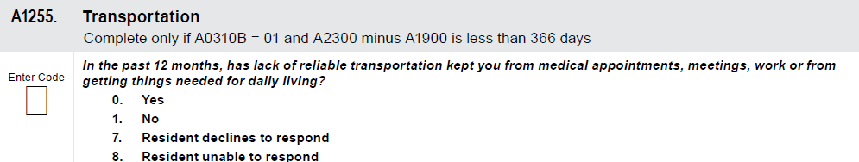
MDS 3.0 Updates – Section A
SNF Quality Reporting Program
  Modification of Transportation Item (A1250) beginning October 1, 2025
    Revise look-back period and simplification of responses
    A1255 In the past 12 months, has a lack of reliable transportation kept you from medical appointments, meetings, work or from getting things needed for daily living?

Slide 30
MDS 3.0 Updates – Section GG
Section GG
  New/updated examples
  Updated Coding Tips
    Clarified assessment timeframe as being up to 3 days
    Do not code mobility or self-care activities with use of a device that is restricted to resident use during therapy services (parallel bars, over head track, harness systems, etc.)
    Consider an item that covers all or part of the foot as footwear, even if it extends up the leg. Do not also consider it as lower-body dressing.
    If resident wears just shoes or just socks, that are safe for mobility, then GG0130H, Putting on/taking off Footwear, may be coded

Slide 31
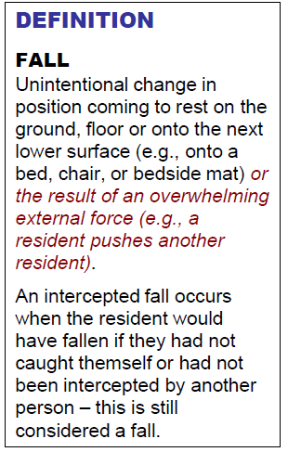
MDS 3.0 Updates – Section J
Fall Definition
  Page J-32

Slide 32
MDS 3.0 Updates – Section J
Falls – Coding Tips
  Page J-33
  Page J-39
CMS understands that challenging a resident’s balance and training them to recover from a loss of balance is an intentional therapeutic intervention and does not consider anticipated losses of balance that occur during supervised therapeutic interventions as intercepted falls. However, if there is a loss of balance during supervised therapeutic interventions and the resident comes to rest on the ground, floor or next lower surface despite the clinician’s effort to intercept the loss of balance, it is considered a fall.
Fractures confirmed to be pathologic (vs. traumatic) are not considered a major injury resulting from a fall.

Slide 33
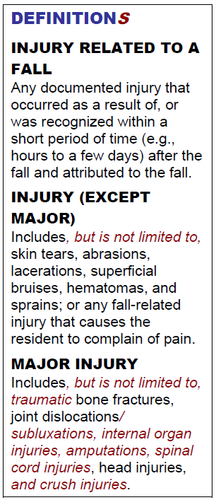
MDS 3.0 Updates – Section J
Injury Definitions
  Page J-37

Slide 34
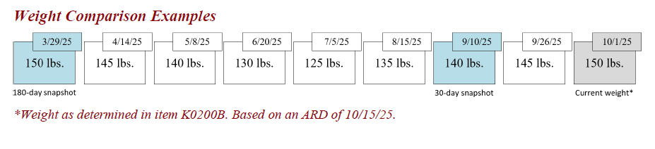
MDS 3.0 Updates – Section K
Coding Weight Loss and G
  In cases in which multiple weights for the resident may exist during the time period being evaluated, select the weight on the date closest to the appropriate time point

Slide 35
MDS 3.0 Updates – Section N
Section N
  Clarified that anticoagulants used for flushing of IV lines are not to be coded at N0415E, Anticoagulant
  Coding Tips for Drug Classification:
    Identify resource staff consistently use for pharmacological classification
    Consult manufacturer’s inserts
    Consult resident’s pharmacist

Slide 36
MDS 3.0 Updates – Section O
  Section O: Therapy Services
    Sections O0400A, B, C, D1, E & F have been retired
      Therapy days and minutes
      Will now only be coded for Part A residents with their PPS Discharge assessments at O0425
    Section O0420 has been retired
      Distinct calendar days
      New Item O0430 Distinct Calendar Days for Part A therapies

Slide 37
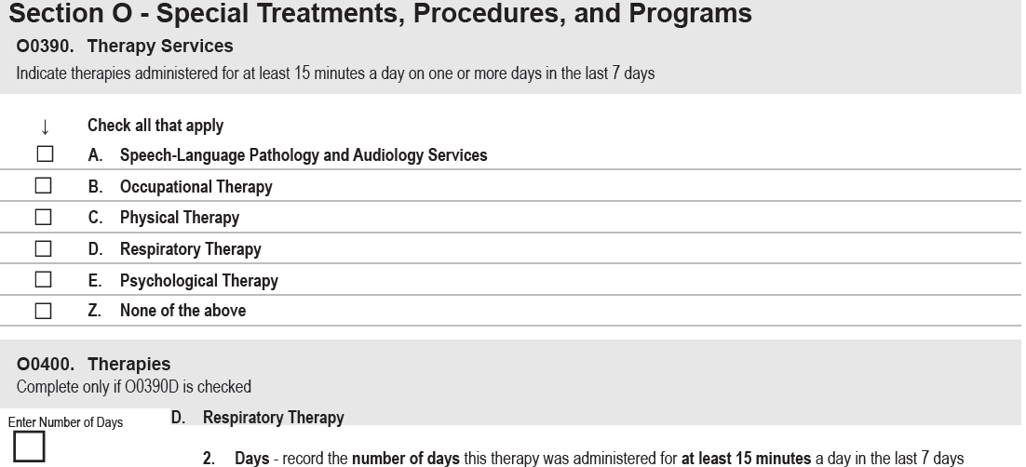
MDS 3.0 Updates – Section O
O0390. Therapy Services and O0400. Therapies

Slide 38
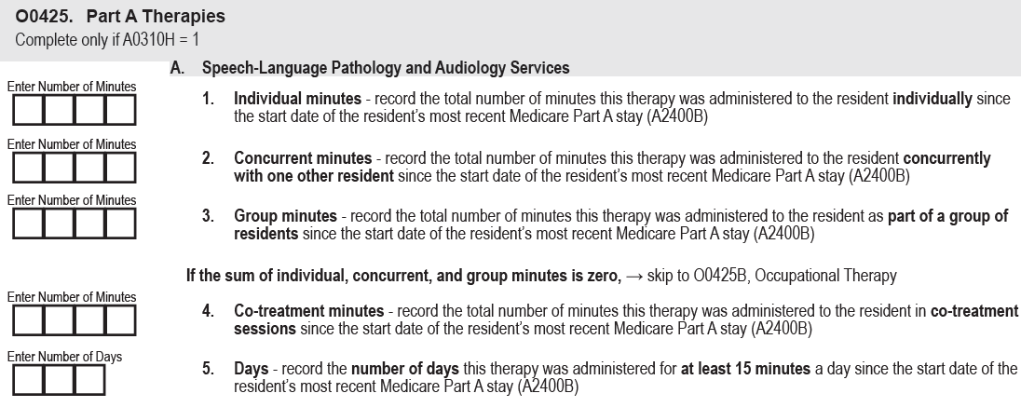
MDS 3.0 Updates – Section O
O0425 Part A Therapies – Completed with PPS Discharge Assessments
  Speech-Language and Audiology Services

Slide 39
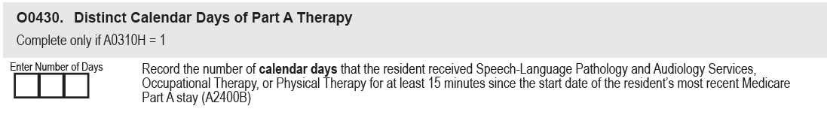
MDS 3.0 Updates – Section O
O0430. Distinct Calendar Days of Part A Therapy
  Completed with PPS Discharge Assessments

Slide 40
PDPM Update

Slide 41
PDPM Update
IHCP Bulletin BT2025115 posted on August 5
    OSA no longer required on assessments with an assessment date of September 15, 2025 and later
    Providers are required to complete all MDS items associated with the PDPM model including the following 3 items:
      I0020: Indicate the resident’s primary medical condition category
      J2100: Recent Surgery Requiring Active SNF Care
      O0400D: Respiratory Therapy

Slide 42
PDPM Update
Myers and Stauffer has completed initial modeling for conversion to PDPM for case-mix using only the Nursing component of PDPM
Workgroup still discussing the application of PDPM and timing
It is recommended that facilities focus on appropriate PDPM coding
  Primary diagnosis
  Section GG ADL Function Coding

Slide 43
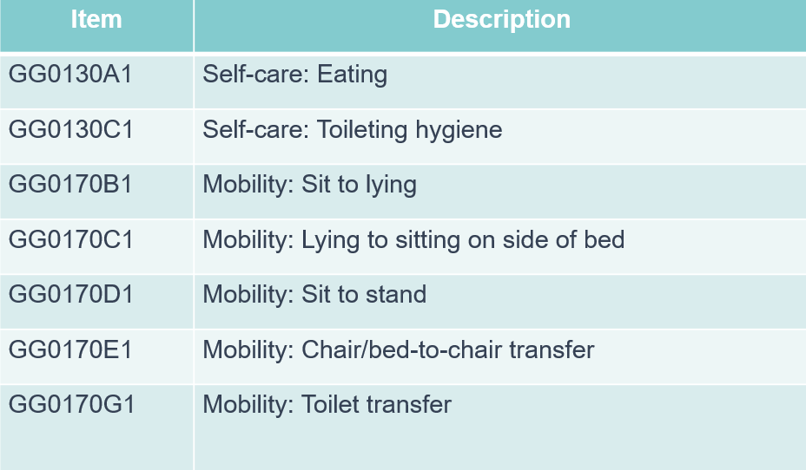
PDPM Update
Nursing Function Score:

Slide 44
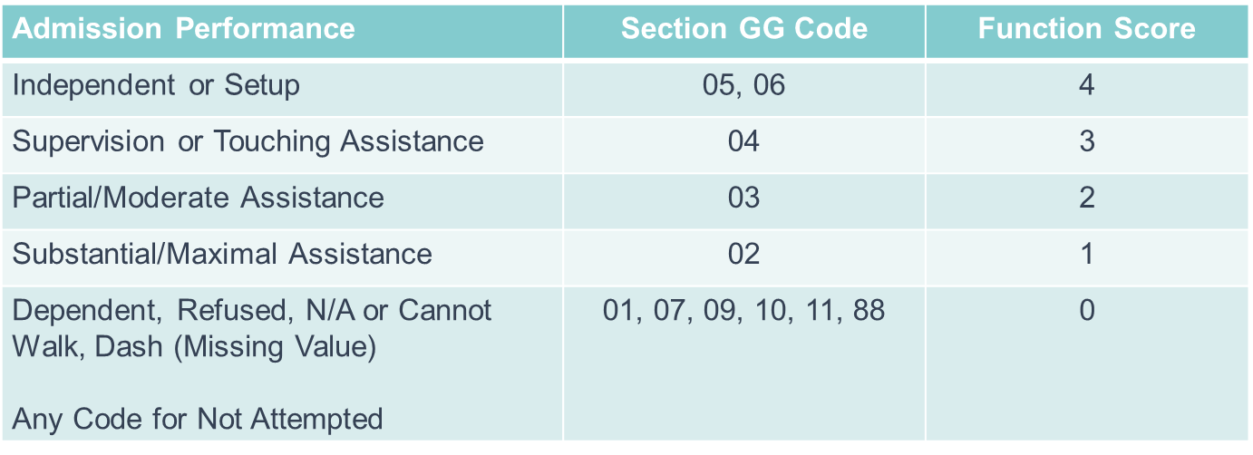
PDPM Update
Nursing Function Score
  Score can range from 0-16

Slide 45
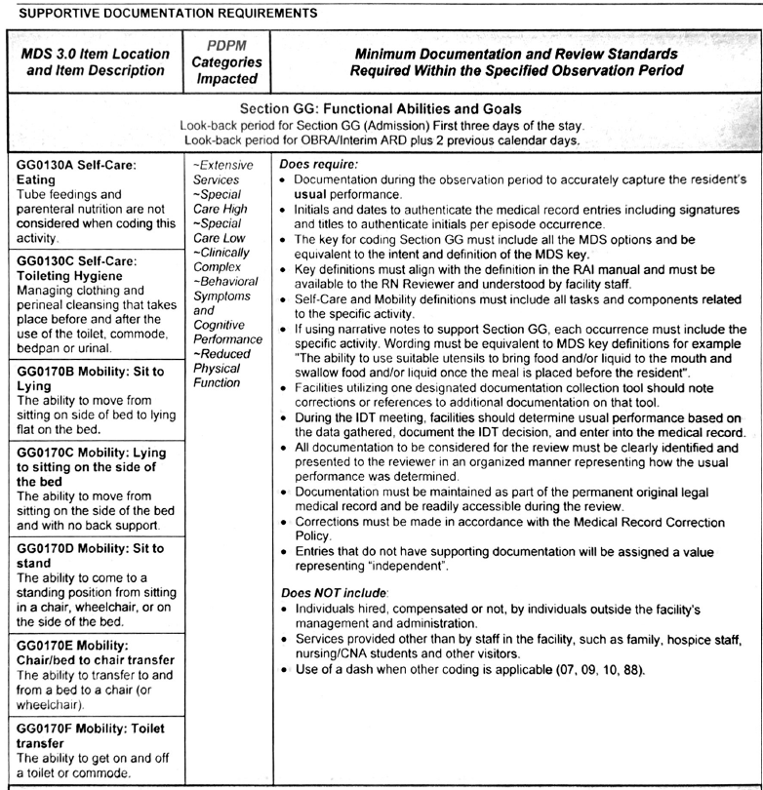
PDPM Update

Slide 46
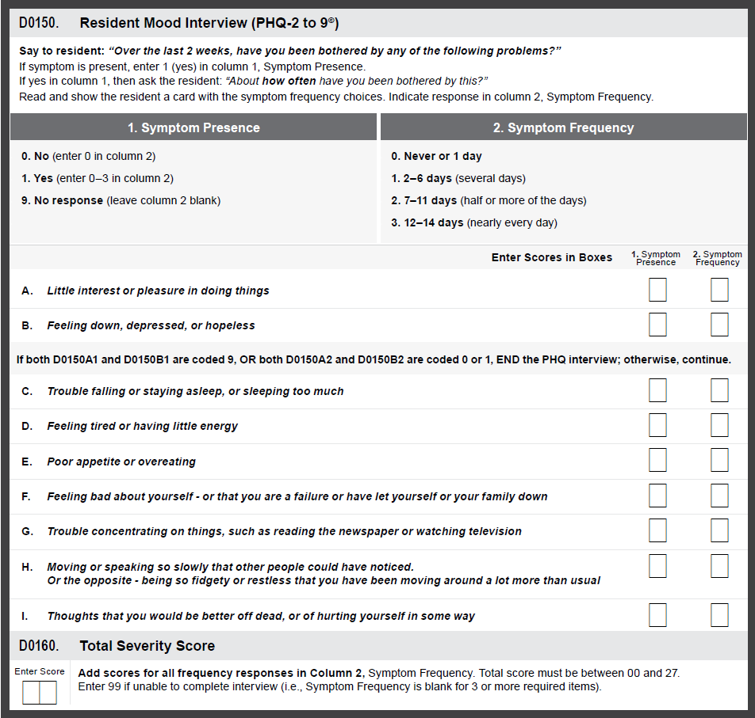
PDPM Update
Resident Mood Interview
  Summary score of at least 10
  Impacts:
    Special Care High
    Special Care Low
    Clinically Complex

Slide 47
PDPM Update
  Restorative Nursing
    2 or more programs each delivered for at least 15 minutes/day for 6 of last 7 days
    Impacts Behavior Symptoms/Cognitive Performance
      Programs
        Urinary toileting program and/or bowel toileting program
        Passive and/or active range of motion**
        Splint or brace assistance
        Bed mobility and/or walking training**
        Transfer training
        Dressing and/or grooming training
        Eating and/or swallowing training
        Amputation/prostheses care
        Communication training
**Count as one service even if both provided

Slide 48
5-Star/QM Update

Slide 49
5-Star Update
Health Inspection Rating
  2 most recent recertification surveys
    Most recent survey (Cycle 1) will be assigned a weighting factor of ¾
    Second most recent survey (Cycle 2) will be assigned a weighting factor of 1/4
    3 most recent surveys will continue to be displayed on Care Compare
  Complaint surveys during the most recent 3-year period
    Most recent 12 months assigned a weighted factor of ¾
    Those within 13-36 months assigned a weighted factor of 1/4
  Deficiencies cited on Infection Control surveys in the most recent 3-year period
    Same weights as Complaint Surveys
  Repeat visits needed to verify facility is back in compliance

Slide 50
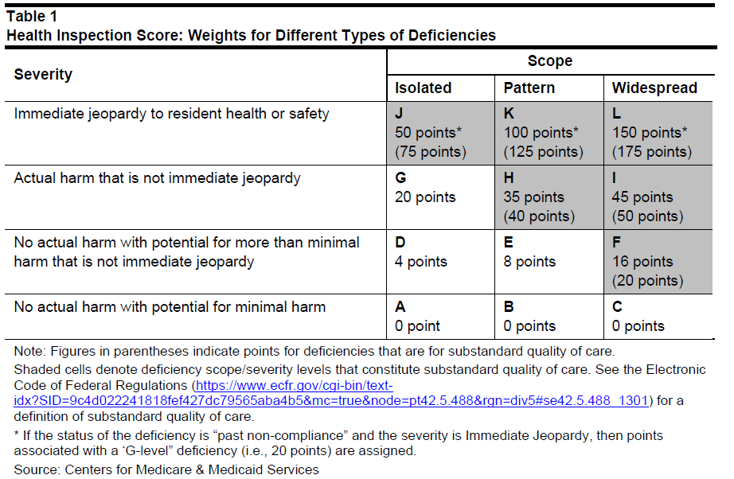
Health Inspection Rating

Slide 51
Long-Stay Antipsychotic Medication Use
Long-Stay Antipsychotic Medication Use
  Improve accuracy of reporting antipsychotic medication use in nursing homes
    14.64% vs 16.98%
  Perceived discord between MDS record and claims
  Updating measure to include the following to supplement MDS data
    Medicare Part D prescribing date
    Medicaid state level claims
    Medicare Advantage (Part C) encounter data

Slide 52
Long-Stay Antipsychotic Medication Use
  Exclusion Validation
    Schizophrenia, Huntington’s disease, Tourette’s syndrome
    1/3 of long-stay resident with schizophrenia had no corresponding service claims (physician visit, hospital stay, etc.)
    MDS-coded diagnosis must be cross-validated against Medicare Part A/B or Part C claims and encounter data

Slide 53
Long-Stay Antipsychotic Medication Use
Percent of Long-Stay Residents Receiving an Antipsychotic Medication (Hybrid Methodology):
  No updated QM manual for new measure
  No updated 5-star manual for updated cut points
  Effective October 29, 2025
  Updated on Care Compare in October 2025

Slide 54
SNF Validation Program

Slide 55
SNF Validation Program
SNF Validation Program
  Audit based program established to assess the accuracy of MDS-based quality measures used in the SNF VBP and SNF QRP programs
  Eligible SNFs are those that have submitted at least one MDS assessment in the previous calendar year and at least one in the current fiscal year
  Contracted to be done by Healthcare Management Solutions, LLC (HMS)
  Scheduled to begin in Fall 2025
  Will be looking at Calendar Year information

Slide 56
SNF Validation Program
SNF Validation Program – SNF QRP Measures
  Fall with major injury in SNF stay
  Drug regimen review
  Discharge self-care
  Discharge mobility
  Transfer of Health Information
  Discharge Function
  New/worsened pressure ulcers
  Resident COVID vaccine

Slide 57
SNF Validation Program
SNF Validation Program – VBP Measures
  Long-stay falls with major injury
  Discharge Function

Slide 58
SNF Validation Program
SNFs will be selected randomly – Can only be selected once within a fiscal year
  Up to 1500 SNFs per fiscal year
  Notified thru iQIES MDS 3.0 Provider Preview Reports folder
    Skilled Nursing Facility Validation Process – Initial Selection Notification
    Skilled Nursing Facility Validation Process – Second Selection Notification

Slide 59
SNF Validation Program
Validation Audit Requirements
  Request to submit medical record documentation to support validation of MDS assessment records
    Instructions for documentation submission
      No Social Security Numbers
      Each resident in a PDF file
    List of requested sampled residents with detailed data requests for the medical records
    Contact information for the contractor
  Information must be submitted within 45 calendar days of the audit notification or SNF will be consider non-compliant

Slide 60
SNF Validation Program
Validation Audit Results
  Will receive a Summary Audit Scoring Report vis iQIES
    Within 3 month following submission deadline
    Audit results for each measure and MDS item
    Detailed results from each sampled assessment
Validation Audit Penalties
  No penalty for audit results – informational purposes
  SNFs in non-compliance will be subject to a 2% reduction of their APU
    Non-compliant letter from MAC
    Summary Audit Scoring Report

Slide 61
SNF Validation Program
CMS website information on program
  “Data Validation Process”
  Frequently Asked Questions (FAQ) with date of August 2025

Slide 62
Payroll Based Journal (PBJ)

Slide 63
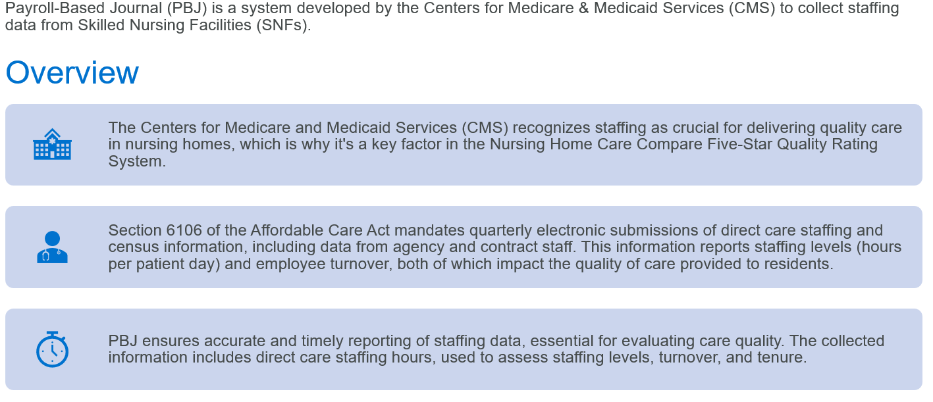
Payroll Based Journal
What is PBJ?

Slide 64
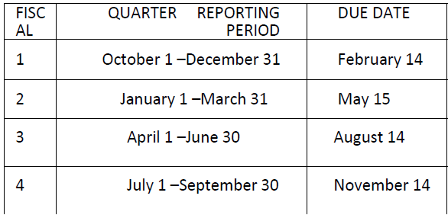
Payroll Based Journal
Submission Deadlines
  Submit by end of 45th calendar day (11:59 PM EST) after last day of each fiscal quarter
  All submitted data must be verifiable and auditable to ensure accuracy

Slide 65
Payroll Based Journal
Reporting Tips:
  Ensure hours for employees and contract/agency staff are reported as worked
  Off site hours are not reportable – must be in facility and available to provide direct care
    Even for nursing positions with administrative duties
  Report hours by calendar day – Midnight is the cutoff for each day reported
  Do not report hours for
    Meal breaks (30 minutes for each full shift) whether it is paid by facility or not
    Training
    Leave
    Bonus time
  For exempt employees – report actual hours worked
    Log in and out

Slide 66
Payroll Based Journal
Reporting Tips – Continued
  Be sure to break down universal care giver hours to reflect hours in direct care
  If a consultant nurse is paid by the facility to be onsite and available to provide direct care to residents, and are not performing monitoring tasks (chart reviews, survey prep, etc.) then those hours may be reported in PBJ.
  If a corporate nurse is in the facility and performing resident care and not monitoring tasks, the hours spent performing care can be reported.
  Run validation report after submitting to ensure acceptance of files

Slide 67
Payroll Based Journal
PBJ Job Codes:
  5 = Registered Nurse DON
  6 = Registered Nurse with Administrative Duties
  7 = Registered Nurse
  8 = Licensed Practical Nurse with Administrative Duties
  9 = Licensed Practical Nurse
  10 = Certified Nurse Aide
  11 = Certified Nurse Aide in training
  12 = Qualified Medication Aide
  24 = Respiratory Therapist
  25 = Respiratory Therapy Technician

Slide 68
Payroll Based Journal
PBJ Census
  Taken from MDS Data
  Ensure Entry records and Discharge assessments are completed and submitted timely
    Inaccurate census calculation that affects staffing levels
    Audit implications
    If no discharge assessment – considered discharged if no assessment present in the last 150 days

Slide 69
Payroll Based Journal
Staff Turnover Measure
  Includes:
    Nursing Staff – Title codes 5-12
    RN – Title codes 5-7
    Administrator – Title code 1
  Contract staff count in turnover measure
  Employment spell = minimum of 120 hours over a 3-month period
  Hire and termination dates are not required and are not used for calculation
  Turnover is based on gaps in days work
    90-day gap = 90 consecutive days that an individual does not work at all
    Last date worked prior to the 90-gap will be turnover date:

Slide 70
Payroll Based Journal
Staff Turnover – Continued
  Turnover is reported as an annual rate
  Updated every quarter based on a rolling annual period
  Administrator turnover is calculated by number of administrators that left
  Nursing and RN turnover:
      Total number of employment spells that ended with 90-day gap
      Total number of eligible employment spells

Slide 71
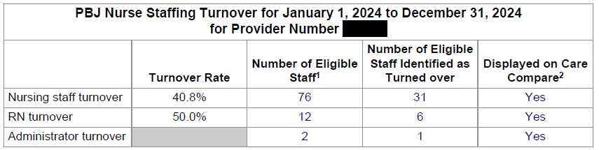
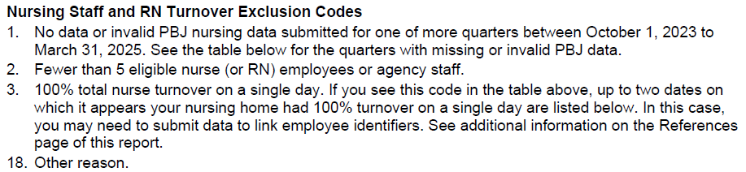
Payroll Based Journal

Slide 72

Payroll Based Journal
Automatic “One Star” Rules
  Gap in hours reported vs. validated in audit
  Four or more days in quarter with zero RN hours
  Failure to respond to an audit request
  Failure to submit requested documentation in an audit
  Failure to submit PBJ by submission deadline
    Submission system is disabled promptly at the deadline
    All staffing ratios are removed from Care Compare

Slide 73
Payroll Based Journal
Achieving 5-Star Success through PBJ
  Training for relevant staff on process and software usage
  Monitor PBJ submission timelines
    Submit early and check validation reports for acceptance
  MDS Census
    Timely entry and discharge tracking
    Daily MDS Census report
    MDS 3.0 Adm/Re-entry – Discharge Report
    Missing OBRA Assessment Report
  Agency/contract Staff
    Frequency and consistency of contract staff
    Monitor gaps in 90-day period
    System to document time

Slide 74
Payroll Based Journal
Achieving 5-Star Success through PBJ – Continued
  Make sure software is compatible to accurately create and upload PBJ files
  Employee classification
  Data Accuracy – hours worked, job title codes, pay type code
    All data must be auditable and verifiable
  Monitor Employee IDs
    If IDs get changed – link the identifiers
      Result of changes in payroll or timekeeping staff
      Conversion from agency to facility employee position
      Employee resigns and is rehired
    Will negatively affect turnover measure if not linked
    Can submit file to link IDs at any time

Slide 75
Payroll Based Journal
Achieving 5-Star Success through PBJ – Continued
  Align staffing with facility acuity
    Understand case-mix index (CMI)
    Higher acuity/CMI facilities will need more staff hours
  Efforts to reduce turnover and increase tenure
    Competitive salaries, benefits, professional development, etc.
  Be audit ready
    Maintain meticulous records and documentation
    Includes detailed staffing logs and evidence of compliance with CMS requirements
  Stay updated with CMS guidelines and best practices

Slide 76
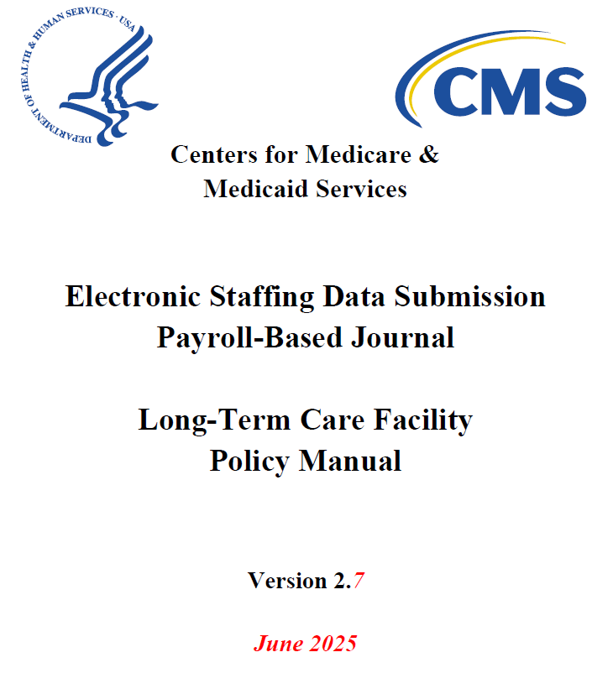
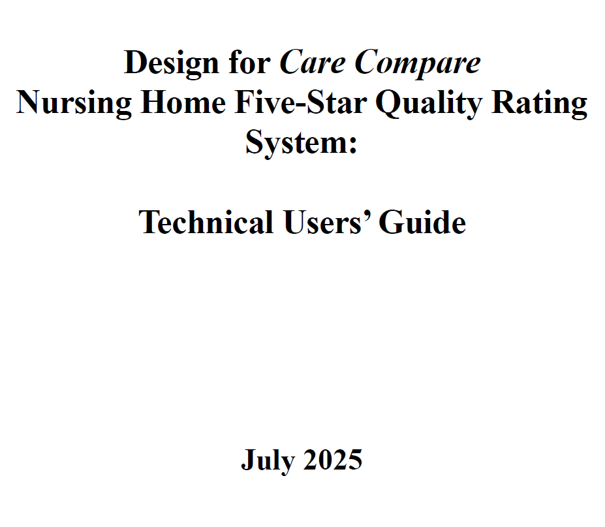
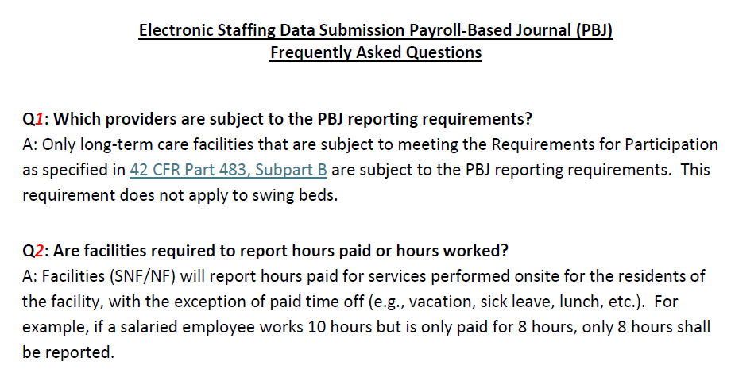
Payroll Based Journal

Slide 77

Thank You!
Deborah.Lake@us.forvismazars.com

