Slide 1


Supporting Safe Transitions of Care
Presented by:
Full Name: Russell Evans, RN, MHA
Company: Probari
Designation/Title: President and COO
WAVES
Fall Conference
September 9-10, 2025
Embassy Suites Noblesville | Indianapolis, IN

Slide 2
Overview
Probari Background
Admissions from hospitals
Discharges
Action steps
Questions
WAVES
Fall Conference

Slide 3



Probari Background
2022
Today’s Model
Program leverages the OPTIMISTIC model in a virtual format, along with continued consulting contracts.
Clinical Review Model
Nursing Home Consulting
State and MCE Consulting
2020
COVID-19 Support work in
Nursing Homes
2012
Centers for Medicare and Medicaid Services $30M Innovations Grant
Notes:
Talk a little about our company and how we came to this pilot
Came from a CMS demo in 2012 - started as 4/13 and ended as 8/30 based on strong results
Nurse driven clinical model, embedded into facilities
Reduced avoidable transfers by a third
Results verified and published
Served as a springboard to Probari
COVID 19 response
Infection Prevention Education
Results reporting for all IDOH lab results
2 statewide LTC testing initiatives
State vaccination clinics
Training national Guard
Pandemic support gave us 2 things
Strong partnerships with NH
Conversion of our in person model to a virtual program
Today - Virtual model and working alongside MCEs

Slide 4

Admissions are crazy!
Settle the patient
Document
Read paperwork
Care for resident
Detect changes
WAVES
Fall Conference

Slide 5

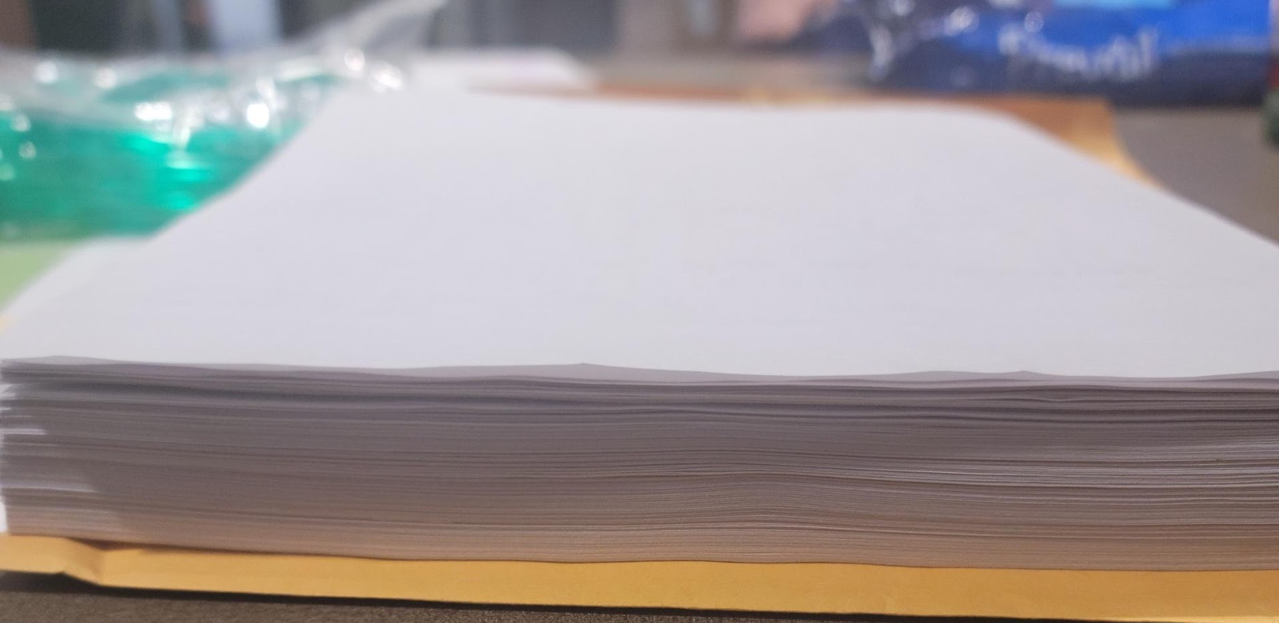
Discharge Instructions – Too much or Too Little
WAVES
Fall Conference
Notes:
INFORMATION
1 in 3 discharge summaries will not have the all the information needed for an admission
12. King BJ, Gilmore‐Bykovskyi AL, Roiland RA, Polnaszek BE, Bowers BJ, Kind AJH. The Consequences of Poor Communication During Transitions from Hospital to Skilled Nursing Facility: A Qualitative Study. J Am Geriatr Soc. 2013;61(7):1095–1102. PMCID: PMC3714367
Many of the issues we were identifying upon admission were related to information issues
Often nurses do not have direct access to Hospital HER
Final discharge instructions can come later

Slide 6

Untangling the patient journey
WAVES
Fall Conference
Notes:
CONTEXT
It’s hard to put together the timeline for the patient
Understanding context is key for the nurse, and that’s simply difficult to do with the information and time they have

Slide 7
Where to focus?
Impact
Frequency
Notes:
Some errors happen all the time, but they don’t have a huge impact
Some errors are serious, but happen very infrequently
For quality improvement reviews – we want to focus on the areas that happen often and have a high enough impact to move the needle
We want that high impact per intervention ratio

Slide 8
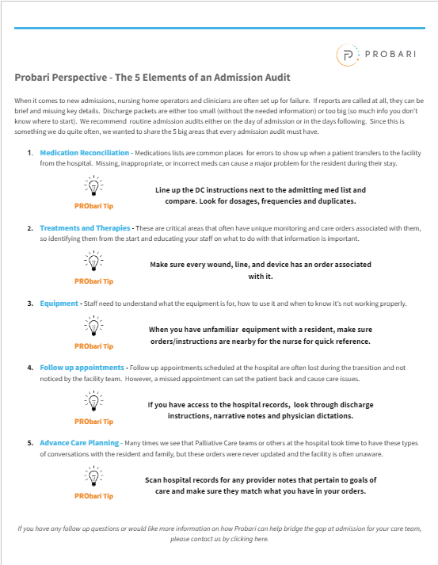
The key areas to a review
Medication reconciliation
Treatments and orders
Equipment
Follow up appointments and orders
Advance Care Planning
WAVES
Fall Conference
Notes:
These are the top impact/frequency areas we have identified
This will be sent out in our newsletter this month for your team to download

Slide 9
The impact of medication errors
More than 800,000 preventable, medication injuries per year (NIH)
Approximately 1/3 of residents are on 9 or more medications
(Institute for safe medication practices)
WAVES
Fall Conference
Notes:
Approximately 1/3 of residents are on 9 medications or more (Institute for safe medication practices)
https://www.ismp.org/resources/hospital-long-term-care-protecting-vulnerable-patients-during-handoff
It’s estimated that there are more than 800,000 preventable, medication injuries per year (NIH)
https://www.ncbi.nlm.nih.gov/pmc/articles/PMC2464957/

Slide 10

Side by Side Med Review
The Medication Drag Net
Dosages changed
New meds missed
Interactions and Allergies
Medications available?
WAVES
Fall Conference
Notes:
Approximately 1/3 of residents are on 9 medications or more (Institute for safe medication practices)
https://www.ismp.org/resources/hospital-long-term-care-protecting-vulnerable-patients-during-handoff
It’s estimated that there are more than 800,000 preventable, medication injuries per year (AGS)
https://www.ncbi.nlm.nih.gov/pmc/articles/PMC2464957/

Slide 11
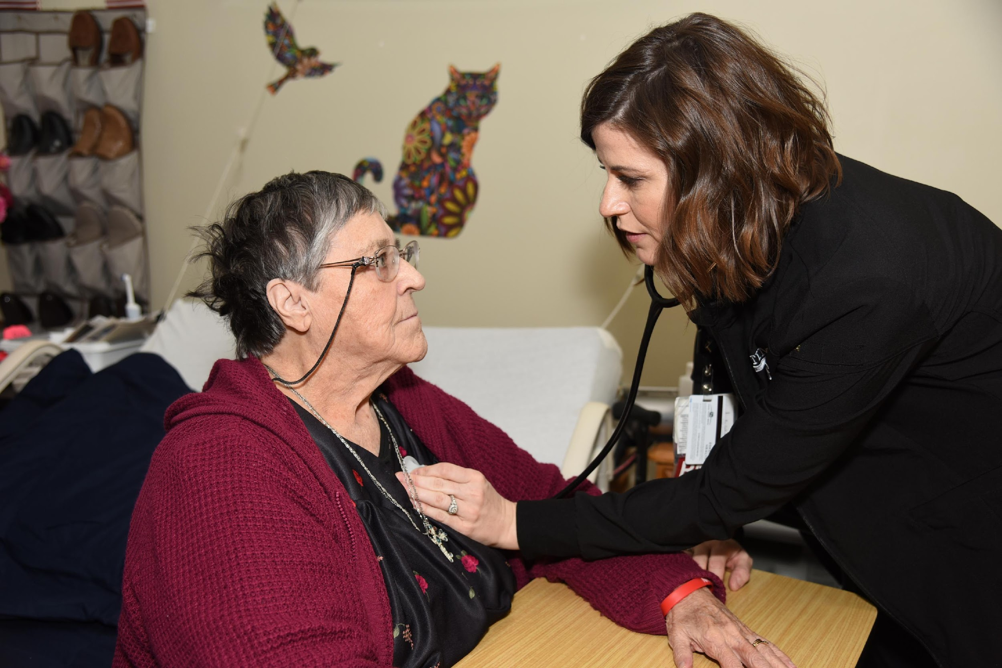
Orders for all treatments
Make sure wounds are identified and documented
Orders to justify lines and other devices
Are the treatment orders specific?
WAVES
Fall Conference

Slide 12
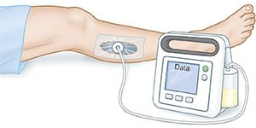
Equipment
Does the equipment received match hospital record?
Does the staff know how to use it?
Are there in services that need to be done?
WAVES
Fall Conference

Slide 13
Follow up appointments
Does the patient have a follow up during their stay?
Does the hospital record reference other providers?
Is the family aware?
WAVES
Fall Conference

Slide 14
The importance Advance Care Planning
ACP can have major impact on quality of life and transfers
OPTIMISTIC Study - JAGS
  94% of residents/families were willing to talk about end of life decisions
  2/3 of conversations resulted in order changes
  About half of residents/families chose less aggressive measures
Many conversations happen in the hospital!
WAVES
Fall Conference
Notes:
https://www.eurekalert.org/news-releases/650518
OPTIMSITIC Study on ACP

Slide 15
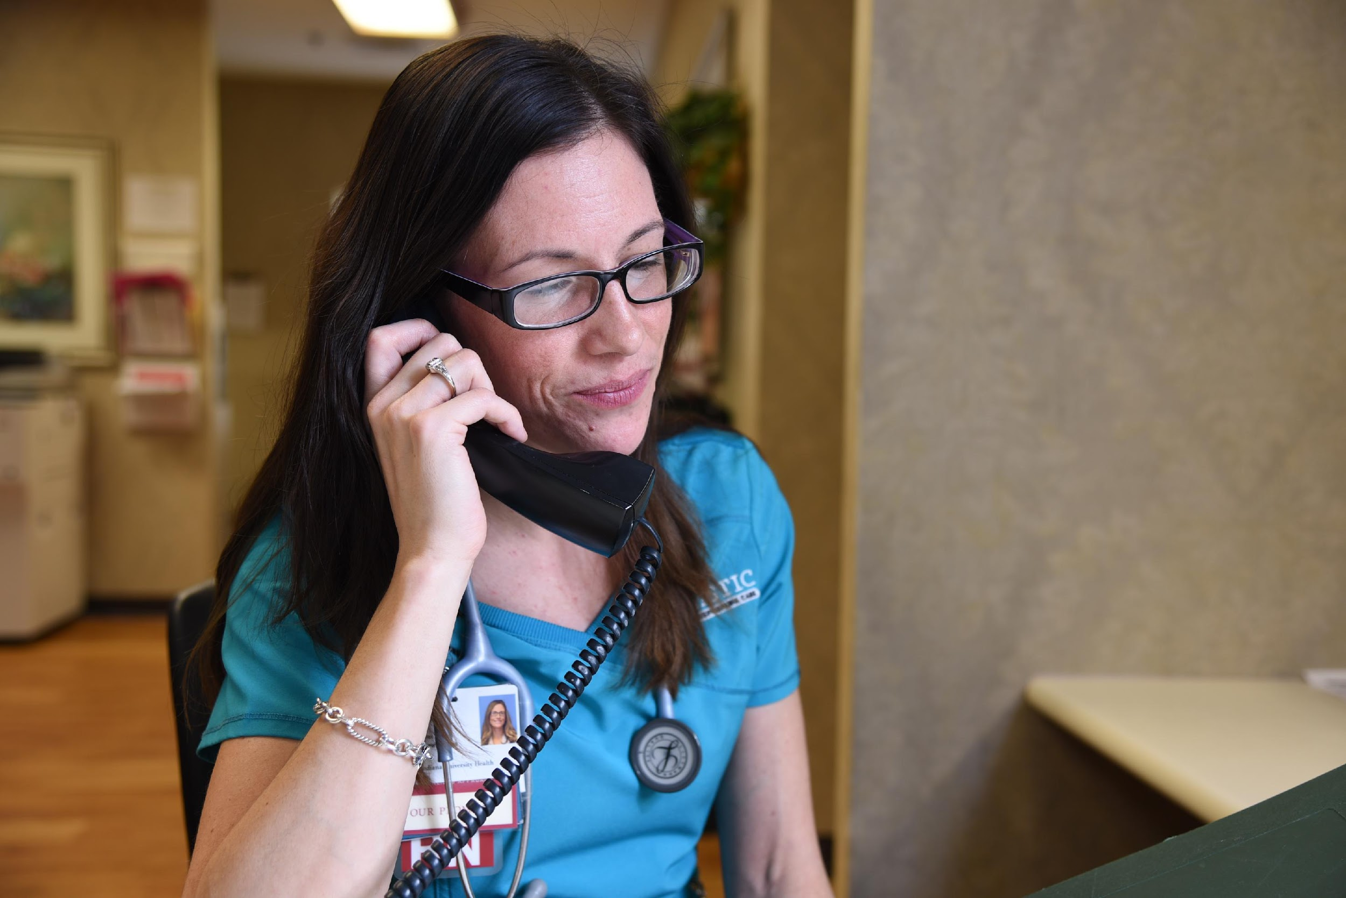
Advance Care Planning
Does the EMR match the discharge instructions?
Were there discussions at the hospital?
Has anyone talked with resident/family since admission?
WAVES
Fall Conference

Slide 16
Some best practice tips
Timing is best 1-2 days after admission
Have a standard tool
Have an audit leader
Review results as a group regularly for trends
Feed information back to admission team
WAVES
Fall Conference

Slide 17
Areas we see improvement
Documentation standardization
Fewer errors and additional orders/protocols
Survey compliance
Reduced number of new infections
Reduced transfers to hospital
WAVES
Fall Conference

Slide 18
Handoff to Coordinators
Many residents living in the community will have a PathWays coordinator
Coordinators will likely visit during rehab stay
Focus will be on services to provide and monitor after discharge
Can assist with discharge planning
WAVES
Fall Conference

Slide 19
Handoff to Coordinators - Summary
What happened at the hospital?
What happened during their rehab stay?
What should they be paying attention to?
What could be a red flag?
WAVES
Fall Conference

Slide 20
Questions?

Slide 21
THANK YOU!
Contact me with questions:
Full Name: Russell Evans
Email address: russ@probarisystems.com
Phone number: 260-515-8117
www.probarisystems.com
WAVES
Fall Conference

Slide 22
WAVES
Fall Conference

Slide 23
WAVES
Fall Conference

Slide 24
WAVES
Fall Conference

Slide 25
WAVES
Fall Conference

