Slide 1


Where The Sidewalk Ends….What Now??!
Presented by,
Debbie Carriveau,
RN,C., CDP, QDCP
Executive Director of Dementia Services
Managing Advanced Dementia Through End of Life Care
WAVES
Fall Conference
September 9-10, 2025
Embassy Suites Noblesville | Indianapolis, IN

Slide 2

The Dementia Journey’s TOLL……….
WAVES
Fall Conference

Slide 3

The Advanced Dementia Walk….
What does it look like, REALLY???
WAVES
Fall Conference

Slide 4
What are the CRITICAL FOCUS areas of Advanced Dementia care?
Becoming more FRAIL
Decreasing MOBILITY and more frequent FALLS
Nutrition and Hydration- problems SWALLOWING, loss of TASTE, TEXTURE issues
Recognition of PAIN symptomology
Increasing “hands on” care needs- ALL aspects
Growing need for a sense of CONNECTEDNESS, BELONGING, and LOVE
Spiritual nurturing and assistance with a PEACEFUL and COMFORTABLE transition from this life to the next
Resolving “UNFINISHED” Business
WAVES
Fall Conference

Slide 5


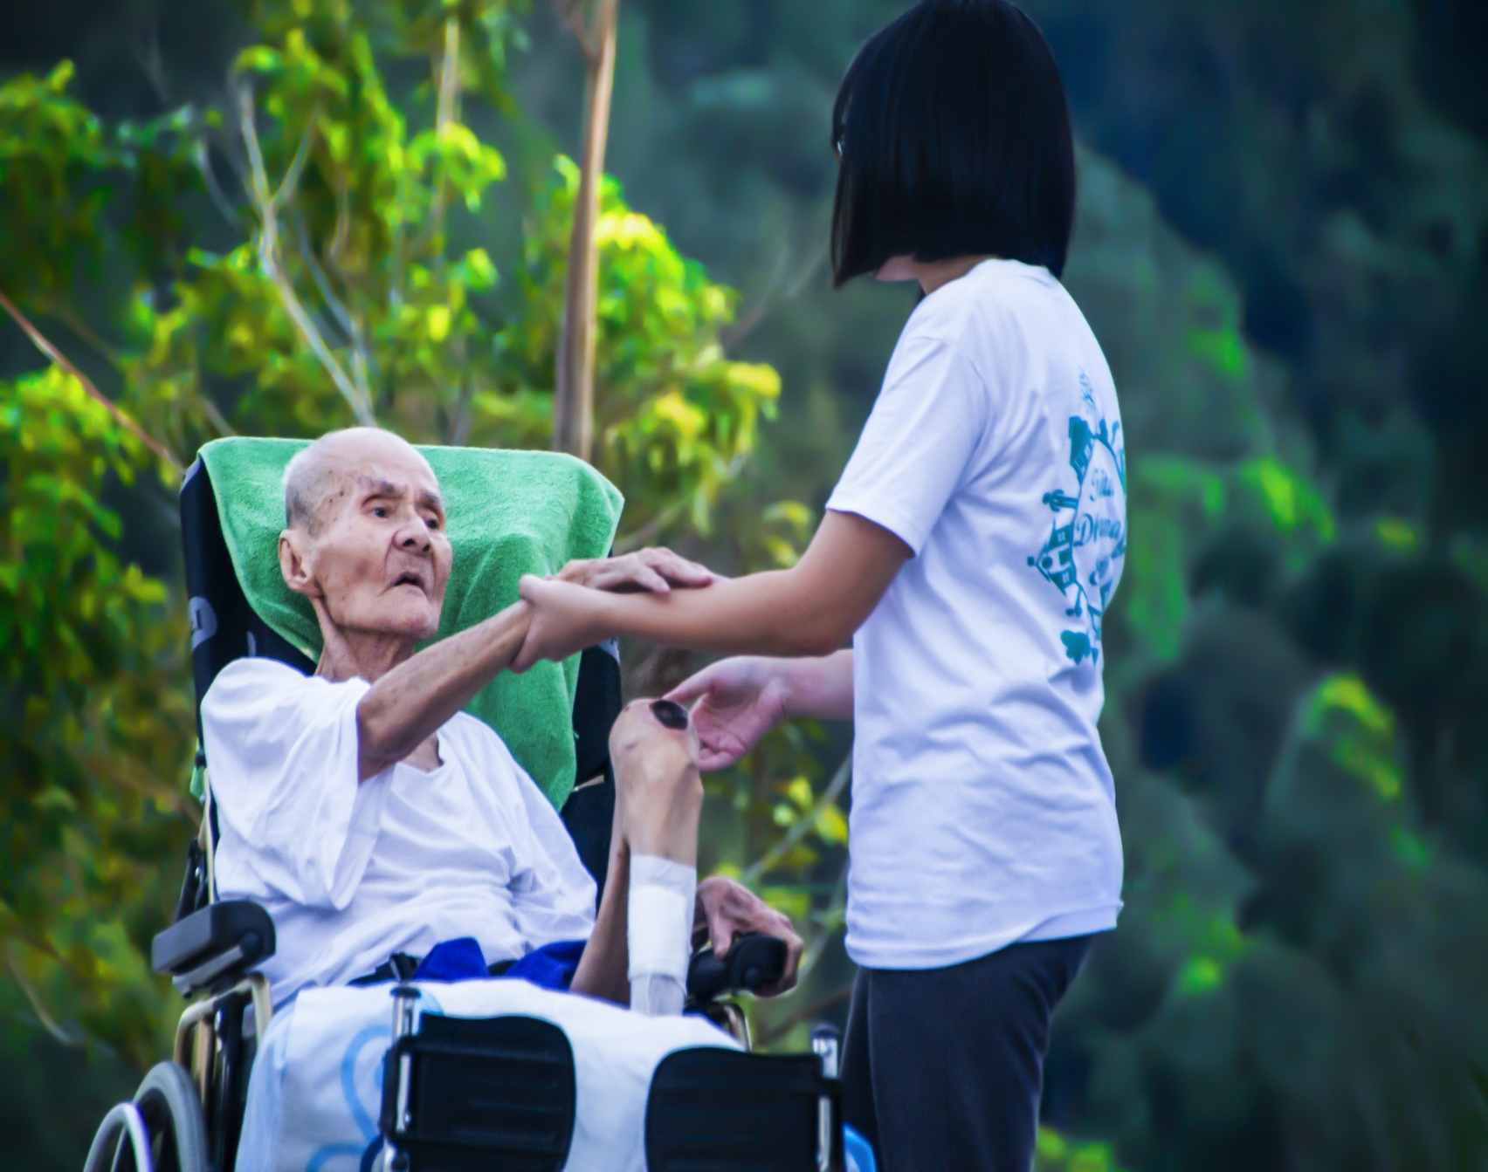
NORMAL Characteristics of Individuals with Advanced Dementia….
WHO do you see?
WAVES
Fall Conference

Slide 6
What are the TRUE characteristics of those with Advanced Dementia?
Resistant to care- depending on approach and the trust and familiarity with caregiver
Looks “unkept”…..removes unnecessary “trappings”
Cannot follow or retain instructions- LESS is MORE
Peripheral losses, visual clifting
Emotions tend to be irrational- afraid of ANYTHING I don’t understand
Functional age- infant-3yo (processing, cognitive interpretation and reaction)
Likes having a “BUDDY”- Needs to be kept BUSY
MY REACTIONS-based on my perceptions, based on what I BELIEVE
WAVES
Fall Conference

Slide 7
Characteristics continued…….
Senses and sensitivity are HEIGHTENED SIGNIFICANTLY- hypersensitivity of the skin, startle reflex, pincher reflex
Overstimulation response-Reacts negatively to any “noxious” stimuli or touch
Hyperorality-everything goes in their mouth- EVERYTHING is sensory oriented and experienced
Fluctuates between hyperactivity and lethargy- progressively sleeping more
Cannot initiate any meaningful action independently
WAVES
Fall Conference

Slide 8
Therapeutic Programming Possibilities….I can still BENEFIT
But looks Completely Different now
They need to touch, feel, hear, see, and taste everything
Infant to Toddler level of function- what does that mean?
Engagement happens with every interaction
Short bursts, and 1:1 or 1:2
Interactions are focused on communicating your love and their value….
Caring ABOUT not just caring FOR
Touch therapy-ADLs, hand and foot massages, back rubs, hand holding, hugs, mother to child stroke, nail care, stuffed animals, life like babies
Music therapy-listening that’s meaningful for the person, singing, rhythm mimicking, last area of the brain to deteriorate
WAVES
Fall Conference

Slide 9
Programming continued…..
Reminiscence-Not necessarily two-way conversation or discussion as much as YOU do the storytelling of their life, reading familiar books, letters, lyrics, picture books of familiar things (baby animals, online baby photos that are FUN) , walks to places they can see and touch
Stacking and sorting- like things that are repetitive
Reciting things from childhood- Sunday school songs, prayers, rosary, nursery rhymes, simple poems or limericks
Baking tasting- focus on smells and tastes versus the task
Physical activity that is very TACTILE and SIMPLE- Beach ball volley or kickball, bean bag toss, parachute ball, dancing or free movement to music
WAVES
Fall Conference

Slide 10

Providing Care and Comfort at the END of LIFE………
Providing Care and Comfort at the END of LIFE………
WAVES
Fall Conference

Slide 11

Typical Lifespan After Diagnosis
Alzheimer’s (Typical) 8-10 years (Early onset 2-7 years, depends on age- younger/shorter)
Vascular 5 years
Lewy Body 6 years
Fronto-Temporal/ Pick’s 6-8 years

Slide 12
The GREAT MYSTERY….Being THERE at the end of life here and facilitating the transition to the next life…..What does that look like?
When death is near:
Terminal Restlessness- neurological sign of discomfort, constant movement, inability to relax, pushing or pulling at staff (neuroinflammation of the brain) Uncooperative, agitated as a result, restless legs, rubbing, picking
Pain- much more related to neurological discomfort. Hypersensitivity to touch and noise, can cause actual pain. Recoiling from caregiver touch, “curling inward” fetal position sitting or standing, holding their heads, rocking, rubbing forehead or temples, pushing at their eye sockets or pulling hair or ears (50-80% experience pain daily)
Hallucinations- sudden delirium, emotional and mental turmoil, outbursts
Irregular breathing patterns- chesty, rattling, apnea- Cheyne stoking
Sleep disturbances- cannot shut things off, not restorative sleep
COOL/COLD discolored hands and feet, mottling
Body temp changes- high or low
WAVES
Fall Conference

Slide 13


LIFE HISTORY IS THE CRITICAL PIECE for PEACEFUL and COMFORTABLE transition…
Experiencing an intimate, person-centered dying experience is just as important as person-centered care during my life….Do you know who I am and what my life has been about? What MATTERS?
WAVES
Fall Conference

Slide 14
Goal of end-of-life care for a dementia person is PEACE and SUPPORT
Things to do to create a comfortable transition from this world to the next:
Making people more comfortable, progressive pain and anti-anxiety meds ( Ativan, Morphine, Zyprexa Zydus), routine not PRN- don’t let level get ahead of meds- Pain is much easier to PREVENT than relieve (non-verbal sxs.)
Pillows, repositioning, recliners versus beds, massages, warm packs
Physical therapeutic touch-hand holding, gentle stroking of face, tops of hands, tops of feet, massages but very gentle pressure
Keep skin moisturized-”hypersensitivity” (lips, mouth, eyes)
WAVES
Fall Conference

Slide 15
Things you to do…..(continued)
Create a peaceful environment- soft music playing, reading scriptures, praying, softly singing, nice smells, tap into good feelings and memories- They are still very sensitive to the atmosphere around them
Prep family and caregivers that things in the environment may trigger emotional responses during transition (anxiety, tears, laughter- inner brain responses)
Spiritual support is important- talk to the person about ways their life has had meaning, talk to family members about impacts they have had on relationship, influences on others lives and remind the person of those impactful things they have done
Reassure them it’s ok to let go, address the status of those they will be leaving behind
Let them know where they are and who is with them- Let them know they are loved, that they matter

Slide 16


Help Them and Their Loved Ones
“Let Go” and Move On

Slide 17

Questions and answers……..
WAVES
Fall Conference

