Slide 1





4B: Risk Management: Impact on Clinical and Financial Outcomes
Tuesday, Sept 9 at 3:15 PM – 4:15 PM
Session Length: 1 hour
This session will explore how effective risk management directly influences both clinical and financial performance in today’s healthcare environment. Attendees will gain insights into current industry trends shaping reimbursement, star ratings, managed care claim submissions, quality measures, and survey outcomes. Through real-world examples and expert guidance, the session will offer practical strategies, tips, and best practices to help organizations navigate these complex areas and achieve their desired outcomes.
WAVES
Fall Conference
September 9-10, 2025
Embassy Suites Noblesville | Indianapolis, IN

Slide 2
“Effective” Risk Management
Clinical and Financial Performance
Quality Measures
Star Ratings
Survey Outcomes
Managed Care Claim Submissions
Reimbursement
WAVES
Fall Conference

Slide 3
BCG – Brighton Consulting Group Report Example
WAVES
Fall Conference

Slide 4
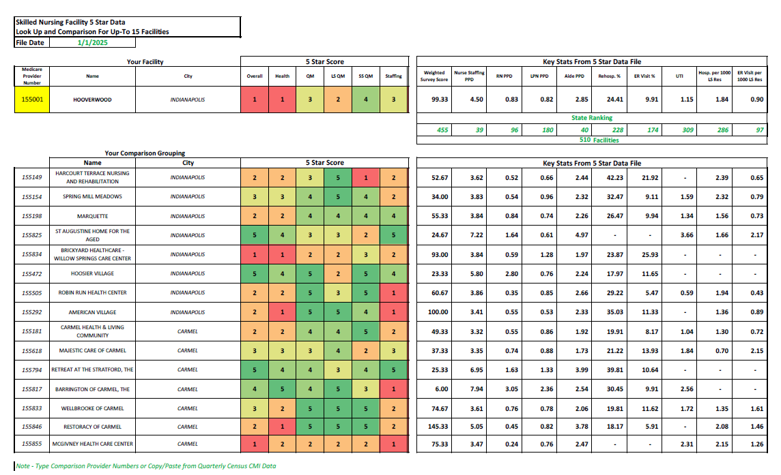
WAVES
Fall Conference

Slide 5
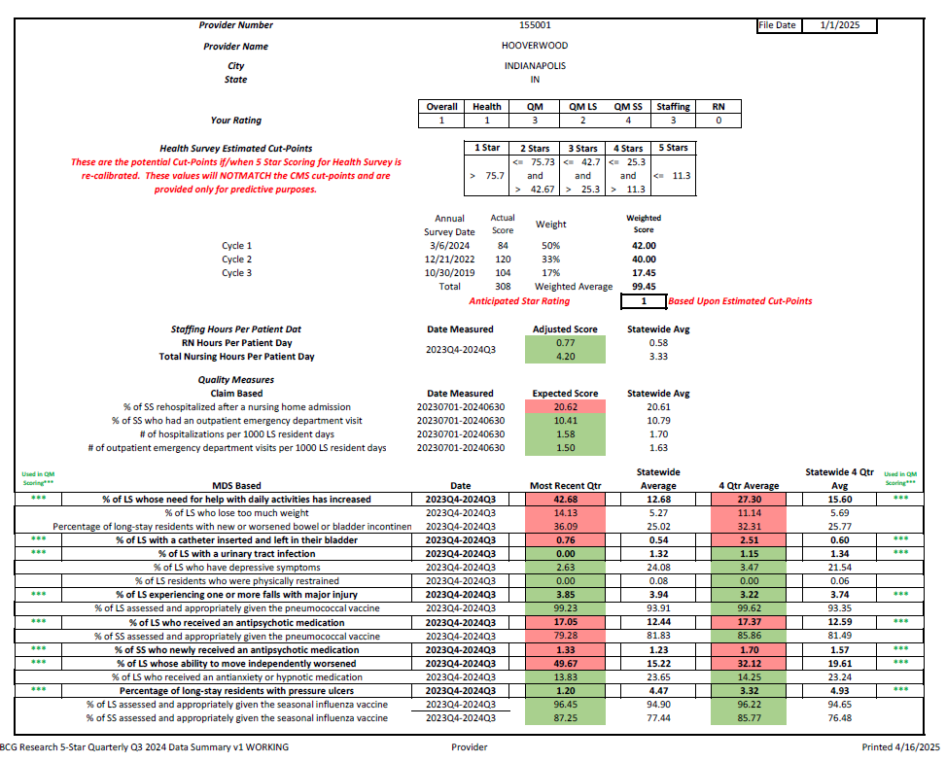
WAVES
Fall Conference

Slide 6
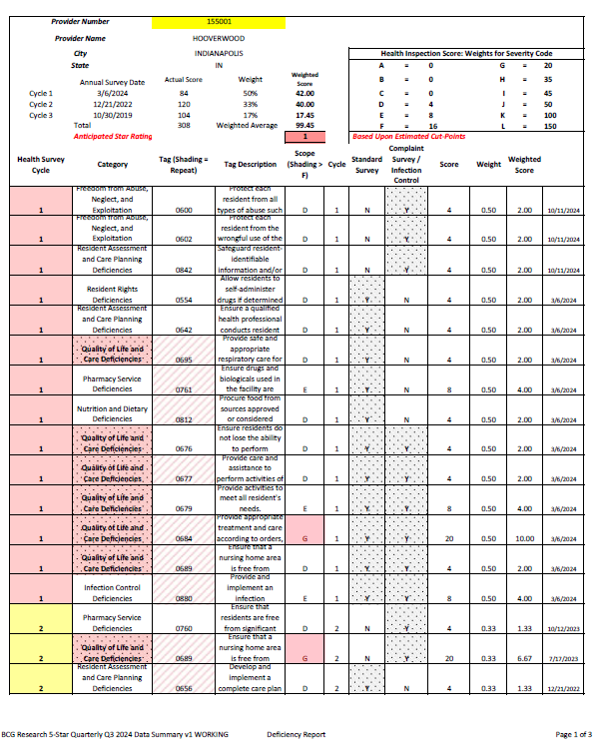


WAVES
Fall Conference

Slide 7
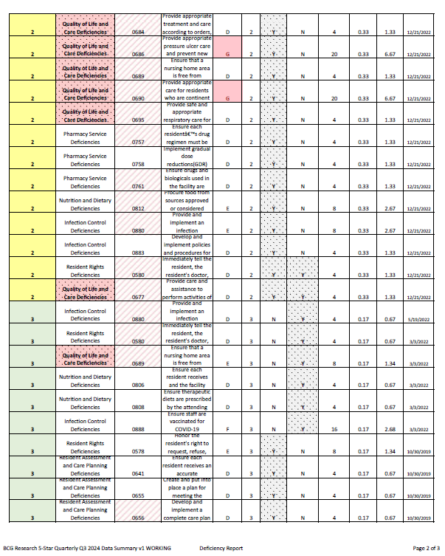
WAVES
Fall Conference

Slide 8
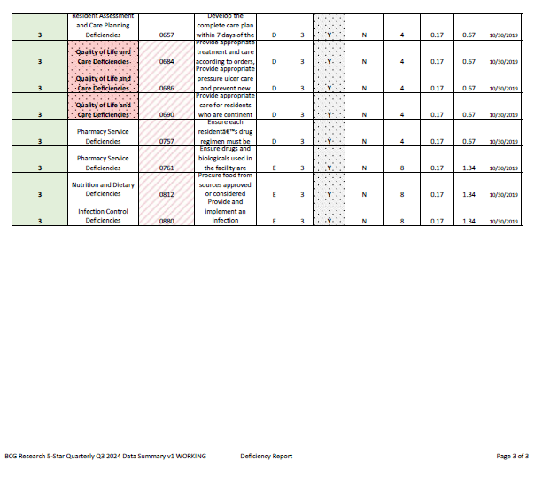
WAVES
Fall Conference

Slide 9
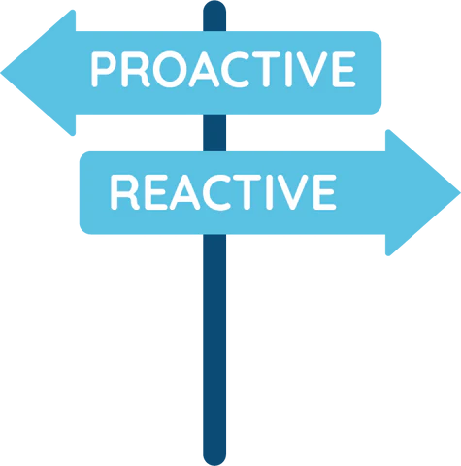
WAVES
Fall Conference

Slide 10

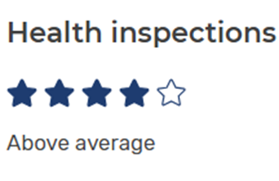
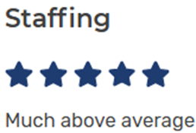
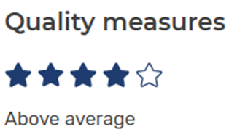
Star ratings
Auditing your star ratings
Proactive approaches to improvement
  In-service your staff on the 5-Star
PIP it
Bring it to your QAPI meeting
5 Star nursing home compare
WAVES
Fall Conference

Slide 11

Survey outcomes
Mock Surveys
Repeat tags
PIP’s
Educate staff
Audit cares
QAPI effectiveness
WAVES
Fall Conference

Slide 12

Pull your CASPER
PIP it
RCA
  Why are you triggering?
  Coding errors
Become Proactive
  IDT meetings
  Ongoing
Educate MDS staff
MDS audit
WAVES
Fall Conference

Slide 13
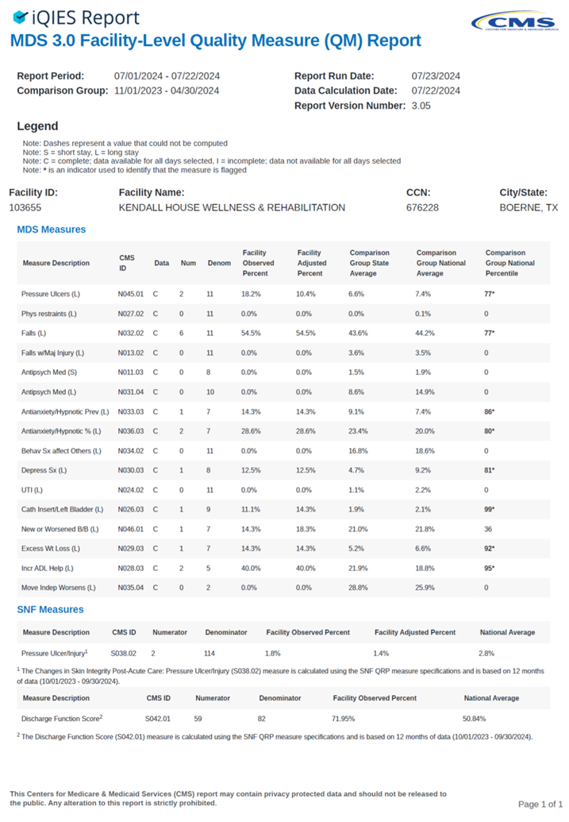
WAVES
Fall Conference

Slide 14
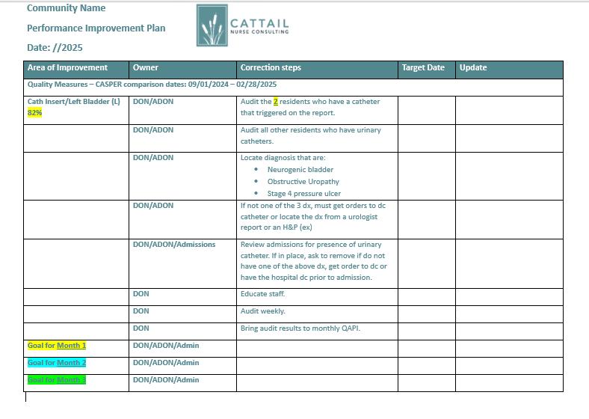
WAVES
Fall Conference

Slide 15
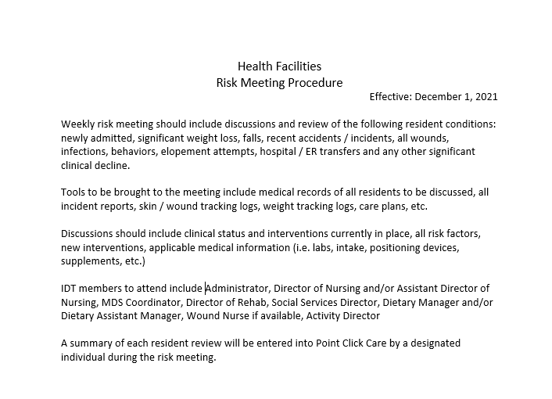

WAVES
Fall Conference

Slide 16
BCG – Brighton Consulting Group
WAVES
Fall Conference

Slide 17
BCG – Brighton Consulting Group
Taking the complexity out of financial management
We help long-term care, skilled nursing, and assisted living facilities manage the administrative and data processes that distract from operational improvements, employee engagement, and quality care.
Overview of services:
  Resident billing and collections, including claims processing
  Accounts payable processing
  Payroll services
  General ledger preparation
  Cost reports
WAVES
Fall Conference

Slide 18
BCG – Claims and reimbursements
Why facilities work with us:
  14 dedicated team members with over 80 years combined experience in claims processing
  Currently handling 120 facilities submitting over 5,000 claims a month with 98% first time acceptance
  Ability to submit all claims electronically, including Medicare, Medicare Advantage, Medicaid/MCO, and secondary
  Experience working with skilled nursing home software systems, including: WellSky, Point Click Care, and Matrix
  Experience with MCO transitions and a variety of insurance plans
  Education to facility staff on requirements and process improvements
  Ensure compliance with regulatory requirements, qualifications, and contracted rates
WAVES
Fall Conference

Slide 19
BCG – Claims and reimbursements
Claims process:
  BCG receives import from therapy company and imports into the facility software
  Enter any ancillary charges into facility software (i.e. RX, labs, med supplies, x-rays)
    If claims need edited it is done directly within the facility's system
  Ensure all PDPMs are accepted
  Generate billing file and upload into Claim Agent to scrub and edit data
  Utilize clean data for upload into Waystar for submission
    Follow up is completed with Waystar to ensure all claims got accepted by payer
  Follow up on aging and denied claims (aging report example)
  No software…no problem! We also hand key claims if needed!
WAVES
Fall Conference

Slide 20
BCG – Claims and reimbursements examples
WAVES
Fall Conference

Slide 21
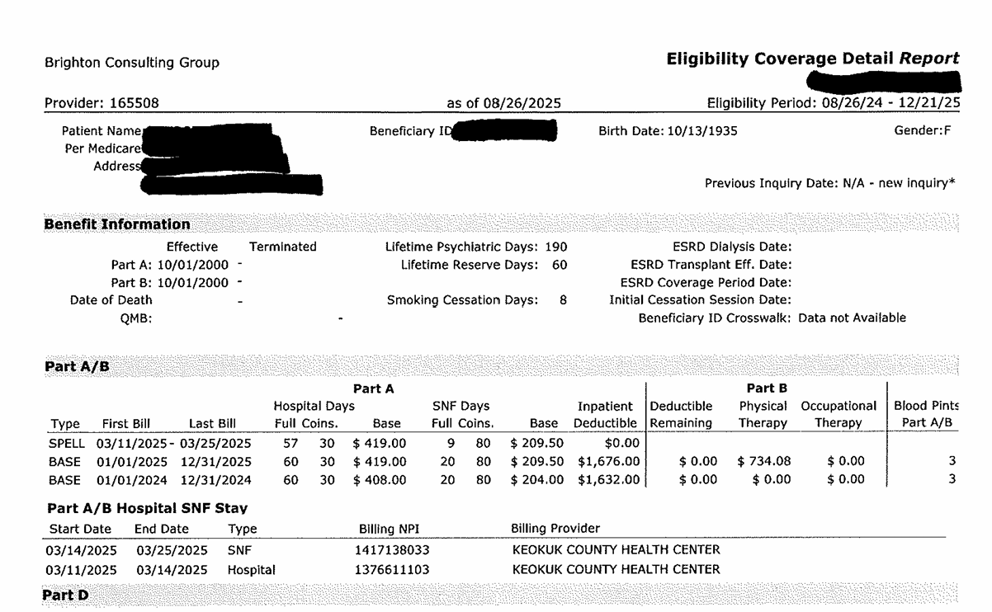
BCG – Claims and reimbursements examples
WAVES
Fall Conference

Slide 22
Q & A
WAVES
Fall Conference

Slide 23

WAVES
Fall Conference

Slide 24

WAVES
Fall Conference

