Slide 1
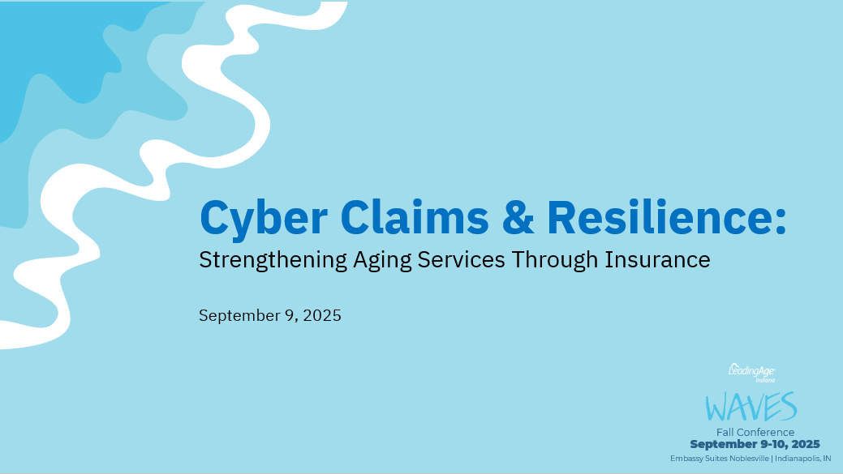

Slide 2


Table of Contents
Introductions
Technology in Senior Living
Cyber Risk Management and Insurance Strategies
  Assess
  Protect
  Respond
  Cover

Slide 3








ORGANIZATION
LEADINGAGE PARTNERSHIP
OFFERING
Top 20 insurance broker nationally
$1B in revenue
Specialized senior living practice
LeadingAge Gold Partner
Exclusive administrator for Aging Services Insurance
Carrier panel offering exclusive P&C coverages for LeadingAge members
Risk Management consulting
CUSTOMERS
TECHNOLOGY PLATFORM
TEAM
90,000+ policyholders
170,000+ SaaS users
11.4 trillion data collection events
>5 billion global IP addresses
700+ employees across 6 countries
Deep bench of insurance & tech veterans
Notes:
Key Points
Coalition was founded to provide integrated protection for businesses
Carrier partners
Deep bench of talent across tech and insurance, marrying the best of both worlds
Coalition protects over 160,000 businesses
Talk Track
Coalition’s co-founder and CEO, Joshua Motta, saw that this siloed approach left businesses unprotected from cyber risk. The vision for Coalition from the beginning has been to provide integrated defense for businesses by combining security technology, expert security services, and comprehensive insurance for end-to-end protection.
Today, Coalition has over 700 employees with deep expertise in cyber security and insurance working to help protect our customers from cyber risks. We have one of the largest dedicated cyber underwriting and claims teams in the industry, along with our in-house security team, and affiliate incident response team.
Coalition is backed by over 10 of the world’s leading insurance companies, including Allianz, Lloyd’s, Arch, and Zurich. In 6 years, Coalition has scaled to protect 160,000+ businesses worldwide across over 80,000 policyholders and 85,000 SaaS users.

Slide 4






Technology usage in Aging Services
Smart Home & Building Automation
Telehealth & Virtual Care
Operational Efficiency Tools
AI-Powered Health Monitoring
Resident Engagement Platforms
Security & Privacy Enhancements

Slide 5


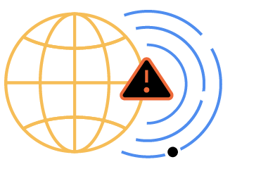
Cyber risks are fundamentally different
Amorphous Nature
Accelerated
Pace
Amplifies Other Risks
Notes:
The shift to digital has made it possible to create, run and scale businesses faster and easier than ever before
Even small businesses are taking advantage of digital technology to reach new customers and make their operations more efficient.
This is where you, as brokers, come in to help your clients understand that the shift to digital technology has also created a new class of risks…
Digital risks are fundamentally different than traditional risks like property or workers’ compensation
They are dynamic and always evolving along with new technology. The shape of threats are often unknown, changing day by day, which makes them harder to spot
They move incredibly fast. It only takes a few seconds for a single click to turn into serious damage
Digital risks can also amplify other risks and spread into operational, executive, and even HR risk, as so much of the business now relies on technology.
This puts brokers and the industry as a whole in a difficult position
These digital risks aren’t just hypothetical.

Slide 6
Cyber threats impacting healthcare
92% of healthcare organizations, including senior living and long‑term care providers, reported experiencing at least one cyber incident in 2024
In Q3 2024, healthcare organizations faced an average of 2,434 cyber attacks per week, an 81% year‑over‑year increase.
In the first quarter of 2025, more than six nursing homes and rehabilitation centers reported major breaches affecting over 130,000 individuals.
Common consequences included compromised medical records, treatment delays, and operational disruptions — all of which can directly impact resident care.

Slide 7
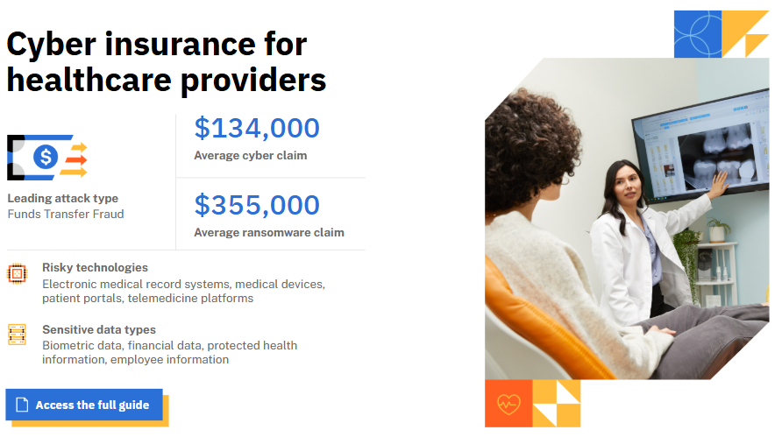
Notes:
Patient confidentiality is paramount in the healthcare industry. Healthcare providers and other related businesses are entrusted to collect, transmit, and store not only health-related information but also personal, financial, and other identifying details. This sensitive data is often required to be available digitally, making it a frequent target of cyber criminals.
Healthcare providers use many technologies that present cyber risks, such as internet-accessible medical devices, remote monitoring tools, and telemedicine applications. Organizations must not only protect sensitive patient information but also maintain security and availability of data, as well as lifesaving technology. Even a minor breach or failure can have major cyber implications, potentially hindering the delivery of service and impacting the health and safety of patients.
Merger and Acquisition (M&A) activity also increases risks in the healthcare industry. Acquirers must evaluate cyber risks thoroughly during the M&A process and prior to integration to avoid inheriting new cyber threats and exposures.

Slide 8
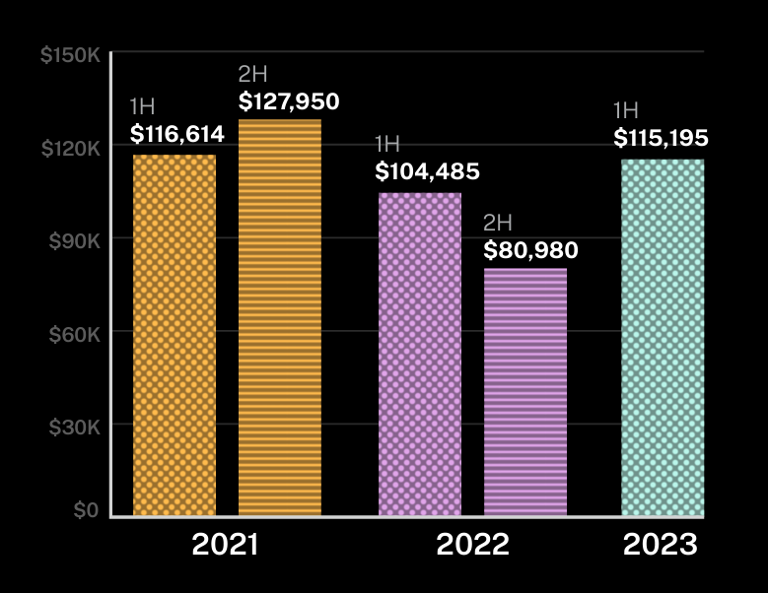

9%
Cyber incidents can be devastating
Overall claims severity increase in 2023
Average claims severity
Source: Coalition 2023 Cyber Claims Report: Mid-year Update
Notes:
They have real consequences for businesses.
The costs of a cyber incident can be truly catastrophic.
In 2023, we saw the overall claims severity increase by 9%
Severity is how we measure the average monetary loss of an insurance claim. It doesn’t take into account policy limits or retentions. It’s simply a measure of how costly a claim is.
In 2023, the average severity was $100,000 across all claims types. Just an average - could be more, could be less. For ransomware, the average loss was $263,000 in 2023.
This is a lot of money, especially for a small business.
This is why it’s critical that brokers understand the importance of cyber insurance – and how to find a policy that provides the right coverage for your clients.

Slide 9
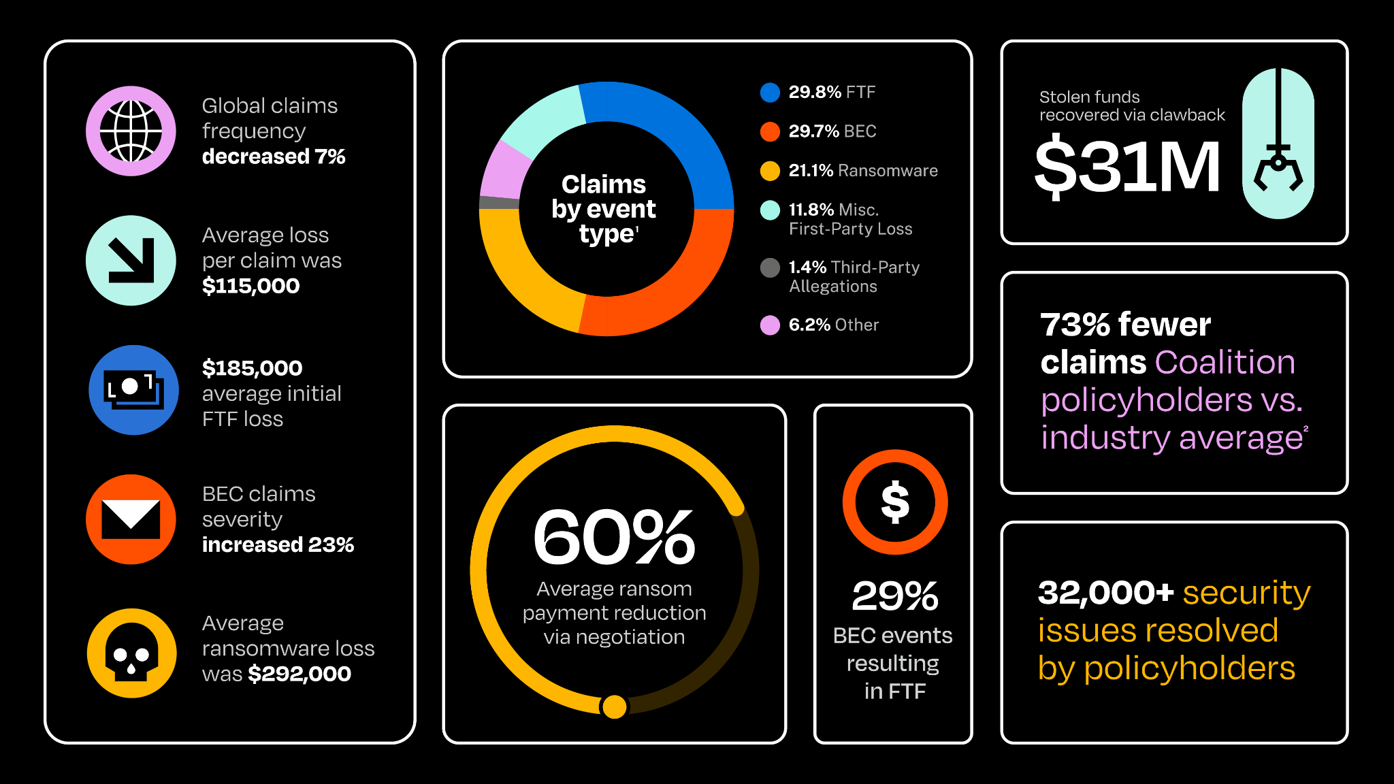
Coalition 2025 Cyber Claims Report

Slide 10
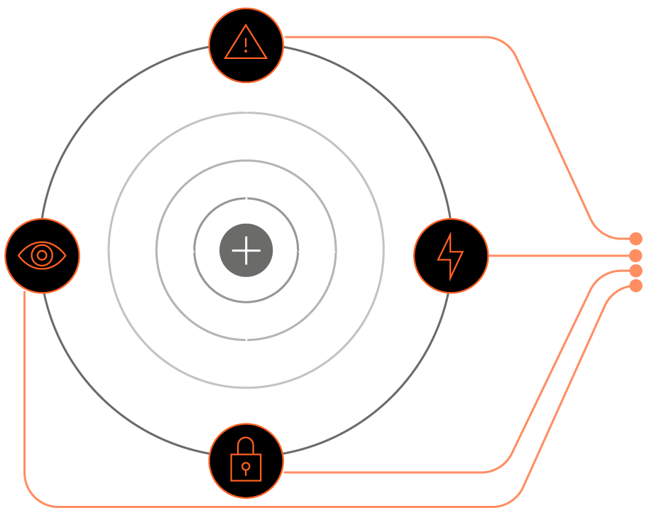






Maximizing Active Insurance
Our cyber tools and security services are optimized to help minimize claims, managed by cybersecurity experts that are just as invested in the security of policyholders as you are, and align with the typical policyholder journey.
Cover
Security Tools & Services
Coalition Incident Response
Cover
Quote & Bind
Exposure Management
Email Security
Awareness Training
Detection
& Response
Incident Response
Renew
Consultative Selling
Loss Control
Maintenance & Support
Claims &
Response
Renewals

Slide 11
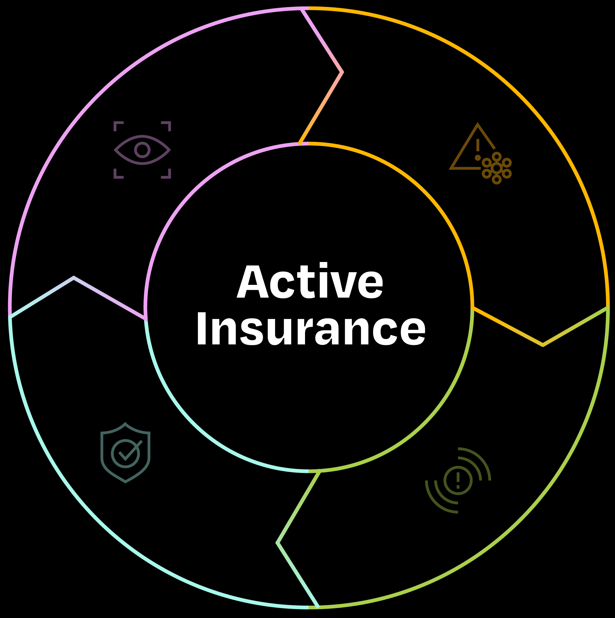
ASSESS
PROTECT
Real-time, external
view of cyber risk
with customized recommendations
Identify and prevent
new threats with tailored remediation guidance and support
COVER
RESPOND
Comprehensive coverage to help
give peace of mind
following an attack
Immediate expert support to minimize impact and speed up recovery
Notes:
Key Points
Active Insurance provides integrated protection from digital risk by helping assess, protect, respond, and cover
Talk Track
The different components of Active Insurance work together to help protect businesses from cyber risk.
First, we help businesses assess their risk with personalized risk insights in real time, prioritized by financial impact
Second, we help protect businesses by identifying and preventing new threats with support from an expert team
We respond to incidents and provide our customers with access to immediate expert support for faster recovery
And lastly, we provide businesses with broad insurance coverage to help give peace of mind following an attack.
This isn't your typical insurance that only works with you when an incident has already taken place. Coalition's Active Insurance means you have an continuous partner invested in the strength and health of your business' security. You have a partner Assessing your immediate risks, helping keep you Protected as threats emerge, expertly Responding to incidents, and keeping you Covered so your business can continue growing with peace of mind.
4 essential components of active insurance which I will go over in detail

Slide 12
Assess

Slide 13
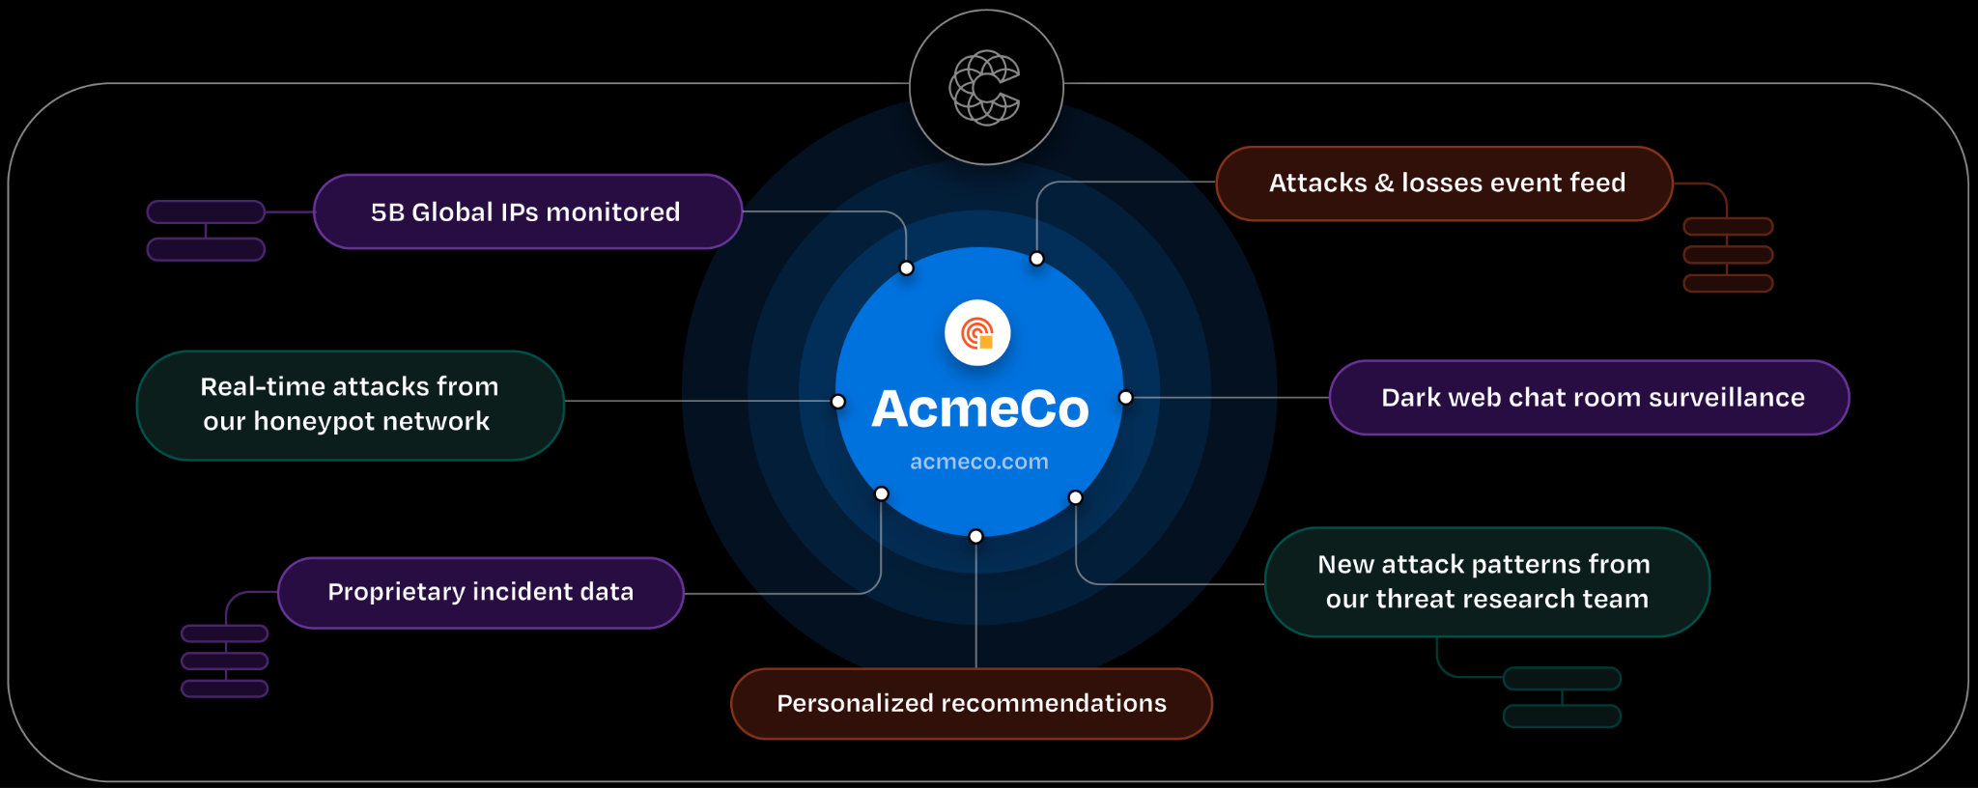
ASSESS
PROTECT
RESPOND
COVER
Active Data Graph
gives the most accurate view of risk
Attack & incident event feed
5B global IPs monitored
Your Client
Real-time attacks from our honeypot network
Dark web chat room surveillance
New attack patterns from our threat research team
Proprietary incident data
Customized recommendations
Notes:
Key Points
Our active data graph is the most comprehensive view of a business’ outside-in cyber risk and we know more about your risk than any other cyber insurer on the planet
This data graph powers every aspect of our integrated cyber defense
Talk Track
All of these capabilities are powered by our active data graph. We are collecting data across the entire public internet, monitoring all 63,000 ports so that we can see vulnerabilities impacting every public IP address. We then combine that with our own proprietary threat intelligence data from our threat research team, which includes our honeypot network, dark web and hacker chatter monitoring, and other proprietary threat sources. Our in-house research team is constantly looking for new threats and attack patterns from our incident data to help us stay ahead of threat actors. We finally layer in our own proprietary incident and claims data from the thousands of attacks we see every year.
From this foundation, we then apply advanced analytics like machine learning and artificial intelligence to help identify the threats that are most likely to be exploited. This helps you cut through the noise and help you prioritize remediating the most immediate risks.
Our data graph gives us the most comprehensive picture of the cyber risk landscape of just about any cyber insurer. We use this data to support our program underwriting, to continuously monitor and evaluate new attack patterns and vulnerabilities, and to notify our customers of emerging threats while offering customized risk recommendations to help secure their ongoing operations.

Slide 14
Cyber insurance requires in-depth risk insights
ASSESS
PROTECT
RESPOND
COVER
PROBLEM:
Limited data creates confusion for brokers and misconceptions for buyers
SOLUTION:
Accurate, real-time picture of digital risk accessible to brokers & clients
Limited Data
Historical data and intelligence gathered from 3rd party sources
Reactive Analysis
Underwriting based primarily on what
we know about today's cyber risk
Generic
Risk assessments, scans and security recommendations
Broad Data Collection
Active Data Graph that delivers the most applicable cyber risk insights
Proactive Analysis
Built for dynamic cyber risk to minimize impacts of new threats
Customized Security
Proprietary data and risk insights help identify exposures unique to each client
Notes:
Cyber risk is complex, but so are many of the other risks brokers help their clients manage and insure every day. What makes insuring cyber risk feel different?
The Problem: A big driver behind this feeling are the misconceptions and competing narratives about how data is collected, analyzed and applied to securing clients.
This is coming from the inherent limitations of traditional insurance
And the promises without validation from some of the newer insurers entering the market
These limitations generally boil down to 3 key areas
Limited data
Reactive analysis
Generic security
The Solution: This is where Active Insurance comes in. Look, we are not here to say we are able simplify the cyber threat landscape or predict the future. Instead, what active insurance is built to do is to help make cyber risk look and feel like other risks brokers are used to helping their clients manage. And, this all starts with cyber risk insights uncovered by Coalition’s Active Data Graph.
Comprehensive data gives brokers and clients a more complete view of cyber risk
Our security researchers and actuaries use AI and machine learning help uncover the most impactful and timely cyber risk insights
Lastly, support is integrated, not bolted on and security assessments, recommendations and alerting are personalized not generic.

Slide 15
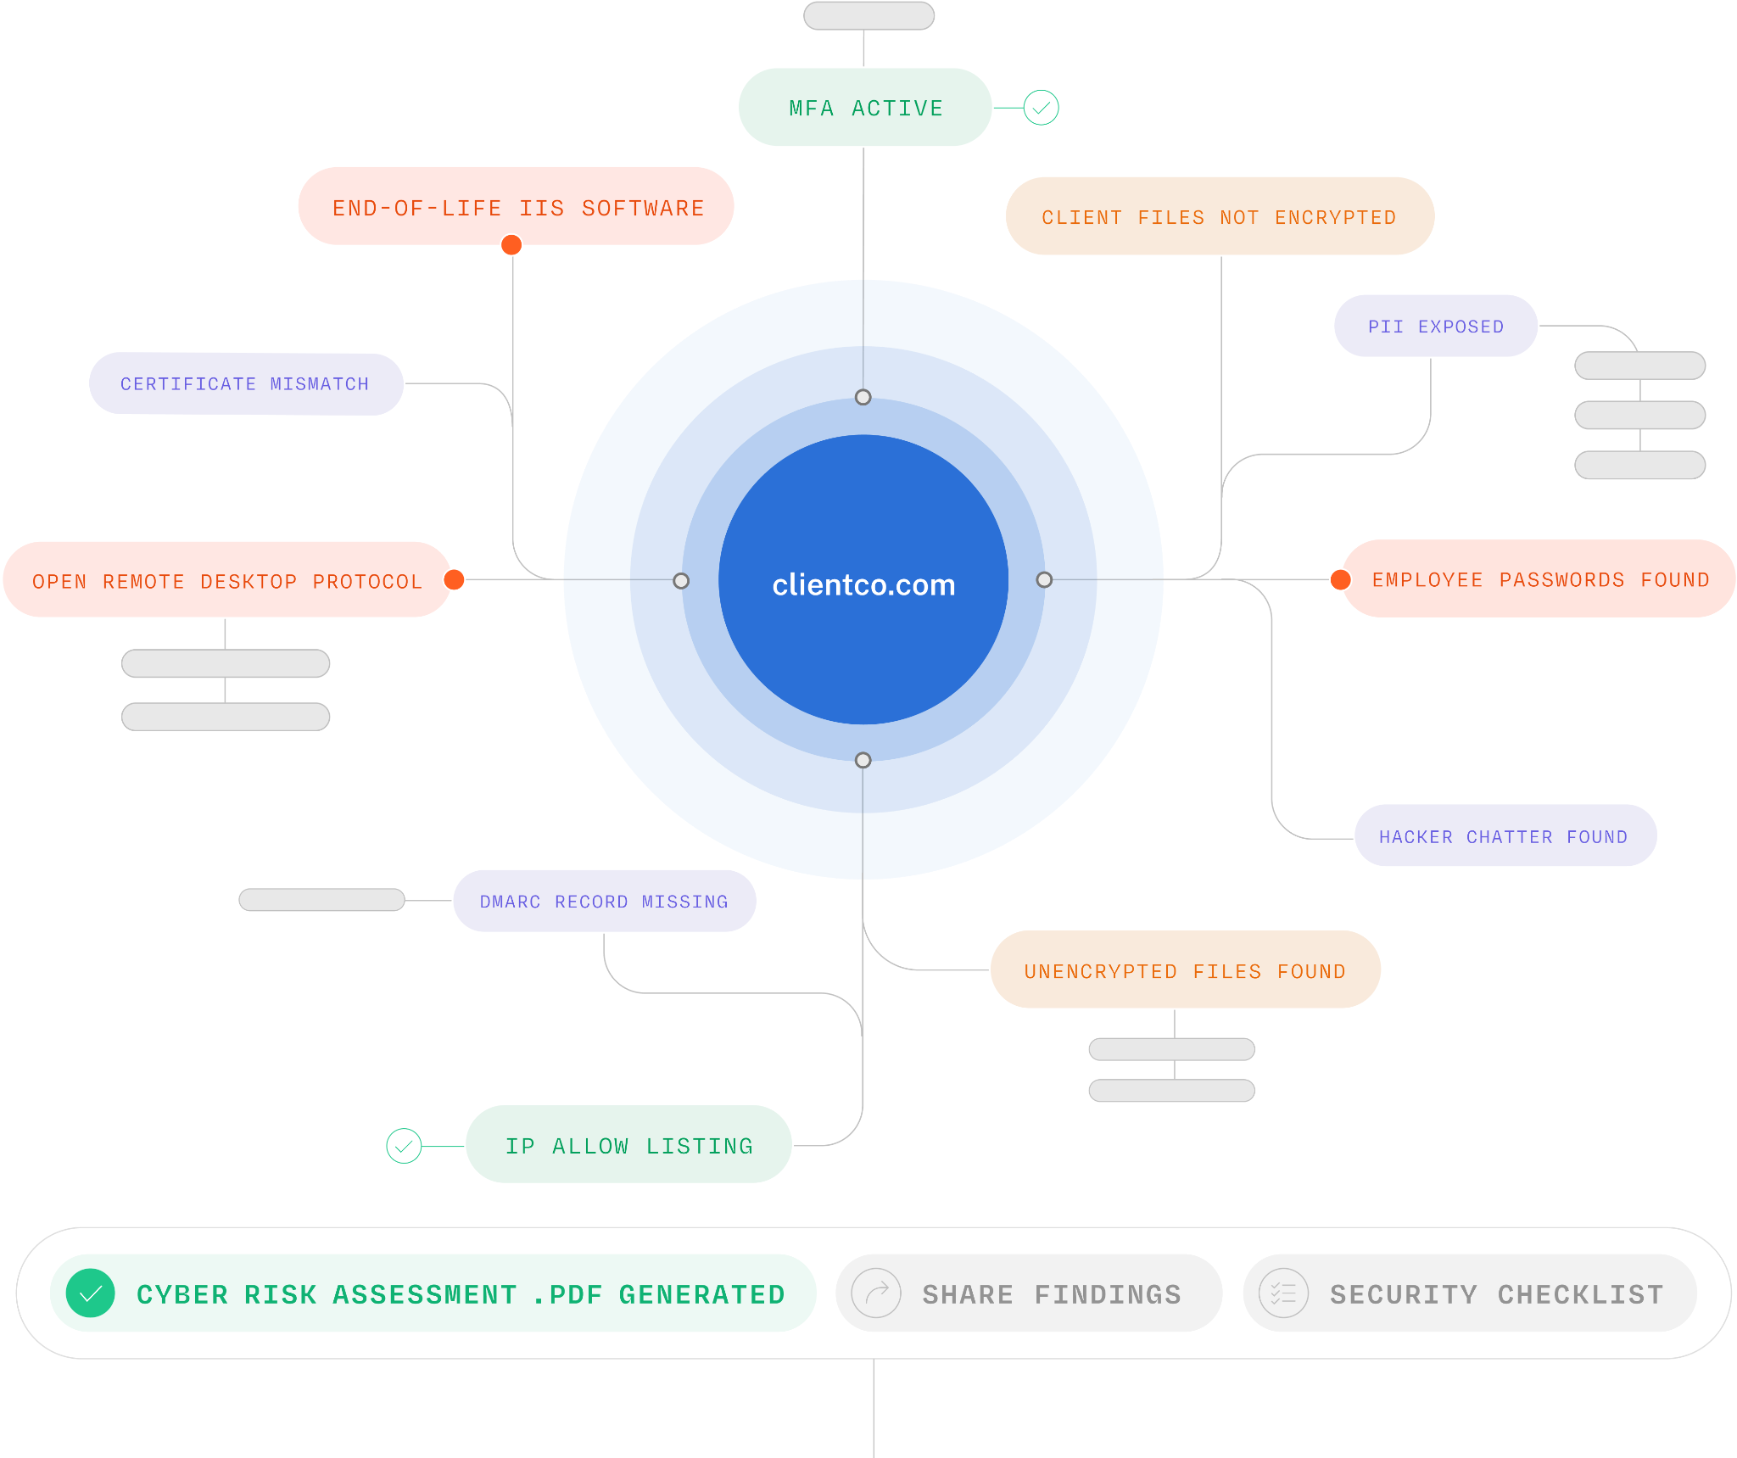
Customized recommendations validated by proprietary data
ASSESS
PROTECT
RESPOND
COVER
Attack surface assessment built on Coalition’s Active Data Graph
Ongoing monitoring of 65,535 ports of every policyholder asset every month
Detect exposures most likely to be targeted, exploited, and lead to losses
Actionable recommendations, support, and self-service resolution tools in Coalition Control
Notes:
Coalition’s cyber risk assessment, recommendations and alerts are effective and unique in the cyber insurance industry.
With the right data and risk assessment approach, we can help clients identify the riskiest exposures on the public internet.
When looking at cyber risk in aggregate, a big piece of the puzzle is understanding what defenders, often unintentionally, expose to the internet.\
How we do it:
Coalition’s risk assessment is more than scanning. Brokers win with Coalition because they are empowered with actionable recommendations validated by proprietary data to reduce the frequency of cyber claims.
Every client receives a Cyber Risk Assessment (CRA) based on their unique external attack surface exposures. What makes Coalition unique in the insurance space is that our security alerts are provided with context, technical details, and in-house security support.
We also focus on attack surface exposures vs internal technology vulnerabilities because attackers often start their attacks using what they can see over the public internet.
Findings are brought to life for every client and updated throughout the policy period in their unique instance of Coalition Control, our cyber risk management platform.
Enhanced visibility makes cybersecurity manageable for your clients, streamlines renewals, and takes the burden off of the broker to make sure clients are aware of and taking action on security exposures that have the biggest impact on claims.

Slide 16
Protect

Slide 17
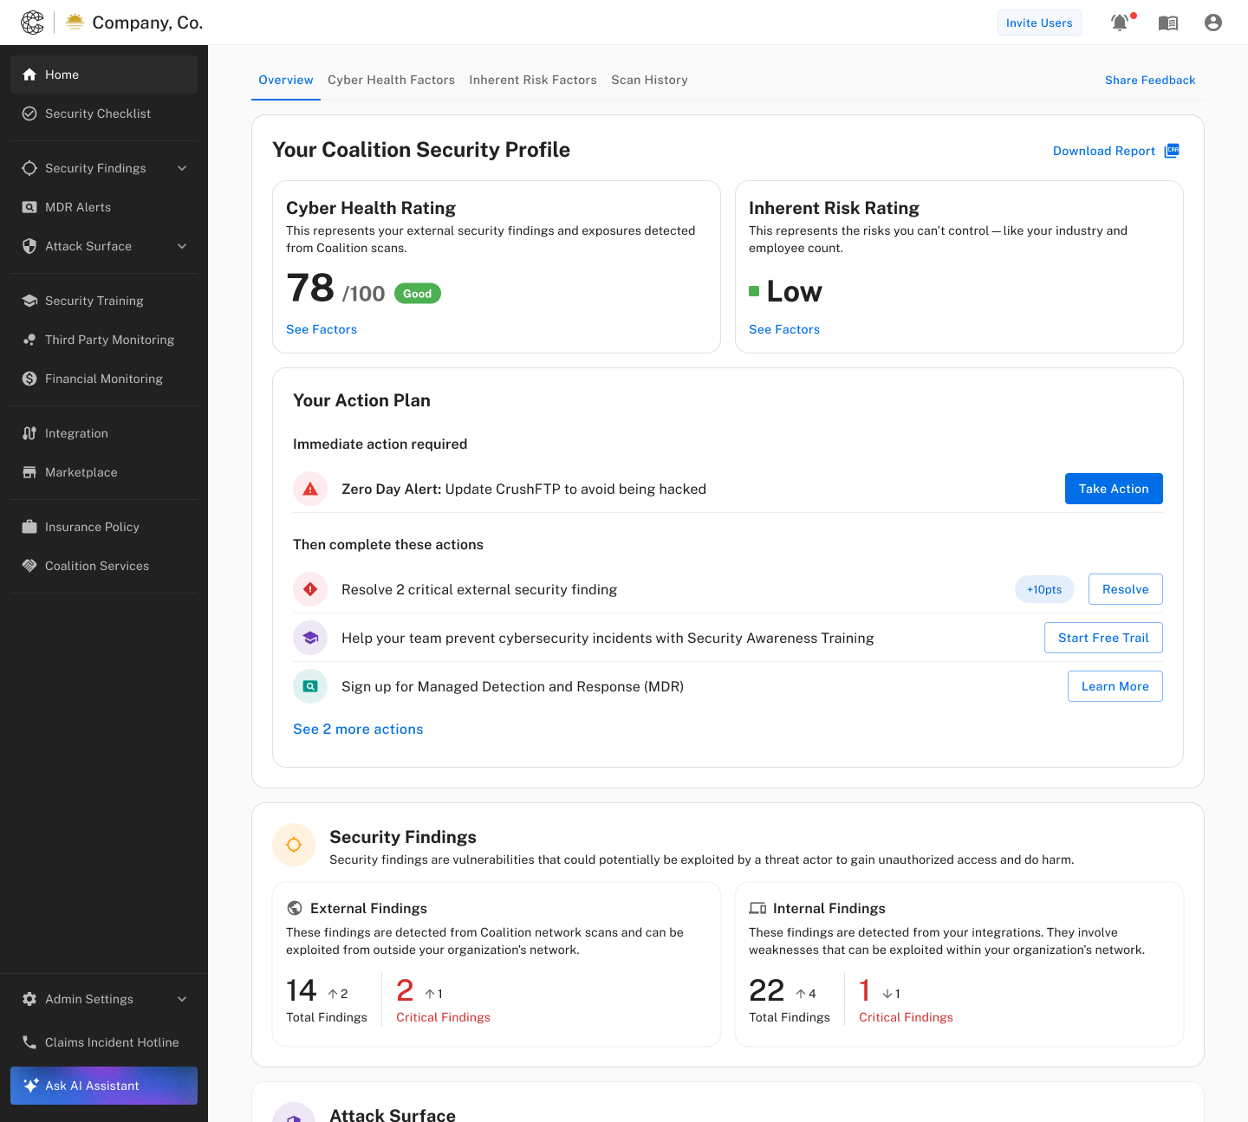
ASSESS
PROTECT
RESPOND
COVER
Identify and prevent new threats
Coalition Control®
Attack Surface Monitoring
3rd Party Risk Management
Integrations with leading cloud platforms
Customized alerts & guidance
Security Awareness Training (SAT)
Security Services
24/7 security support
Managed Detection & Response (MDR¹)
1. Coalition Security Services MDR services are provided by Coalition Incident Response, an affiliate of Coalition, Inc.
Notes:
Key Points
Coalition control provides continuous monitoring of your organization and third parties, along with tailored guidance. It also includes security awareness training solution to train employees to recognize and report cyber attacks.
Coalition Security Services gives access to 24/7 and premium support to help respond to security threats
Talk Track
The first stage of defense is prevention and protection. Our risk management platform, Coalition Control, provides continuous alerts on new vulnerabilities and risks that we identify through our security data graph. We monitor each business’s entire external attack surface, from their domains to the technologies they use. We also monitor the third party vendors and partners they work with, because the organizations you partner with also create exposure for you. We also offer integrations with leading cloud-based platforms such as Google Workspace, Microsoft 365, and Amazon Web Services for a unified view of risk. Control also includes security awareness training solution so you can educate your employees on cyber threats and how to spot them through engaging videos, interactive phishing exercises and simulations, uplevel your employees’ cyber defense and reduce cyber risk.
Active protection also includes security services. All customers get access to an expert security team to help remediate security issues and provide personalized guidance. For more in-depth support, customers can enroll in managed detection and response (MDR) services which can help give greater peace of mind that the alerts we identify will be handled on their behalf.

Slide 18




ASSESS
PROTECT
RESPOND
COVER
Easily understand cyber risks
and simplify risk management
Coalition Control
Effortlessly reduce risks with
expert remediation and guidance
Strengthen your defense with advanced security solutions
Key Benefits
Unlock cost savings and improve cyber insurability

Slide 19
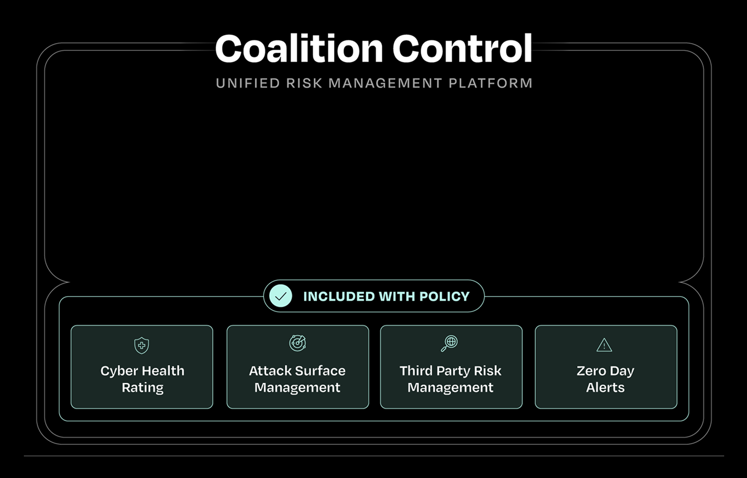
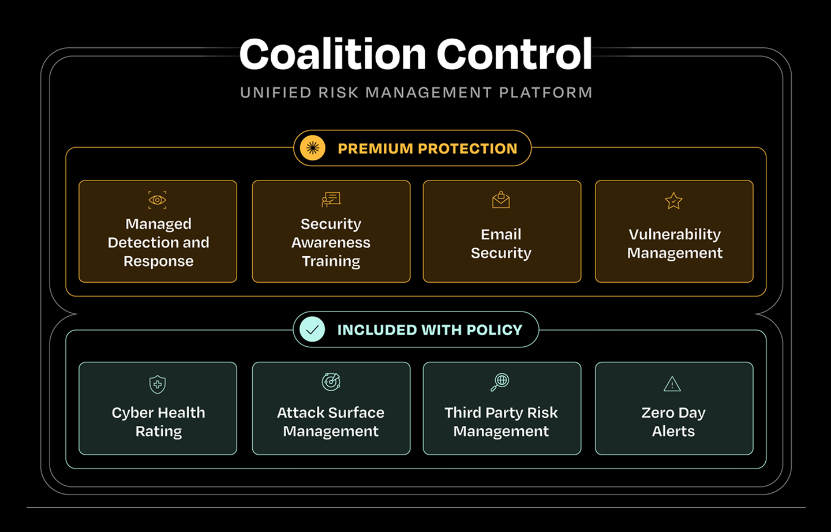
ASSESS
PROTECT
RESPOND
COVER
Notes:
Control comes with a suite of solutions included with your policy to help you spot and stop attacks and dramatically improve your security posture. And a set of premium solutions that are priced and purpose-built for SMBs to proactively address risks and strengthen your defenses even further. Best part is Control truly simplifies risk management by acting as your one stop shop for risk management and eliminating the complexity of dealing with multiple vendors.
We will get into the details of these offerings shortly. But first, let me walk you through the benefits you can expect through this platform.

Slide 20
Respond

Slide 21

ASSESS
PROTECT
RESPOND
COVER
Cyber 911 for immediate support
Round-the-clock support
Pre-claim services
5 minute average response time
Expert team
In-house expert Claims team
Priority access to Coalition Incident Response¹
Network of trusted partners
Best-in-class recovery tactics
Ransomware negotiation and recovery
Funds recovery network
Notes:
Key Points
Our affiliate incident response team is your 911 for cyber incidents
Our response team provides industry-leading recovery tactics and techniques
Talk Track
If an incident does happen, you want to make sure you have the best team in your corner to help you respond. Coalition provides policyholders with immediate access to cyber forensic experts for fast support and assistance in recovering lost data. This team of incident responders and forensics experts handles thousands of incidents per year and responds in minutes to help contain incidents in real time.
But Coalition doesn't stop there. Policyholders have access to a trusted network of skilled experts and professionals including breach coaches, digital asset recovery providers, crisis communication specialists and more to ensure you have the best team at your defense. We also have access to unmatched recovery tactics, such as the ability to claw back stolen funds that have already been wired to a hacker, thanks to our trusted network across banks and law enforcement.

Slide 22
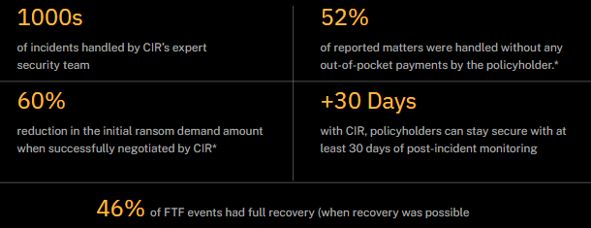
ASSESS
PROTECT
RESPOND
COVER
Minimize cost and maximize security
Notes:
Speaker Notes:
With CIR clients can trust that they will have access to a trusted team of DFIR experts that are not new to the industry or learning on the job
With CIR policyholders can get more out of their policy and make their limits go farther because CIR offers competitive rates and policyholders that select CIR (when available) have a $0 retention for covered forensic investigation claim expenses.
Experience negotiating with threat actors helps clients reduce ransom payments when paying is the best course of action.
CIR clients get enhanced protection and peace of mind with post-incident monitoring included. This same technology can be converted into a paid 24/7/365 managed detection & response service.

Slide 23
Cover

Slide 24

ASSESS
PROTECT
RESPOND
COVER
Broad insurance to recover after an attack
Coverage for today’s threats
FTF, ransomware, data breach
Preserve cash flow
“Pay on behalf” language
Separate limit for breach response costs
Additional benefits for policyholders
Pre-claims assistance
Training & table-top exercises
BREACH RESPONSE
CYBER EXTORTION
BUSINESS INTERRUPTION
Notes:
Key Points
Broad cyber coverage for today’s threats including FTF, ransomware, and data breaches
Pay on behalf language preserves your cash flow
Talk Track
If you do have an incident that breaks through your defenses, you want to have the peace of mind that you have the right coverage in place to help you recover and get back to business. Our comprehensive cyber policy provides coverage for the most critical cyber threats that businesses face, including funds transfer fraud or social engineering, ransomware, data breaches, and more. We regularly evolve the policy to add new coverages as the threat landscape evolves.
If an incident does happen, the costs start to add up fast between ransom payments, lawyer fees, forensics fees, and more. Coalition policyholders benefit from “pay on behalf” terms, which means that after your retention is paid, vendors are paid on your behalf. Policyholders benefit from keeping more of their cash reserves to keep their business running.
Our incentives are aligned with our customers, so customers who practice good cyber hygiene qualify for better policy terms.

Slide 25

























3rd Party Security and Privacy
Event Response
Network & Information Security Liability
Breach Response Costs
Cyber Extortion (Ransomware)
Business
Interruption
& Extra Expenses
Digital Asset Restoration
Regulatory Defense & Penalties
PCI Fines & Assessments
Funds Transfer Liability
Media and Professional Liability
Crisis Mgmt & and PR
Proof of Loss Preparation Expenses
Computer Replacement & Bricking
Reputational Harm Loss
Multimedia Content Liability
Technology Errors & Omissions
(available by endorsement)
Misc. Professional Liability
(available by endorsement)
Court Attendance
Criminal Reward
Cyber Crime
Other Coverages (available by endorsement)
Funds Transfer Fraud, Personal Funds Fraud, and Social Engineering
Service Fraud including Cryptojacking
Impersonation Repair & Phishing
Invoice Manipulation
Bodily Injury & Property Damage
1st Party
Bodily Injury & Property Damage
3rd Party
Pollution
Reputation Repair

Slide 26
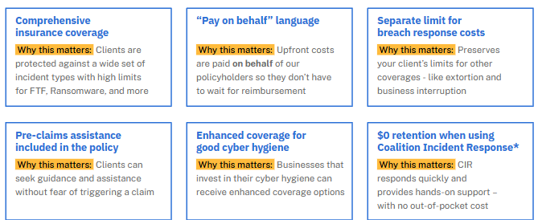
ASSESS
PROTECT
RESPOND
COVER
Not all cyber policies are created equal
Notes:
Diving in a bit further, let’s discuss some of the essential advantages of Coalition’s cyber insurance policies.
We offer comprehensive cyber insurance coverage to protect your clients against a wide set of incident types. This allows you, as brokers, to feel confident you’re offering your clients the most comprehensive coverage – without back and forth negotiations.
Our policies are written with “pay on behalf” language, which is really important if your client has a claim. Breach response costs, ransom payments, forensics, and other first-party expenses can add up fast. We pay these upfront costs on behalf of our policyholders, so they don’t have to wait for reimbursement. This means there’s less for them to worry about – with no out-of-pocket costs and no hoops to jump through.
We also offer a separate limit for breach response costs on most of our policies. This reserves limits for other coverages, like extortion and business interruption, so you can feel confident your clients will have sufficient limits to respond in case of an incident.
We include pre-claims assistance in each of our policies. When a cyber incident occurs, time is of the essence. This dedicated assistance allows policyholders to seek guidance without fear of triggering a claim. We’ll help your clients quickly triage incidents and keep them from escalating into claims whenever possible, freeing you up to provide technical expertise where it matters.
We also look for ways to enhance coverage for policyholders with good cyber hygiene. Cyber risk is dynamic and requires active participation. When clients are active participants in their own cyber risk management, they can benefit from improved terms. For example, if a business email compromise occurs and clients had MFA in place and active, Coalition will reduce the retention the client must pay – which means less financial burden for them.
Last, but certainly not least, clients pay a $0 retention when using Coalition Incident Response. Coordinated expertise is critical when dealing with a cyber incident. CIR responds quickly and provides expert, hands-on support – with no out-of-pocket cost. This allows you to save your clients money and give them access to our expert team to help minimize the overall impact to their business.
These are some of my favorite highlights of our policy, but there are many other examples…

Slide 27
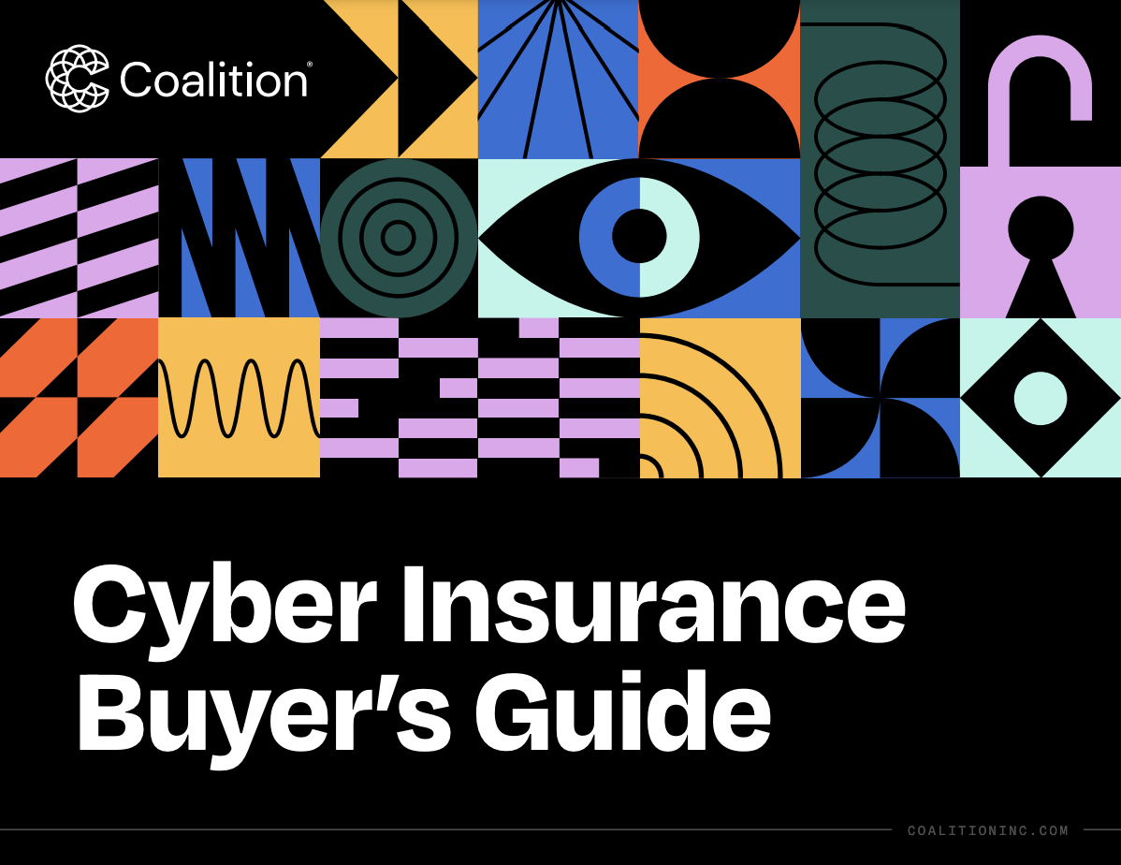
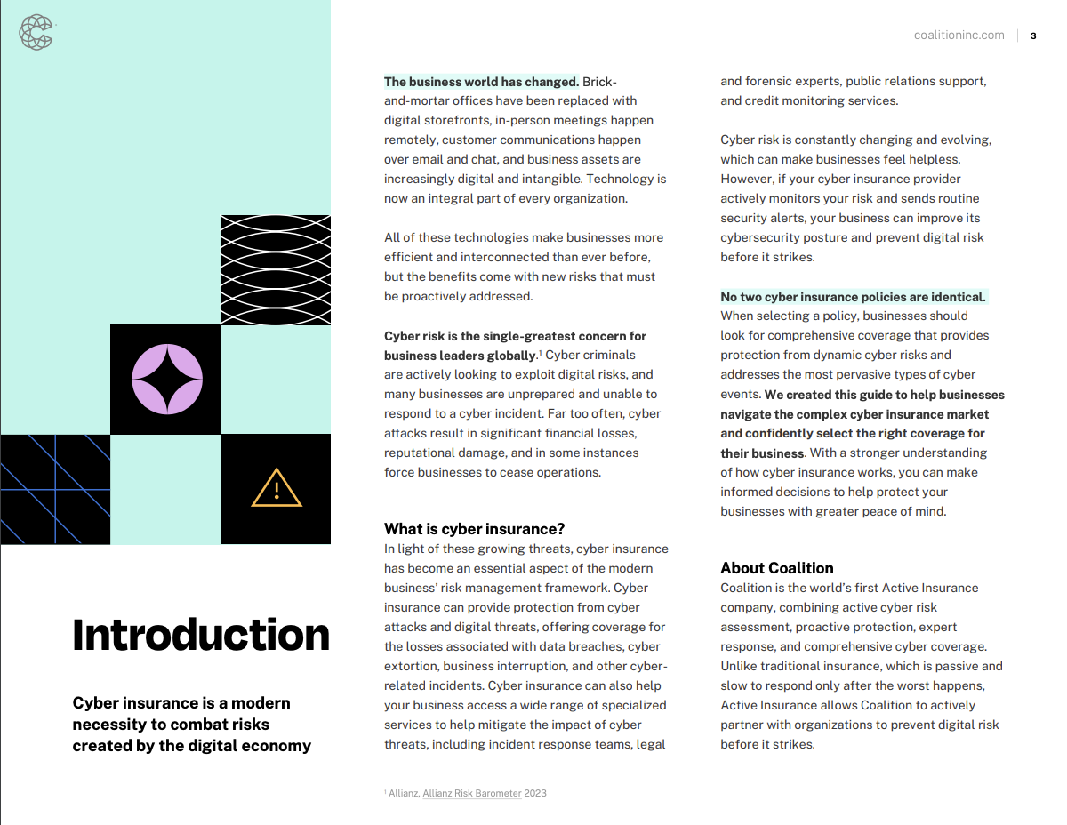
ASSESS
PROTECT
RESPOND
COVER
Cyber Insurance Buyer’s Guide
A quick introduction and how-to for businesses considering cyber insurance for the first time.
Includes:
Why businesses need cyber insurance
Key coverage terms
Buyer’s checklist
Why Coalition
Download
Notes:
What it is: A 15-page guide that provides a quick introduction and how-to for businesses considering cyber insurance for the first time. In the guide, they'll find why businesses need cyber insurance today, mythbusters around cyber, main areas of coverage, a buyer's checklist, and how Coalition is redefining insurance.
Why it's important: Lack of education and orientation is a large barrier to entry for businesses who have yet to purchase cyber. Having a digestible, easy-to-understand guide that explains why they need cyber, and what they should look for, is an extremely valuable tool that brokers (especially those newer to cyber themselves) can share with their clients to help close the education gap.

Slide 28
Thank You!
Myles Miller
Production Underwriting Manager
Coalition
myles@coalitioninc.com
Jim Staed
Vice President
EPIC Senior Living
Jim.staed@epicbrokers.com

