Slide 1



What to Do After the Strategic Plan
Keeping Key Players Involved & Turning Vision into Action
A session for organizational leaders responsible for strategic implementation
Fall Conference
September 9-10, 2025
Embassy Suites Noblesville | Indianapolis, IN

Slide 2
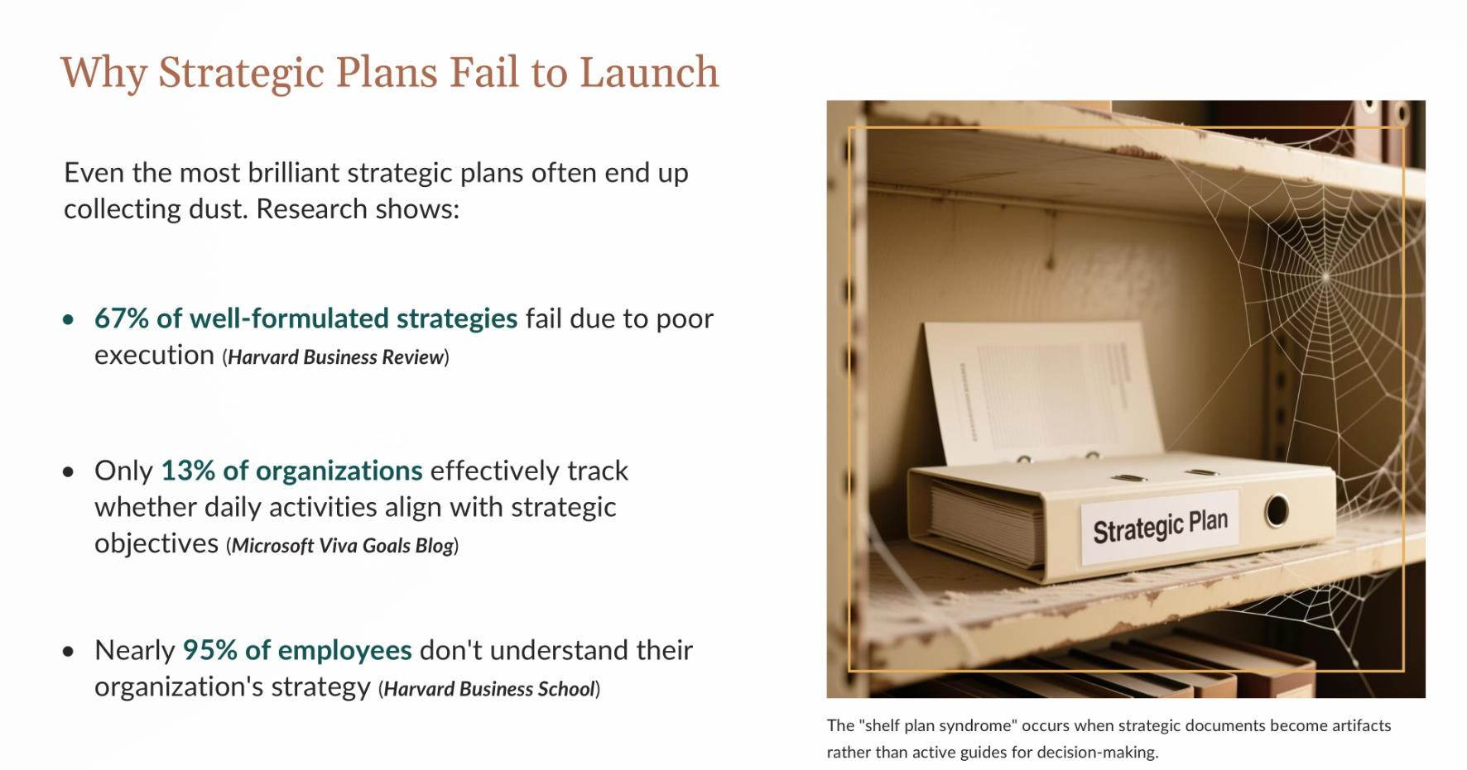



Slide 3
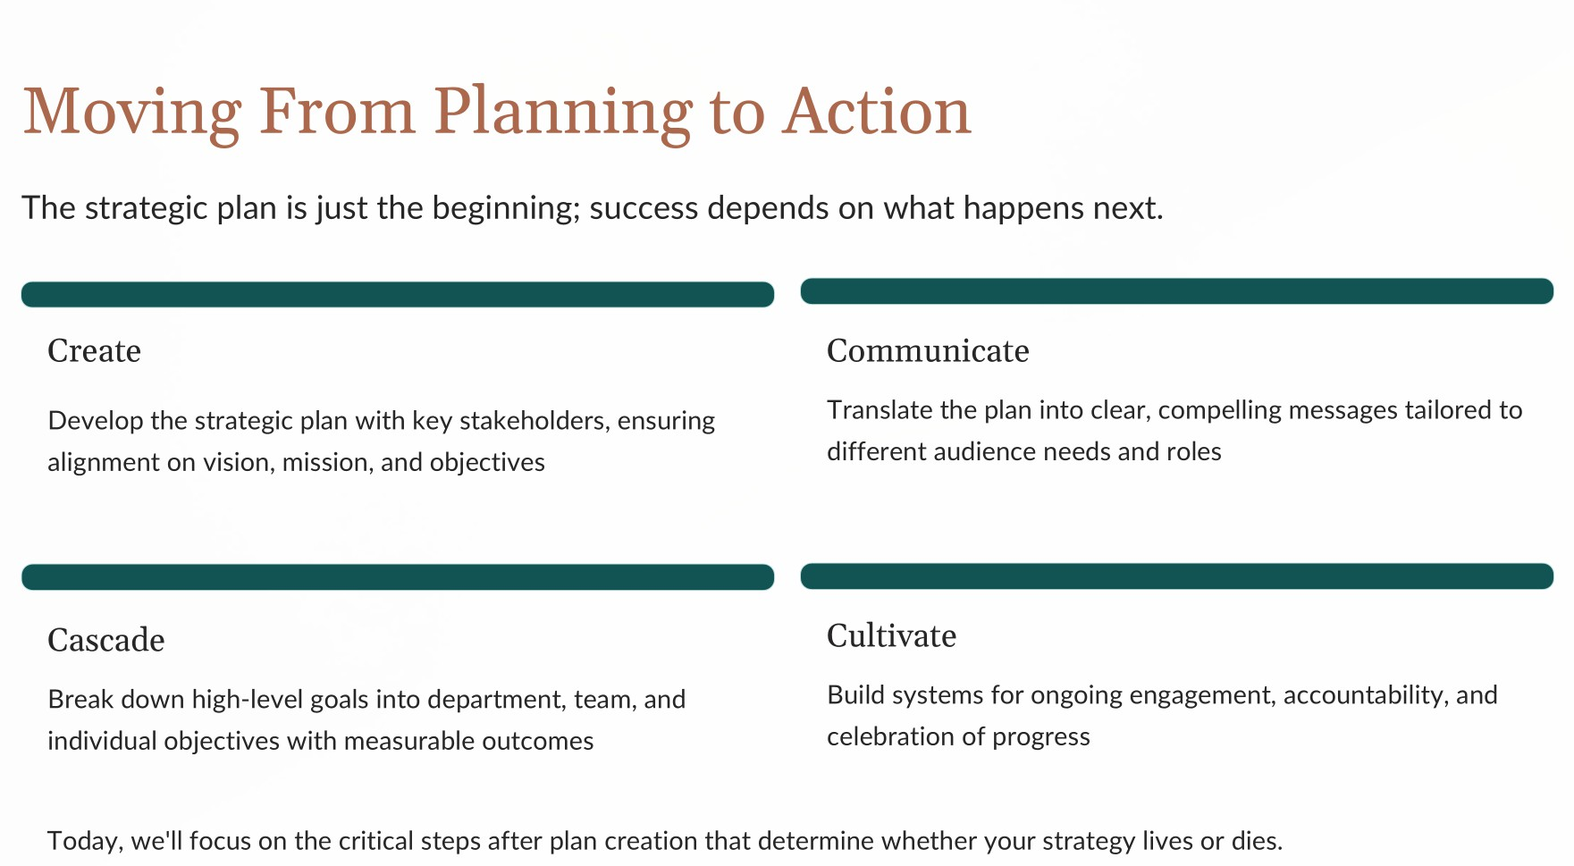

Slide 4

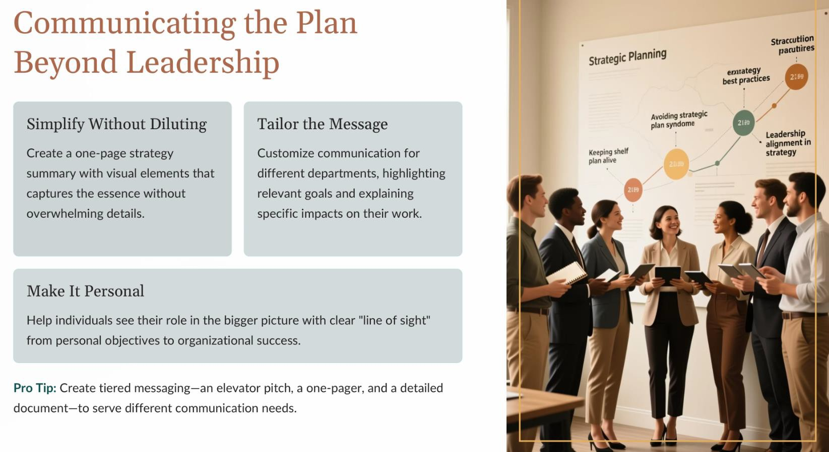

Fall Conference

Slide 5


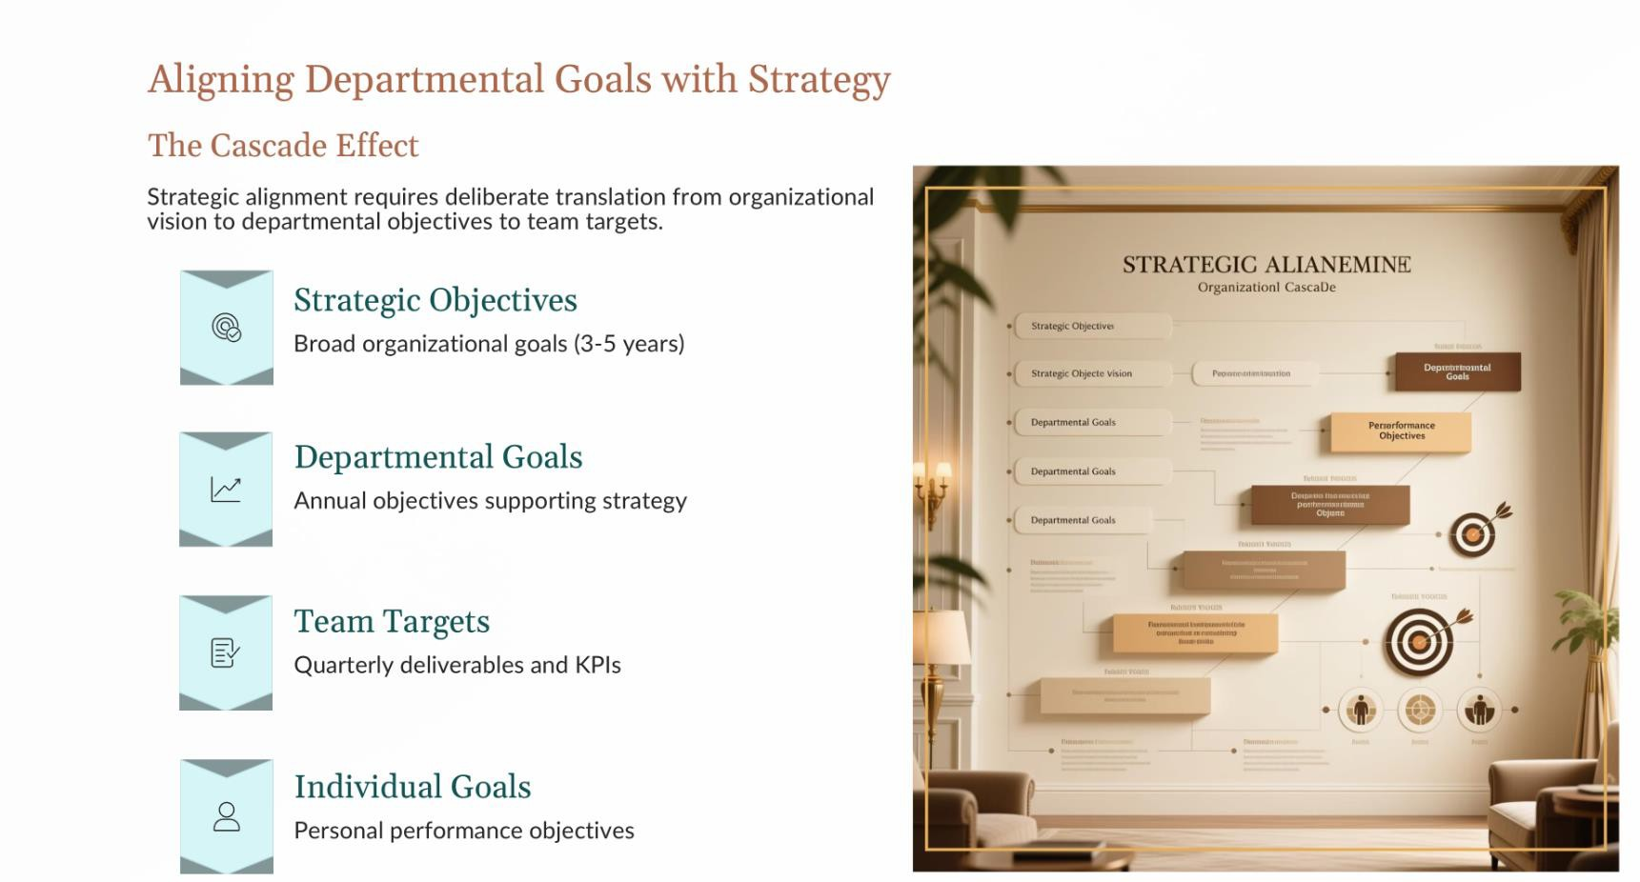


Slide 6
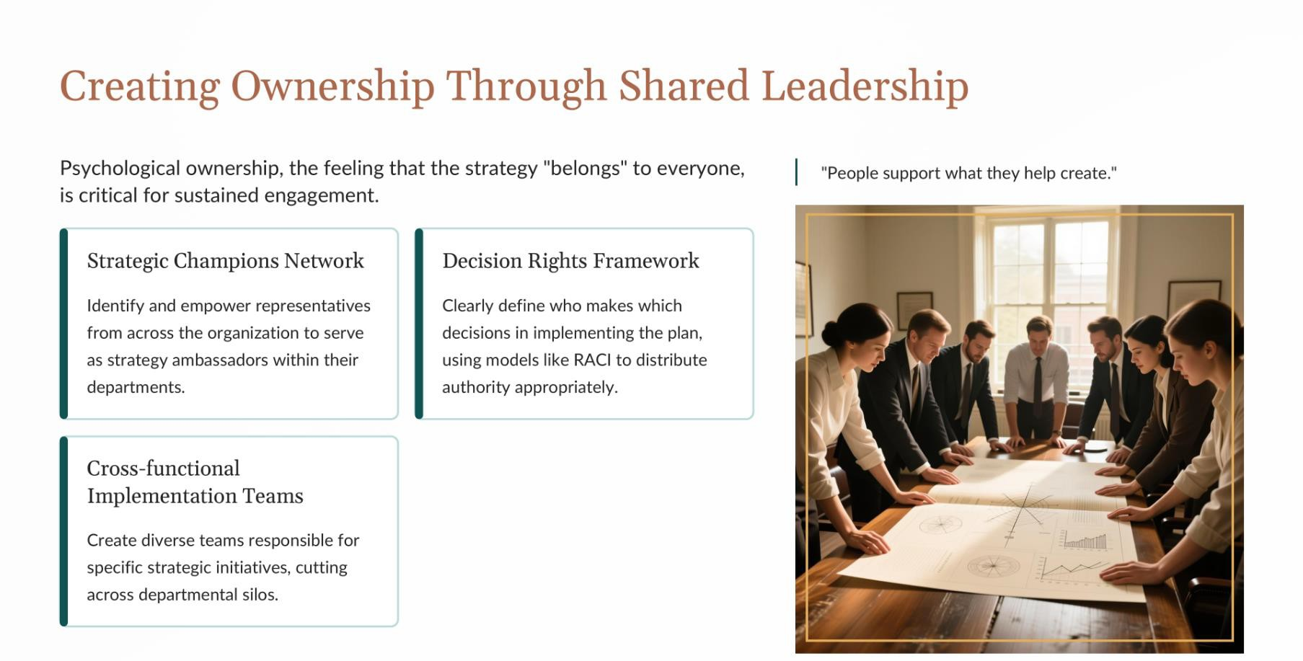

Slide 7
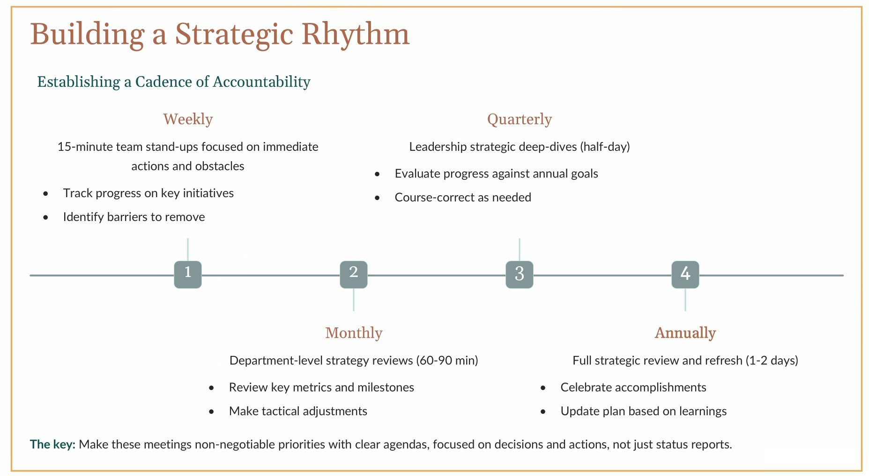

Slide 8

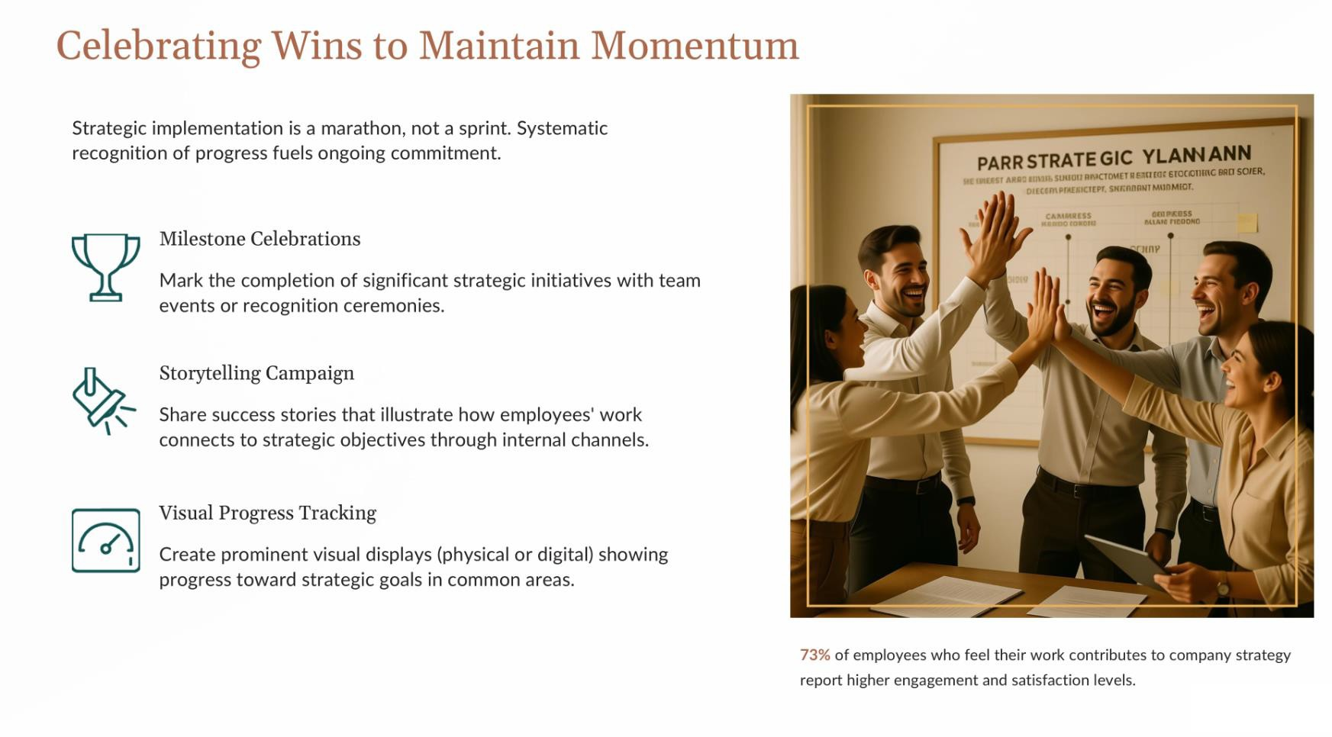
Fall Conference

Slide 9
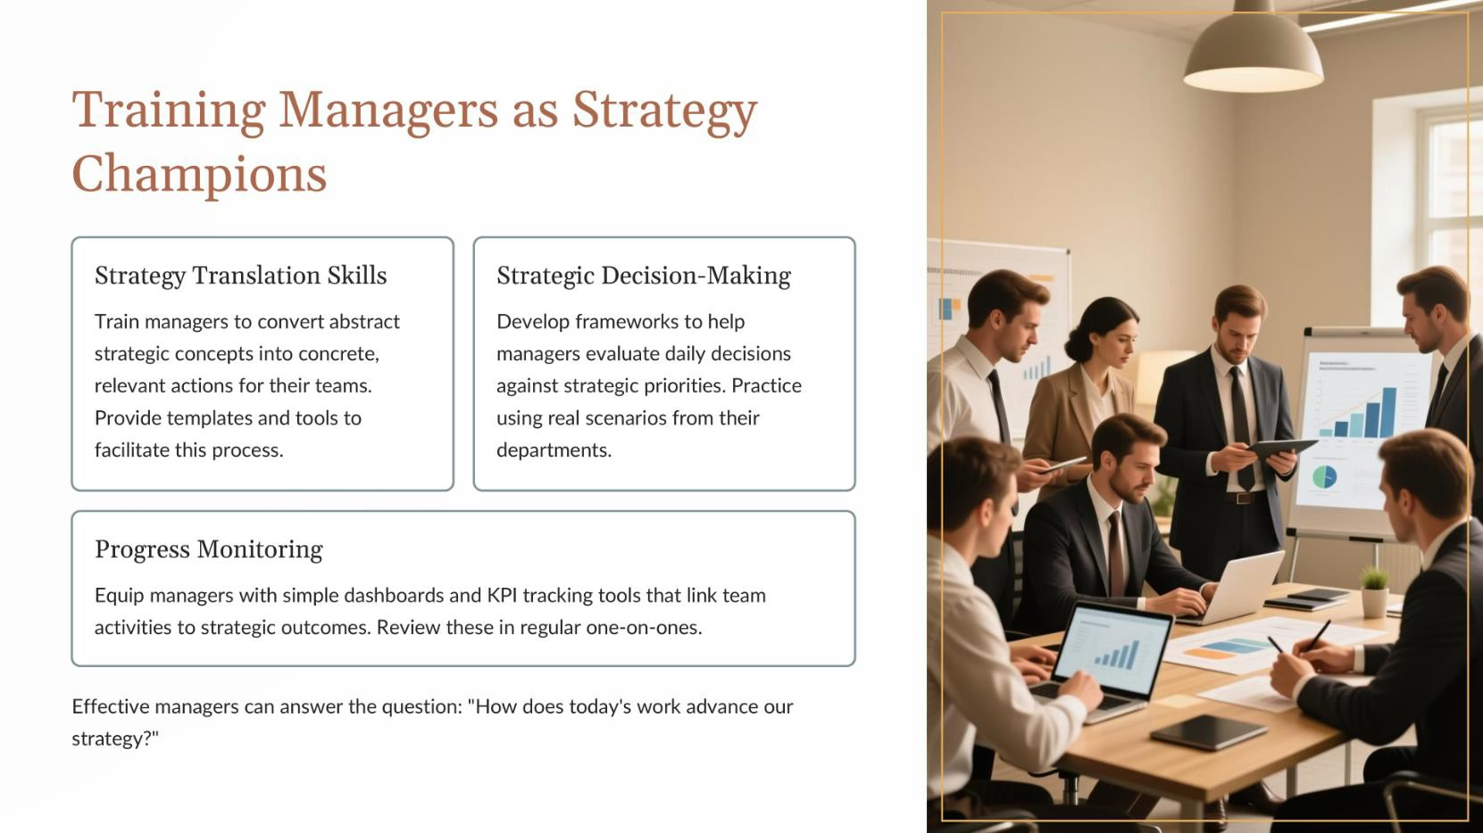

Slide 10
