Slide 1
LeadingAge Indiana Advocacy Training & 2024 Session Wrap Up
Wednesday, April 9, 2024
Heather D. Harris, Partner
Barnes & Thornburg LLP

Slide 2
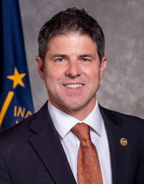
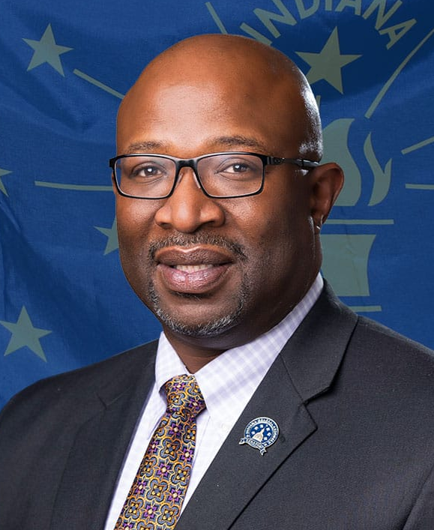
Legislative Leadership
Indiana House of Representatives
Indiana State Senate
70 Republicans
House Speaker,
Todd Huston (R)
Fishers
40 Republicans
President Pro Tempore,
Rodrick Bray (R)
Martinsville
30 Democrats
House Minority Leader,
Phil GiaQuinta (D)
Fort Wayne
10 Democrats
Senate Minority Leader,
Greg Taylor (D)
Indianapolis

Slide 3
Short Session
The 2024 Legislative session was a short session
Non-budget year
Largely focused on policy matters
Largely did not entertain bills with a fiscal impact to the State.
Start date: Monday, January 8, 2024
End date: Friday, March 8, 2024 (one week earlier than the statutory deadline)

Slide 4
Long Session
Long sessions occur in odd-number years and must adjourn by April 29th.
These are known as “budget sessions” where the General Assembly creates a two-year (biennial) budget for the state.
The 2025 session will be critical for LeadingAge as we revisit the nonprofit status of our CCRCs/ Senior living providers.

Slide 5
Campaign Season is Upon Us
The Republican primary for Governor is heating up with several candidates vying for the Republican nomination. These include:
Mike Braun
Brad Chambers
Suzanne Crouch
Eric Doden
Curtis Hill
Jamie Reitenour

Slide 6
What Nonprofits Can / Cannot Do
CAN
Hold non-partisan voter education activities including
- public forums and
- publishing voter education guidelines.
Encourage participation in the electoral process
- voter registration
- get-out-the-vote drives
CANNOT
Prohibited from directly or indirectly participating in, intervening in, any political campaign on behalf (or in opposition) of any elective public office.
Make contributions to a political campaign on behalf of the organization.

Slide 7
How a Bill Becomes a Law – Step 1
The Formal Introduction of a Bill:
"The style of every law shall be: "Be it enacted by the General Assembly of the State of Indiana"; and no law shall be enacted, except by bill. Bills may originate in either House, but may be amended or rejected in the other; except that bills for raising revenue shall originate in the House of Representatives" Article 4. Section 1; Article 4, Section 17

Slide 8
How a Bill Becomes a Law – Step 2
Formal Consideration of a Bill:
"Every bill shall be read, by title, on three separate days, in each House; unless, in case of emergency, two-thirds of the House where such bill may be pending shall, by a vote of yeas and nays, deem it expedient to dispense with this rule; but the reading of a bill, by title, on its final passage, shall, in no case, be dispensed with; and the vote on the passage of every bill or joint resolution shall be taken by yeas and nays." Article 4. Section 18

Slide 9
How a Bill Becomes a Law – Step 3
Passage of a Bill:
"A majority of all the members elected to each House, shall be necessary to pass every bill or joint resolution; and all bills and joint resolutions so passed, shall be signed by the Presiding Officers of the respective Houses" Article 4, Section 25

Slide 10
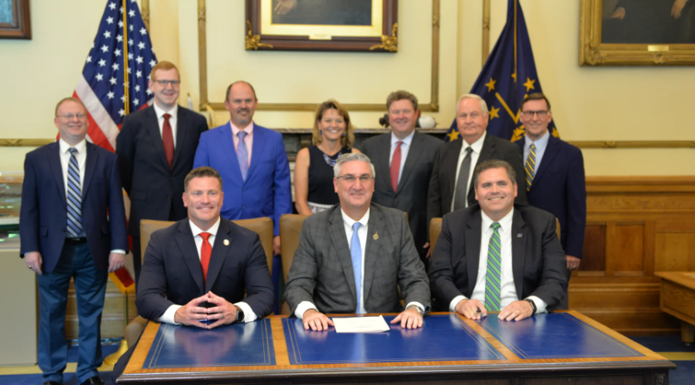
How a Bill Becomes a Law – Step 4
Presentment of a Bill:
"Every bill which shall have passed the General Assembly shall be presented to the Governor." Article 5, Section 14

Slide 11
How a Bill Becomes a Law – Step 5
Filing of the Bill:
"Every bill presented to the Governor which is signed by him or her on which he/she fails to act within said seven days after presentment shall be filed with the Secretary of State within ten days of presentment. In the event a bill is passed over the Governor's veto, such bill shall be filed with the Secretary of State without further presentment to the Governor." Article 5, Section 14

Slide 12
How a Bill Becomes a Law – Step 6
Circulation of the Bill to the State at Large:
"No act shall take effect, until the same shall have been published and circulated in the several counties of the State, by authority, except in case of emergency, which emergency shall be declared in the preamble, or in the body, of the law." Article 4, Section 28

Slide 13
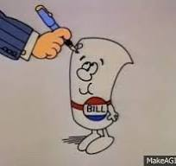
SO WHAT DOES THAT REALLY MEAN?

Slide 14
From Idea to Bill…
An idea is developed. A legislator – either a Representative or a Senator – decides to sponsor a bill. This could be an original idea, or it could come as a suggestion from a constituent, an interest group, a public official, or the Governor. Other lawmakers may be asked to join as co-sponsors. The co-sponsors may or may not be of the same political party as the sponsor. A bill is drafted. At the sponsoring legislator’s direction, the nonpartisan Legislative Services Agency (LSA) provides research and drafting assistance. LSA prepares the bill in proper technical form. The bill is introduced. The bill is filed by the legislator in her/his own chamber, which could be either the Senate or the House of Representatives. If the chamber leadership does not call the bill for First Reading, it “dies.” If the bill is called, it is scheduled for First Reading. The bill has its First Reading in the house of origin. The bill is read by title for the first time to the full legislative body.

Slide 15
Committee
The bill is assigned to committee. The President Pro Tempore of the Senate or the Speaker of the House of Representatives can choose not to refer the bill to a committee. In this event, the bill “dies.“ If the bill is to advance, it is referred to a committee for review. The committee takes action on the bill. The committee chairperson may choose not to schedule the bill for hearing. In this event, the bill “dies.“ If the bill is to advance, it is scheduled for a public hearing. At that hearing, the committee discusses the merits and disadvantages of the bill, and any interested party may ask to speak to the committee. Interested persons may speak in favor of or in opposition to the bill. Following this hearing, the bill can be voted upon or tabled. If the bill is tabled, it may or may not come back for a vote. If it does not come back for a vote, the bill “dies”. If the committee casts a vote on the bill, the bill can be defeated or it can advance.

Slide 16
Second Reading
The committee sends the bill back to the house of origin for Second Reading. If the committee advances the bill, it is printed and the full body of legislators has at least two days to review it. Chamber leadership may choose not to schedule the bill for Second Reading. In this event, the bill “dies.“ If the bill is scheduled, any legislator of the house of origin can suggest amendments to the bill. The amendments can be approved by a majority vote of the full body of legislators. Following a vote on amendments, a vote is held on the bill itself. The bill may “die” at this point, or it may advance.

Slide 17
Third Reading
The house of origin holds the Third Reading and the bill is voted upon by the full chamber. Again, chamber leadership may choose not to schedule the bill for Third Reading, and the bill “dies.“ If the bill is scheduled, amendments can once again be made. However, on Third Reading, the amendments cannot be approved unless two-thirds of the legislators agree to the change. Following a vote on amendments, the bill once again comes to a vote by the full body. A simple majority of the full house can advance the bill. If a majority vote is not received, the bill “dies.”

Slide 18
Bill in Second Chamber
The process repeats in the other chamber. Once the bill has advanced through the house of origin, it is sent to the second house, where the process repeats. The second chamber may fail to act on the bill, in which case the bill “dies.“ If action is taken, the bill must pass through First Reading, Committee, Second Reading and Third Reading. The bill can “die” at any step of the way, just as it can in the house of origin. At the same stages as in the house of origin, as long as the bill is advancing, amendments may be proposed and accepted.

Slide 19
Bill Returns to House of Origin
The bill returns to the house of origin. If the bill advances through the second chamber without amendments, the bill is sent to the Governor for signature. If the bill advances with amendments, it returns to the house of origin. The house of origin may fail to take action, and the bill “dies.” The legislative body may vote to approve the changes made by the second chamber. If this happens, the bill is sent to the Governor for signature. If the first chamber does not approve the changes made by the second chamber, and both houses want the bill to advance, the bill is assigned to a Conference Committee.

Slide 20
Conference Committee
Conference Committee. Conference Committee is made up of two members from each of the legislative bodies. Each chamber sends one member from both major political parties. The four members attempt to reconcile differences between the chambers. If agreement cannot be reached, the bill “dies.” If agreement is reached, the bill returns to both chambers. Both the Senate and the House of Representatives must approve the bill before it can be sent to the governor for signature.

Slide 21
Governor’s Review
The bill is sent to the Governor. Once the governor receives a bill, he can sign it, veto it, or do nothing. If he signs it, the bill becomes law. If he does nothing, the bill becomes law without his signature. If he vetoes the bill, and the Senate and House of Representatives do nothing, the bill “dies.“ If he vetoes the bill and the Senate and the House of Representatives attempt to over-ride the veto, the bill may still become law. If less than 26 Senators and less than 51 House members do not vote to over-ride the veto, the bill “dies.“ If a simple majority of both chambers vote to over-ride the veto, the bill becomes law. The bill becomes law. The bill becomes law at a date specified in the body of the bill. It could be the date of the actual passing or a date at some point in the future.

Slide 22
Gov. Holcomb’s State of the State Address
Indiana Leading the Way:
Forbes ranked Indiana as the number one state in America in which to start a business.
Indiana paid down $4.5 billion in debt, returned $1.5 billion to taxpayers, and maintained a AAA state credit rating.
The state’s GDP grew by $150 billion since the year 2017.
READI 2.0:
Holcomb announced a $250 million contribution from the Lilly Endowment to support projects in the program.
This money will be earmarked for projects concerning various arts and cultural initiatives as well as blight reduction and will be targeted toward rural towns and communities.
Hoosier Healthcare:
Holcomb championed new funding for local health departments through Health First Indiana (HFI), a historic investment in public health.
86 counties opted to receive a total of $75 million in HFI funding to address improving the health of all Hoosiers through guaranteed access to core public health services.
Child Care:
Holcomb and lawmakers look to increase accessibility of child care in the state.
Improvement goals included: adding workforce training programs, allowing child care workers to be eligible for free or reduced child care for their own children, and reducing the age requirement for child care workers to eighteen.

Slide 23
State of the State Address link
The following is a link to the Governor’s full State of the State Address:
https://events.in.gov/event/gov_holcomb_delivers_2024_state_of_the_state_address?utm_campaign=widget&utm_medium=widget&utm_source=State+of+Indiana

Slide 24
HEA 1058, Breast Cancer Screening and Services
Author: Rep. Sharon Negele (R)
Requires a facility performing a mammography examination to provide:
(1) An assessment of the patient's breast tissue density using specified classifications.
(2) Written notice to the patient and the referring provider.
(3) Concerning the notice to the patient, specified notification language depending on whether the facility determined the patient to have dense breast tissue or not dense breast tissue.
Requires the medical licensing board of Indiana to amend an administrative code rule to remove references to "high breast density" and to align with the breast tissue density classifications in this act.
Bill Status: Signed by Governor Holcomb on 3/4/2024.

Slide 25
HEA 1067, Human Services Matter
Author: Rep. Ed Clere (R)
Original bill addressed services considered by the Individuals with Intellectual Disabilities Task Force.
Language added from the Conference Committee Report:
Inserted the special service review team and emergency placement language. (HB 1187)
Added various provisions concerning a risk based managed care program for certain Medicaid recipients. (SB 256)
Required the office of FSSA and the division of mental health & addiction to include that each community mental health center meet the requirements to provide comprehensive behavioral health care. (SB 233)
Bill Status: Signed by Governor Holcomb on 3/13/24.

Slide 26
HEA 1070, Mental Health Grants
Author: Rep. Becky Cash (R)
Allows the Division of Mental Health and Addiction to award mental health grants to for-profit community mental health organizations if a non-profit does not qualify for the grant.
The Division of Mental Health and Addiction currently release several grants for non-profit community mental health organizations a year.
Bill will allow for-profit community based mental health entities to apply for and accept a grant.
Only when a non-profit does not qualify.
Criteria still must be met.
Bill Status: Signed by Governor Holcomb on 3/11/24.

Slide 27
HEA 1259, Health Care Matters
Author: Rep. Brad Barrett (R)
The CCR report added language from various health care related bills that were unsuccessful in the second half of the session.
HEA 1259 mandates the following:
Establishment of the psilocybin research fund administered by the division of mental health and addiction, to provide financial assistance to research institutions in Indiana to study the use of psilocybin to treat mental health and other medical conditions. (SB 139)
Sets forth clinical study requirements.
Allows the majority of nursing program faculty to be part-time employees of an approved postsecondary educational institution or a hospital that conducts the nursing program.
Removes the requirement that a clinical preceptor must have at least 18 months of experience as a licensed nurse.
Requires a contract with a third party administrator, pharmacy benefit manager, or prepaid health care delivery plan to provide that the plan sponsor has ownership of the claims data. (HB 1327)
Allows a contract holder to request an audit of a pharmacy benefit manager one (1) time per calendar year and not earlier than six (6) months after a previously requested audit.
Bill Status: Signed by Governor Holcomb on 3/13/24.

Slide 28
HEA 1332 Insurance Matters
Author: Rep. Martin Carbaugh (R)
Addresses insurance regulations within the Indiana Department of Insurance (IDOI)
Adopts provisions of the National Association of Insurance Commissioners concerning liquidity stress testing framework.
Allows a plan sponsor to choose one (1) of the two (2) offered plans.
Plan that applies 100% of the rebates to reduced premiums for all covered individuals equally.
Or a plan that calculates defined cost sharing for covered individuals of the plan sponsor at the point of sale based on a price that is reduced by an amount equal to at least 85% of all the rebates received or expected to be received by the insurer.
Provides that if a party to a health provider contract intends to terminate the contractual relationship with another party to the health provider contract, the terminating party must provide written notice to the other party of the decision to terminate the contractual relationship not less than 90 days before the health provider contract terminates.
Amends the property and casualty insurance guaranty association law concerning the allocation, transfer, or assumption by one insurer of a policy that was issued by another insurer. (HB 1359)
Bill Status: Signed by Governor Holcomb on 3/13/24.

Slide 29
HEA 1385, Emergency Medical Services
Author: Rep. Brad Barrett (R)
Requires a health plan operator to provide payment to a nonparticipating ambulance service provider for ambulance service provided to a covered individual.
Health plans will now be required to compensate out-of-network ambulance providers for transports at rates determined by local units.
In cases where these rates haven't been established, insurers will reimburse either the cheaper option:
The provider's bill or the Medicare base rate at 400%.
Clarifies the rate at which a health plan operator shall provide payment to a nonparticipating ambulance service provider for ambulance service provided to a covered individual.
Establishes the community cares initiative grant pilot program for the purpose of assisting in the costs of starting or expanding mobile integrated health care programs and mobile crisis teams in Indiana. (SB 10)
Bill Status: Signed by Governor Holcomb on 3/13/24.

Slide 30
SEA 9, Notice of Health Care Entity Mergers
Author: Sen. Chris Garten (R)
Requires health care entities to provide notice of certain mergers or acquisitions to office of the attorney general.
Allows the office of the attorney general to:
Analyze in writing any antitrust concerns with the merger or acquisition.
Issue a civil investigative demand for additional information.
Specifies that the information is confidential.
Bill Status: Signed by Governor Holcomb on 3/13/24.

Slide 31
SEA 132, Professions and Professional Services
Author: Sen. Liz Brown (R)
Authorizes the office of the secretary of family and social services (office) to implement a risk based managed care program for certain Medicare recipients.
Eliminates the requirement that a provider who is licensed in Indiana, physically located outside Indiana, but providing telehealth services to patients who are in Indiana, file a certification constituting a waiver of jurisdiction.
This bill will clean up telehealth, changes the requirements for a health facility or residential facility administrator license, and the processing of payments.
Specifies:
The manner in which certain nurse applicants may demonstrate English proficiency.
Requires graduates of foreign nursing schools to pass a designated examination.
Identifies additional organizations for verifying credentials of certain nurse applicants.
Bill Status: Signed by Governor Holcomb on 3/11/24.

Slide 32
SEA 215, Medicare Supplement Insurance
Author: Sen. Kyle Walker (R)
This will require that starting from December 31, 2024, any issuer providing Medicare supplement policies or certificates to people aged 65 or older must also offer the same policy or certificate to individuals under 65 who are eligible for Medicare due to a federally recognized disability or end-stage renal disease.
Additionally, that if a person under 65, eligible for Medicare due to a federally recognized disability or end-stage renal disease, and meets specific application deadlines, applies for a Medicare supplement policy or certificate, the issuer of that policy or certificate is restricted from:
Denying or conditioning the issuance or effectiveness of the individual's policy or certificate.
Charging the individual a premium rate for a policy or certificate standardized.
Bill Status: Signed by Governor Holcomb on 3/11/24.

Slide 33
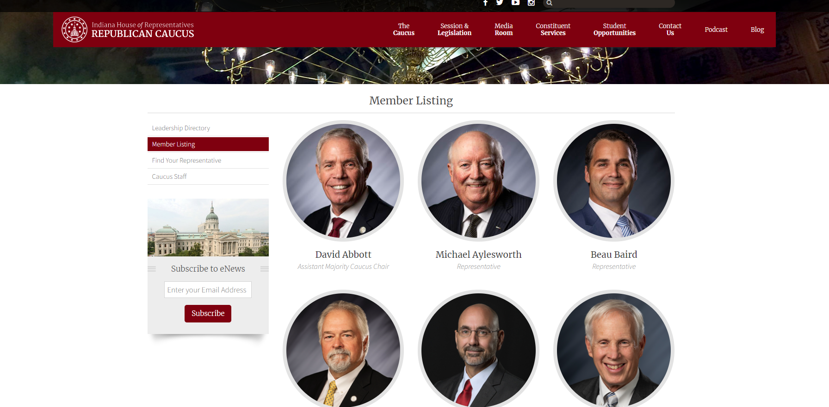
How to Contact a Legislator at the State House
Search the member list directory to find the legislator.
Caucus Directory Links
-House Republican Caucus
-House Democrat Caucus
-Senate Republican Caucus
- Senate Democrat Caucus

Slide 34
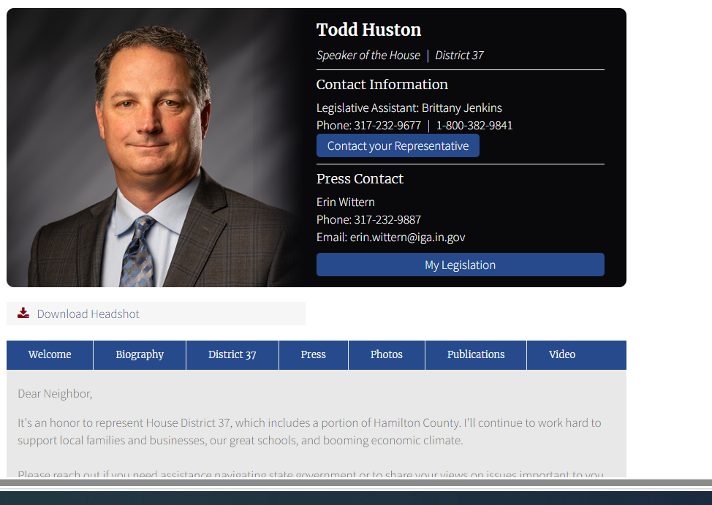
How to Contact a Legislator at the State House cont.…
2. Click on the Legislator’s profile and press “Contact your Representative”.

Slide 35
How to Contact a Legislator at the State House cont.
3. Fill out the “Contact your Representative” form with your information and any questions and or concerns you may have.

Slide 36
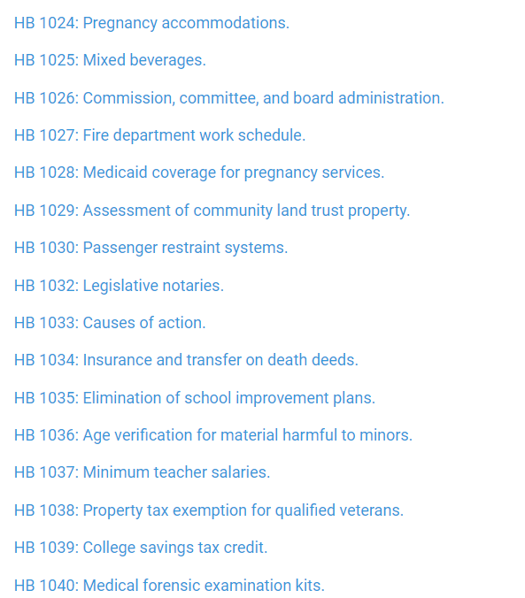
How to Find a Bill or Amendment
Visit this Indiana General Assembly website for the 2024 Legislative Session Bills.
Click on the bill you’re searching for.
Example HB 1024:

Slide 37
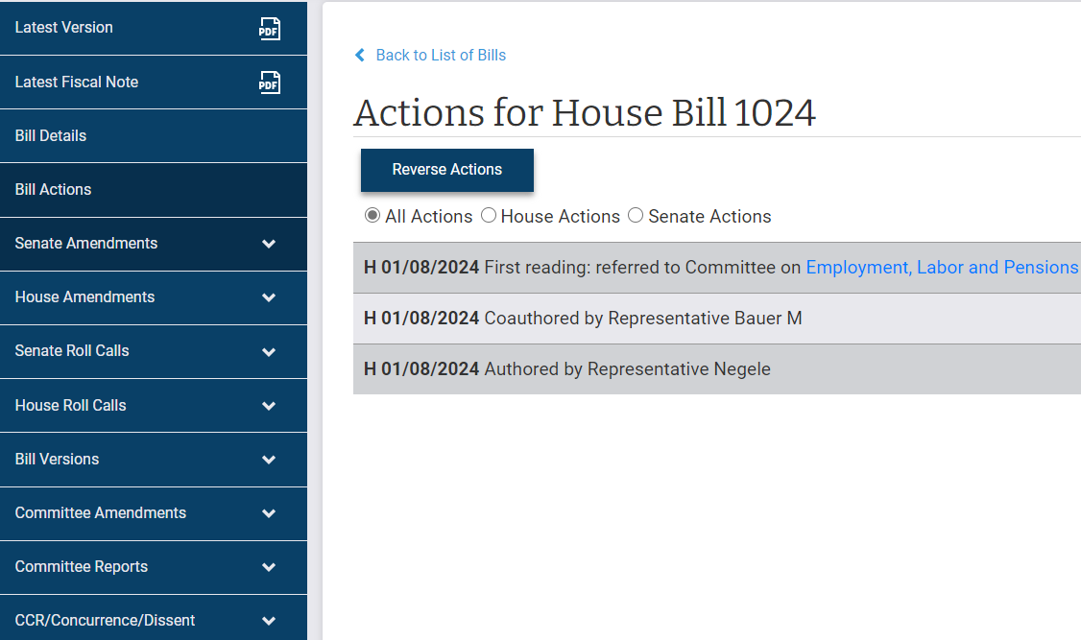
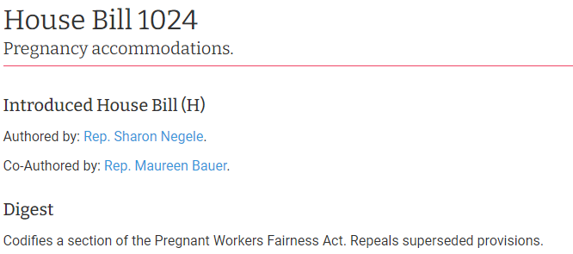
How to Find a Bill or Amendment cont.
3. You will then be prompted to the Bill Details page.
Which includes
-Author / Co-Author
-Digest
4. The left side bar will allow you to toggle through the bill actions and any amendments to the bill.

Slide 38
How to Watch a Committee Online
Visit the Indiana General Assembly Website links below:
-House Public Health Committee
-Senate Health & Provider Services Committee

Slide 39
How to Watch a Committee Online cont.
2. Click on the video icon to join the committee livestream with closed captioning.
The link also provides:
Video recordings
Meeting agenda

Slide 40
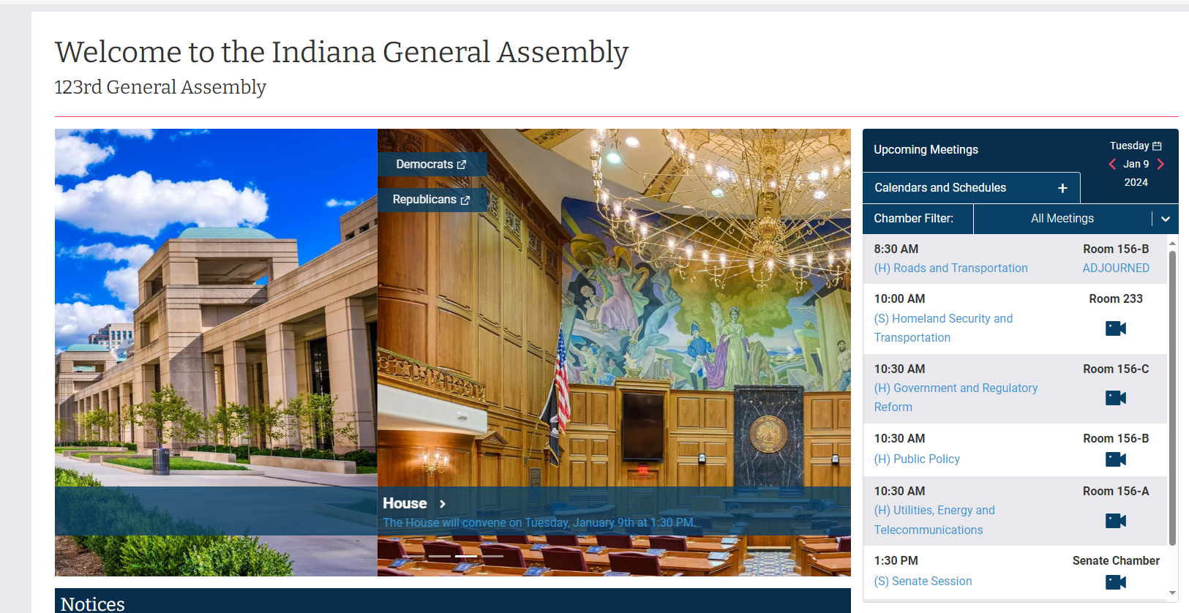
How to Watch a Session Online
Visit the Indiana General Assembly link
On the right side of the page you will see an “Upcoming Meetings” calendar. This will have all the current committee and session schedules currently available.

Slide 41
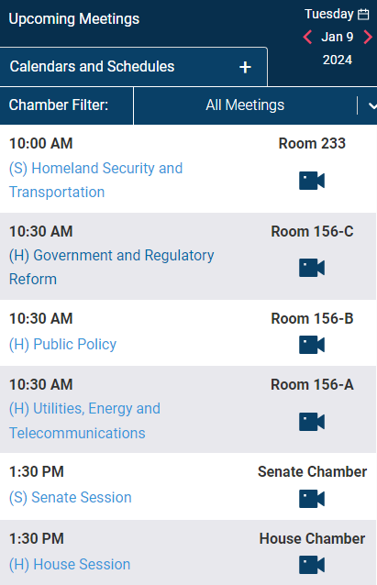
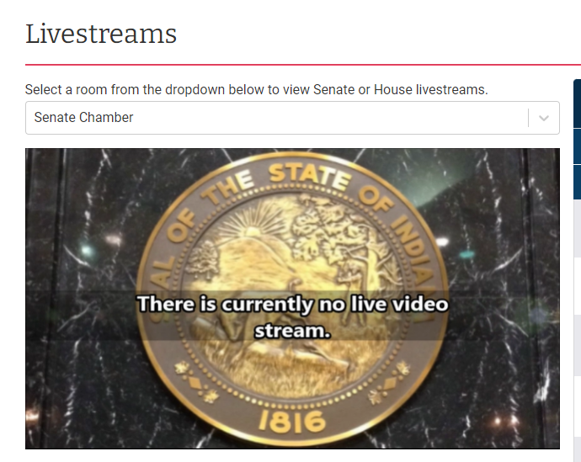
How to Watch a Session Online cont.
3. Scroll through the schedule until you find either Senate Session or House Session and click the icon.
4. You will then be prompted to the video livestream of the session.

Slide 42
Questions?

Slide 43
Contact Information
Heather D. Harris
Partner
Barnes & Thornburg LLP
11 South Meridian Street
Indianapolis, IN 46202
Heather.Harris@btlaw.com
(317) 231-6448 (direct) or (317) 490-3652 (cell)

