Slide 1



Care and Service Coordinator Roles

Slide 2
Goals of this presentation
Context of the PathWays program
Overview of the Care and Service Coordinator role
How to prepare as things move forward
Questions and Answers

Slide 3
MLTSS Basics - Key terms
MLTSS - Managed Long Term Services & Support
MCE - Managed Care Entity (Insurance Company)
Providers - Nursing Homes and other service providers
Members - Residents within the plan
NFLOC - Nursing Facility Level of Care (home or NH)

Slide 4
MLTSS Basics - Key terms
HCBS - Home and Community Based Services
NF - Nursing Facility
ICT - Interdisciplinary Care Team
ICP - Interdisciplinary Care Plan
Care / Service Coordinator - focus of this presentation!

Slide 5
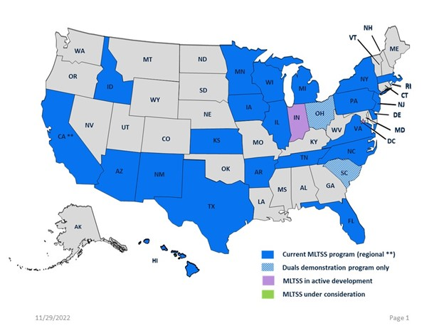
MLTSS Basics - Facts
Managed Medicaid
25 states have plans already (first was 1989)
“PathWays” is the Indiana based MLTSS program

Slide 6

PathWays Goals
Ensure equitable access to services and support
Reduce complexity of the system
Break down silos between service providers
Bring new benefits to members and families
Increased home based services
Increase quality of care
Notes:
Robust Care Coordination for equity across all individuals
Demystifying the complex LTSS environment (including Nursing Homes)
Benefits to the individual member and family
Increased services to the home
Value based care across the board
https://www.in.gov/fssa/indiana-pathways-for-aging/managed-long-term-services-and-supports/

Slide 7
What does success for PathWays look like?
Strong collaboration between MCE and NH
Shared incentives for all providers
Smoother transitions for residents between settings
Most important - improved resident/member experience

Slide 8
What will make a successful transition?
Minimal disruption for NH management/operations
Minimal disruption to NH clinical staff
Clear, coordinated conversations with residents/families
Consistent approach among MCEs

Slide 9
The Coordinator Roles
Navigates complex services offered to members
Regular assessments with members in facility
Facilitation of clinical support services
A critical component of the PathWays program

Slide 10
Service vs. Care Coordinators

Slide 11
Care Coordinator & Service Coordinator Roles Overview
Care Coordinator | Service Coordinator
Available to all Indiana PathWays members | Available only to Indiana PathWays for Aging members who are determined NFLOC and are receiving LTSS
Members are able to opt-out | Required for members who are determined NFLOC and are receiving HCBS
Primary responsibility for coordination of the member’s physical and behavioral health | Supplements, but does not supplant, the roles and responsibilities of the Care Coordinator. Collaborates heavily with the Care Coordinator and focuses primarily on waiver-specific services available to the member.
Primary writer of the ICP | Primary writer of the Service Plan, which must be incorporated into the ICP
For members in NFs, assesses at least annually the member’s potential for an interest in transition to the community. | Conducts the monthly loneliness assessment, quarterly needs assessment, annual informal caregiver assessment, and nursing facility assessments (if applicable).
MCEs ensure that the member’s Service Coordinator and ICT are provided with all CHAT and Care Coordination assessment results applicable to LTSS-specific Service Coordination to inform Service Planning and prevent the need for the administration of duplicative assessments (SoW Section 4.6)
The Care Coordinator and Service Coordinator work together to review and modify the Service Plan with the member, their caregivers, and the member’s ICT.
The Care Coordinator and Service Coordinator will meet together annually with the member to conduct the CHAT reassessment, submit results to the entit(ies) responsible for LOC reassessment, update the ICP, and complete any other assessments based on the member’s needs (SoW Section 4.7).
Stars throughout the presentation signal collaboration points between care coordinators and service coordinators

Slide 12
Care Coordinator & Service Coordinator Roles Overview
Care Coordinator | Service Coordinator
Available to all Indiana PathWays members | Available only to Indiana PathWays for Aging members who are determined NFLOC and are receiving LTSS
Members are able to opt-out | Required for members who are determined NFLOC and are receiving HCBS
Primary responsibility for coordination of the member’s physical and behavioral health | Supplements, but does not supplant, the roles and responsibilities of the Care Coordinator. Collaborates heavily with the Care Coordinator and focuses primarily on waiver-specific services available to the member.
Primary writer of the ICP | Primary writer of the Service Plan, which must be incorporated into the ICP
For members in NFs, assesses at least annually the member’s potential for an interest in transition to the community. | Conducts the monthly loneliness assessment, quarterly needs assessment, annual informal caregiver assessment, and nursing facility assessments (if applicable).
MCEs ensure that the member’s Service Coordinator and ICT are provided with all CHAT and Care Coordination assessment results applicable to LTSS-specific Service Coordination to inform Service Planning and prevent the need for the administration of duplicative assessments (SoW Section 4.6)
The Care Coordinator and Service Coordinator work together to review and modify the Service Plan with the member, their caregivers, and the member’s ICT.
The Care Coordinator and Service Coordinator will meet together annually with the member to conduct the CHAT reassessment, submit results to the entit(ies) responsible for LOC reassessment, update the ICP, and complete any other assessments based on the member’s needs (SoW Section 4.7).
Stars throughout the presentation signal collaboration points between care coordinators and service coordinators

Slide 13
Care Coordinator & Service Coordinator Roles Overview
Care Coordinator | Service Coordinator
Available to all Indiana PathWays members | Available only to Indiana PathWays for Aging members who are determined NFLOC and are receiving LTSS
Members are able to opt-out | Required for members who are determined NFLOC and are receiving HCBS
Primary responsibility for coordination of the member’s physical and behavioral health | Supplements, but does not supplant, the roles and responsibilities of the Care Coordinator. Collaborates heavily with the Care Coordinator and focuses primarily on waiver-specific services available to the member.
Primary writer of the ICP | Primary writer of the Service Plan, which must be incorporated into the ICP
For members in NFs, assesses at least annually the member’s potential for an interest in transition to the community. | Conducts the monthly loneliness assessment, quarterly needs assessment, annual informal caregiver assessment, and nursing facility assessments (if applicable).
MCEs ensure that the member’s Service Coordinator and ICT are provided with all CHAT and Care Coordination assessment results applicable to LTSS-specific Service Coordination to inform Service Planning and prevent the need for the administration of duplicative assessments (SoW Section 4.6)
The Care Coordinator and Service Coordinator work together to review and modify the Service Plan with the member, their caregivers, and the member’s ICT.
The Care Coordinator and Service Coordinator will meet together annually with the member to conduct the CHAT reassessment, submit results to the entit(ies) responsible for LOC reassessment, update the ICP, and complete any other assessments based on the member’s needs (SoW Section 4.7).
Stars throughout the presentation signal collaboration points between care coordinators and service coordinators

Slide 14
How do the roles differ?
Care Coordinator | Service Coordinator
All Pathways Members | NFLOC Members (in NH or home)
Assists with health care related services | Connects to long term services and support
Maintains Individualized Care Plan | Primary writer of Service Plan
Leads the Interdisciplinary Care Team (ICT) | Ensures that there is transitional support between settings
More focused on “clinical” services | Support for social support services

Slide 15
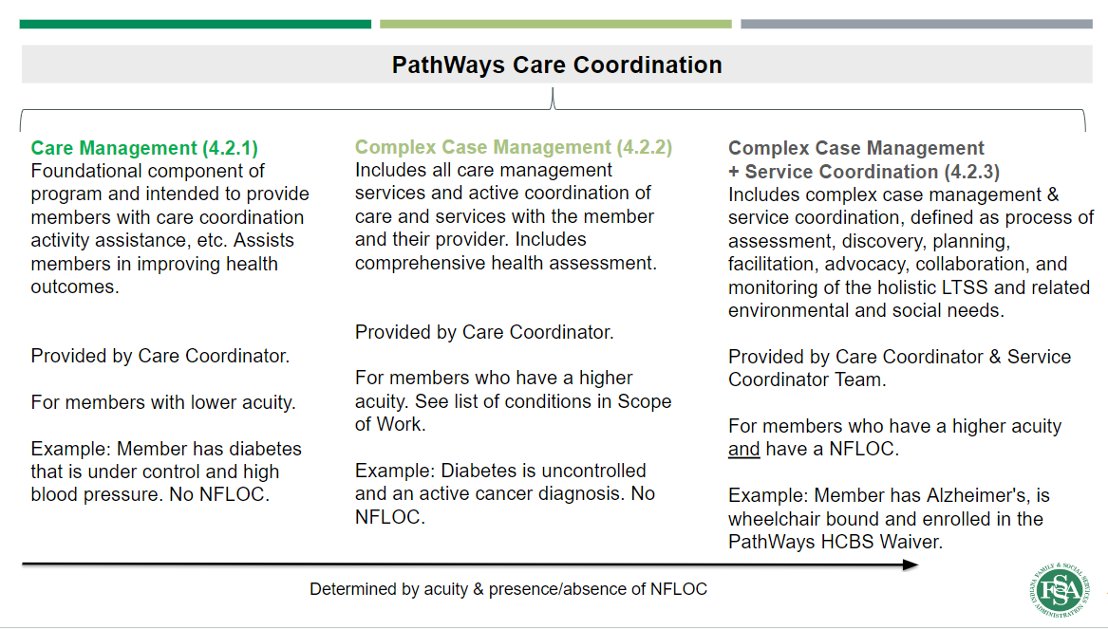
Nursing homes will have both roles

Slide 16
What does this mean for NH members?
NH members will likely have both coordinators
BOTH roles could be combined in one person

Slide 17
What is meant by “Clinical”?
This person is NOT a clinical staff member
Focus - coordination of clinical services
Evaluation and Facilitation are main roles

Slide 18
The Individualized Care Plan
Records all care services being provided
Updated with member at least quarterly
All communication with member recorded here
Annual assessment of member interest to RTC
Will not be documented in the Facility Care Plan

Slide 19
Return to community (RTC)
Care Coordinator will assess annually
CC will provide onsite visit within 10 days of transfer to update plan of care
CC and SC must be part of the Transitions Team
Focus will be on new residents

Slide 20
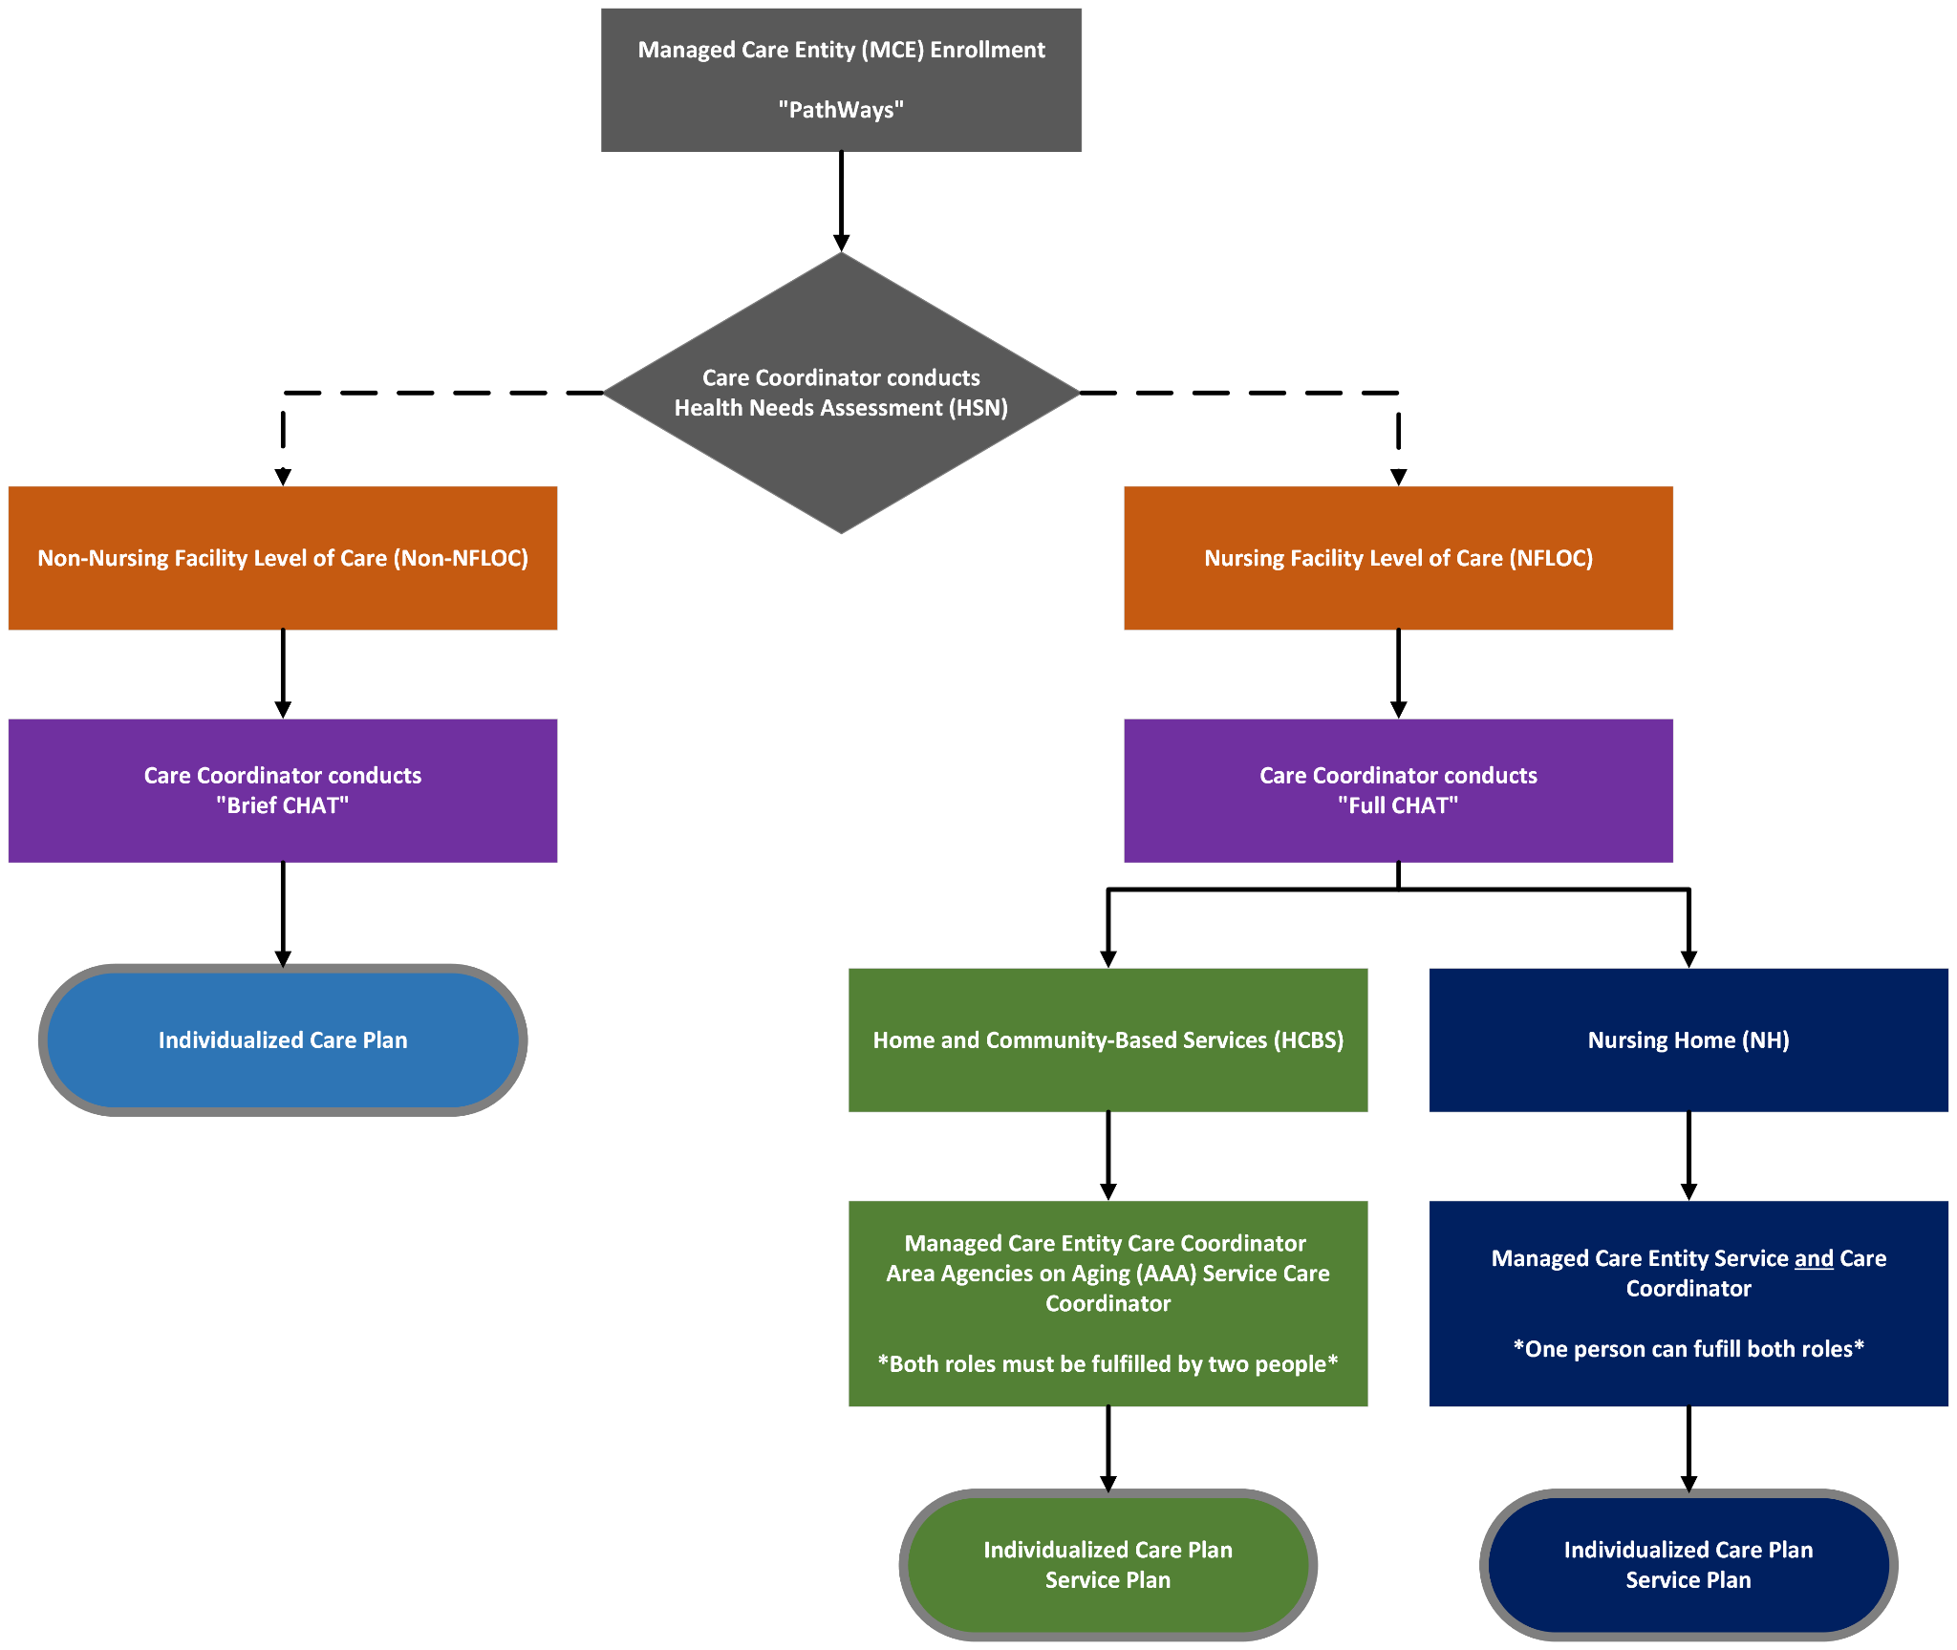

Slide 21
Contact frequency
Member/family contact at least quarterly
New admissions - within 10 days
Annual assessments
  CHAT
  Update ICP / Service Plan
  RTC Planning

Slide 22
Resident and Staff Interactions
Role Element | Interaction with Resident | Interaction with Facility
Frequency of contact | Quarterly or as needed | Will be in facility monthly
Initial Onboarding | Initial assessments for resident to identify clinical needs and ability to transfer home | Questions regarding patient status
Ongoing support | Regular assessments for needed support | Can assist with obtaining services for resident
For Residents Discharging Home | Will work to ensure needs and services are in place before transfer | Collaborate with staff and family before discharge

Slide 23
Care Coordinator Requirements
Care Coordinators Shall be located in Indiana and licensed as applicable in Indiana. Care Coordinators must be
Registered nurses in good standing OR
Have a Master’s degree in social work OR
Possess a bachelor’s degree in social work, psychology, special education, or counseling, and have at least a minimum of one (1) years of experience in providing case management services to individuals who are older adults and/or individuals with physical or developmental disabilities and/or individuals determined to have a serious mental illness (SMI),
OR be a licensed practical nurse (LPN) with a minimum of three years of clinical experience with older adults.
A portion of the Contractor’s Care Coordinators shall have experience in behavioral health so that they may appropriately assist members with behavioral health conditions.
(SoW Section 2.4.3)

Slide 24
Service Coordinator Requirements
Service Coordinators The Contractor shall employ service coordinators located in Indiana. Service coordinators may be
An individual continuously employed as a care manager by an AAA since June 30, 2018
OR a registered nurse, a licensed practical nurse, or an associate’s degree in nursing with at least one (1) year of experience serving the program population
OR a Bachelor's degree in Social Work, Psychology, Counseling, Gerontology, Nursing or Health & Human Services
OR A Bachelor’s degree in any field with a minimum of two years full-time, direct service experience with older adults or persons with disabilities (this experience includes assessment, care plan development, and monitoring)
OR A Master's degree in Social Work, Psychology, Counseling, Gerontology, Nursing or Health & Human Services
OR An Associate’s degree in any field with a minimum of four year full-time, direct service experience with older adults or persons with disabilities (this experience includes assessment, care plan development, and monitoring).
(SoW Section 2.4.3)

Slide 25
How could this role help NH residents, families, staff and leadership?
Coordination of benefits for residents
Help navigate PathWays program
Identify quality issues for leadership
Support QI efforts and provide resources
Family interaction and support

Slide 26
How could Probari support successful rollout and implementation?
Education and training for SC/CC roles
Ongoing support for SC/CC
Probari Care Transitions program
Reviewing clinical quality of members
Maintain facility profile to support communications

Slide 27
What education should coordinators have?
Nursing home 101
Palliative Care and Hospice
Care Plans in Nursing Homes, Advance directives
Family Caregiver Support
Nursing home regulations and survey

Slide 28
Ongoing support
Regular workshops with case studies
Office hours with Care Coordinators
Regular meetings with FSSA and MCEs
Collaboratives with Nursing Homes

Slide 29
Preparing your facility for this role
Continue to take care of residents per usual
Proactive communication with staff
Have materials available to answer questions
Talk with team about coordinator collaboration
Evaluate systems for quality improvement
Notes:
Continue to take care of residents per usual
Proactive communication with staff
Have materials available to answer questions from residents and families (requires awareness of communication schedule/outreach from MCEs)
Talk with management teams about appropriate point people to work with Service/Care Coordinators
As quality metrics are defined, evaluate systems for tracking and reporting on metrics and addressing priority areas, e.g.-reducing hospital transfers

Slide 30
Discussion
What are your primary concerns related to this role?
What benefits can you envision?
What regular communication would you like, from FSSA, from MCEs?
How would you be best supported by Probari?

