Slide 1
Nursing Facility Reimbursement Design Changes
Indiana Family and Social Services Administration
September 15, 2023
1

Slide 2




Why Reform Indiana’s LTSS System?
Choice: Hoosiers want to age at home
75% of people over 50 prefer to age in their own home – but only 45% of Hoosiers who qualify for Medicaid are aging at home*
The risk of contracting COVID and impact of potential isolation drives an even increased desire to avoid institutional settings
Cost: Developing long-term sustainability
Indiana has about 2% of the U.S. population, but over 3% of nursing facilities
LTSS members are 4% of Medicaid enrollment, yet 28% of spend - only ~ 19% of LTSS spend goes to home and community-based services (HCBS)
For next ten years, population projections show 28% increase in Hoosiers age 65+ and 45% increase in Hoosiers age 75+
Quality: Hoosiers deserve the best care
AARP’s LTSS Scorecard ranked Indiana 44th in the nation
LTSS is uncoordinated and lacks cultural competency
Payment for LTSS services is poorly linked to quality measures and not linked to outcomes
From 2010 to 2030 the proportion of Hoosiers over 65 will grow from 13% to 20%. Indiana’s disjointed system must be reformed to meet growing demand and to ensure Choice, drive Quality and manage Cost.
2
Our payment design should support these goals
Notes:
Reimbursement must be aligned
To provide a REAL choice
To provide sustainability
To add accountability for quality

Slide 3
Proposed Reimbursement Approach:
Twin Programs for Fee for Service and Managed Care
Supplemental (UPL) Payments to Reflect Quality Differences
Quality based payments will initially represent 10% of the UPL pool, will transition to 20% over time
Quality metrics under consideration: CMS Long Stay Measures (including hospitalizations, ED visits) and Staffing Metrics
UPL Payments proposed to transition from facility specific to uniform percentage of base rates
Use of pass-through payment approach will provide flexibility to moderate year over year payment changes
Facility Specific Base Rates
Direct Care Floor Approach will be used to transition toward acuity adjusted median costs, incremental rate increases will be contingent on demonstrated investment in direct care staffing
Higher rates will be set for facilities that serve Specialized Populations or invest in Capital Improvements
Simplified administration (prospective rate setting, no retro adjustments ) will ease transition to Managed Care
Rates to be rebased annually for initial 3-year MLTSS transition period
3

Slide 4
Nursing Facility Base Rate - Direct Care Floor
Impact on three illustrative facilities
XXXXXXXXXXXXXXX
Direct Care Price: Set at the 85th percentile of direct care costs
Median cost: 50th percentile
Facility A: Setting the Direct Care Price at the 85th percentile allows higher cost facilities to be reimbursed for more of their staffing costs than using the median.
Facility B: Facilities within 5% of the Direct Care Price will still receive the full price, to allow for reasonable profit and investment in staffing.
Facility C: Facilities with lower staffing will have profits limited to 5%. This caps the potential profit that can be generated from lower staffing.
4

Slide 5
Supplemental (UPL) Program – Payment Amount
Current Program
Each facility paid difference (if any) between their Medicare and Medicaid rates
No quality considerations
Managed Care Payment Alternatives
Uniform Dollar payment Per day
Uniform % of Medicaid Base Rate
Opted for approach that would pay higher supplemental payments to facilities with higher base rates with the thought that supplemental payments should increase with resident acuity
Quality Portion of UPL Payment
10% of UPL Payment Pool
20% of UPL Payment Pool
To minimize disruption associated with MLTSS transition, UPL Quality amount will start at 10% and ramp up to 20% over time (2% added each year)
= Selected

Slide 6
Supplemental (UPL) Program – Payment Type
Managed Care Payment Alternatives
Pass-Through Payment
  Option for FFS supplemental program transitioning to managed care
  Pass-Through Payments are allowed for up to three years
  Total annual Pass-through payments are capped at amount paid under UPL program prior to transition to managed care
  CMS does not require detailed reporting on Pass-Through payments by facility
Directed Payments
  Requires prior CMS approval via submission of “Preprint” form
  Payments are not subject to cap based on prior year UPL payments
Providers had initially favored a Pass-Through approach as no detailed reporting would be required. More recent discussions have favored Directed Payment to avoid cap limiting annual payments in the future.

Slide 7
Proposed Quality Approach
Current Metrics
CMS Long Stay Measures
Health Dept Surveys
Staff Retention
Advance Care Planning
Transition Metrics
CMS Long Stay Measures
CMS Staffing Requirements
Pathways Metrics
TBD
TBD
TBD
TBD
Short Term Revisions
  Retire Health Department Survey Score and Advance Care Planning raining Metrics
  Shift from current staffing Metric (Retention) to CMS Staffing Requirements
  Focus on smaller number of CMS Long Stay Measures
Long-term goals
  Connect to other Pathways quality programs
  Enable short term changes in quality metrics
  Long-term Quality Advisory Committee

Slide 8
Transitional Plan for Base Rates
Base Rates to be refreshed every six months
  Rate effective period
SFY 2025
SFY 2026
SFY 2027
SFY 2028
Jul - Dec
Jan - Jun
Jul - Dec
Jan - Jun
Jul - Dec
Jan - Jun
Jul - Dec
Jan - Jun
100%
83%
67%
50%
33%
17%
100%
100%
  Old Methodology
83%
67%
50%
33%
  New Methodology
17%
  Cost report period for base rates
CY 2022
CY 2023
CY 2024
CY 2025
  Acuity period – acuity lag increased by 1.5 months under new methodology
Sept23 – Mar24
Apr24 – Aug24
Sept24 – Mar25
Apr25 – Aug25
Sept25 – Mar26
Apr26 – Aug26
Sept26 – Mar27
Apr27 – Aug27
8

Slide 9
Indiana PathWays for Aging for Leading Age Members
September 15, 2023
Notes:
Darcy

Slide 10
Topics Covered
What is Indiana PathWays for Aging?
Population to be served
Program overview
Program goals/quality goals
  Who the MCEs are
  How people will enroll
  Key features of the program
MCE Readiness
Future stakeholder engagement
Appendix - Definitions
Please note: This is not the full and final Indiana PathWays for Aging operational training, which will be available in September 2023. Please check with OMPP Care Programs for PathWays training materials for staff, stakeholders, and vendors.
Notes:
Darcy

Slide 11
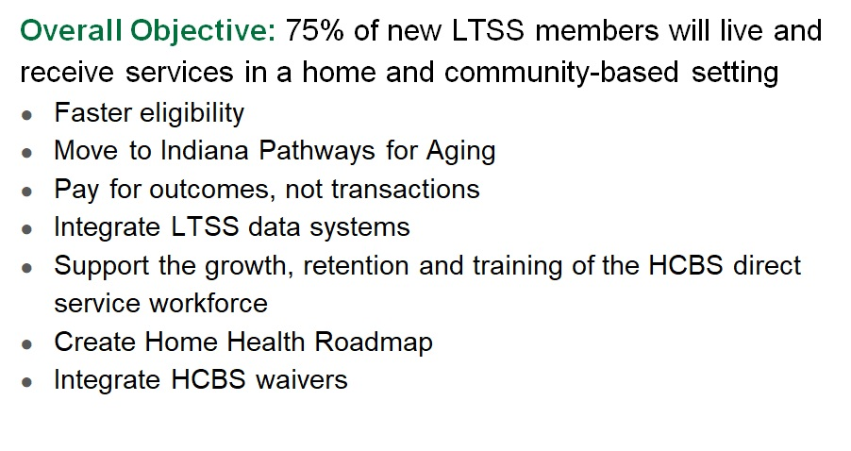
LTSS Reform & Indiana Pathways for Aging
Notes:
Darcy

Slide 12












Where We Started & Aiming for the Future
Indiana Current State
Indiana Future State
Enhanced Home & Community Based Service Offerings​
Fee-For-Service Medicaid
Medicare Integration
Strong State Oversight
Comprehensive Care Coordination​ - Including with Aligned Medicare
Provider Protections​
MLTSS
Incorporation of Member & Caregiver Voice​
Comprehensive Provider Network​
Medicare
High-Quality, Indiana-Based Health Plan Administration​
Notes:
Clarissa

Slide 13
Purpose of Pathways Codesign
Stakeholder engagement has been and continues to be an essential part of the larger long-term services and supports reform effort in Indiana with over 600 meetings held to date
The Pathways codesign workgroup is the first stakeholder group FSSA convened at the end of 2020 when the reform project began
The purpose of gathering this group of stakeholders was to inform the design, development, and implementation of the Indiana Pathways for Aging program. There have been four phases of the engagement.
Our engagement promotes buy-in and support for the reform effort and ensures organizations are prepared to have a successful transition to Pathways
Codesign Workgroup Goals:
  Share information and keep key parties up-to-date
  Receive feedback, answer questions, and dispel confusion or myths
  Build support for the program
  Assist stakeholders in navigating change
Notes:
Darcy

Slide 14

Stakeholder Engagement Overview
Who are our "stakeholders"?
Aging Hoosiers receiving Medicaid, their families and caregivers; organizations representing aging individuals and individuals with disabilities; providers; trade organizations; and other interested parties
2+ years of surveying and community conversations
Indiana Pathways for Aging Scope of Work
Years' worth of feedback from stakeholders
        Model contract language from other states
        National subject matter expertise
        Federally mandated requirements
Stakeholders reviewed excerpts from the Pathways SoW; care management manual; MCE reporting manual
Ongoing updates on readiness review
600+
92%
10
Meetings with stakeholders
of stakeholder considerations fully or partially incorporated into Pathways Scope of Work
Peer-state programs reviewed in detail
Notes:
Darcy

Slide 15
PathWays Milestones
2021
Design Program and Procure Health Plans (’21-’22)
Co-designed program with stakeholders over the course of a year to release a Request for Procurement in June 2022. Health plans bid on the RFP for a contract with the state through a competitive process facilitated by the Indiana Department of Administration
2022
Implementation and Readiness (’22)
FSSA conducts systematic review of staffing, policies, processes, documents, subcontracts, system capabilities and provider network to ensure state and health plans are ready for the program launch
2023
Award Health Plan Contracts and Onboard (’23-’24)
Contract recommendations announced to health plans in March 2023
Continue readiness review activities to ensure state and health plans are ready for the Pathways program launch
2024
Health Plans Contracts Signed (’24)
Contracts will be finalized in early 2024 with plans who completed readiness
D-SNP statewide operations and 3 Plan Benefit Package (PBP) structure to begin in January 2024
Program Go-Live (’24)
Program to launch in summer 2024
Notes:
Darcy

Slide 16
PathWays Population
Notes:
Clarissa

Slide 17
Who Is Eligible for PathWays?
Who is eligible for the Pathways program?
Indiana’s Medicaid enrollees who meet the following requirements:
60 years of age and older
Eligible for Medicaid based on age, blindness, or disability
Also eligible for Medicare
Have limited income/resources
Can be in a nursing facility
Can be receiving hospice services
Can be receiving long-term services/supports in a home or community-based setting
Who is NOT eligible for the Pathways program?
Anyone aged 59 and under
Partial benefit dually-eligible (QMB-only, SLMB-only, QI, or QDWI) members
DDRS waiver recipients
Program of All Inclusive Care for the Elderly (PACE) members
Room and Board (RCAP) members
End Stage Renal Disease (ESRD) 1115 members
Breast and cervical cancer (MA-12) eligible members
Individuals who are TBI waiver recipients
TBI out of state placements
I/DD residents of intermediate care facilities (ICF) (i.e., group homes)
Emergency services only (ESO) members
Family planning only members
Members with MAGI eligibility in HIP or HHW
PathWays is mandatory for most eligible populations (meaning the individual cannot be served in fee-for-services). However, the following individuals may opt-in to PathWays but are not required to participate:
American Indians and Alaska Natives
Individuals on hospice when entering the program
Additional Level of Care Eligibility is necessary to access the long-term services and supports in PathWays:
This eligibility is conducted by State partners other than the MCEs (AAAs, Maximus/Ascend)
Must be found eligible to have long-term nursing facility care or home-and-community-based services (HCBS)
Notes:
Clarissa

Slide 18
PathWays Program Overview
Notes:
Clarissa

Slide 19
PathWays Awarded Managed Care Entities (MCEs)
On March 1st, 2023 following a competitive procurement process, FSSA and IDOA announced 4 awarded vendors for the Indiana Pathways for Aging program:
MCE | Medicaid Experience | LTSS Program Experience | Indiana D-SNP Experience
Anthem | 11.1M members across 26 states/territories | 416K members in 10 states | ~40K members
Humana | 1M members across 5 states | 40K members in 3 states | ~23K members
Molina | 4.6M members across 17 states | 360K members in 11 states | N/A
United Healthcare | 7.9M members across 32 states + DC | 350K members in 10 states + DC | ~30K members
This table presents an overview of background information about the awarded vendors (listed alphabetically) and does not represent any evaluation criteria. Member enrollment figures are estimates provided by the MCEs as of 2022.
Notes:
Clarissa

Slide 20
Indiana-Focused PathWays Scope of Work Features
Innovative enhancements to the SoW include:
  Transformative quality framework
  Person-centered integration and coordination of a member’s medical, behavioral health, and social needs
  Seamless experience accessing Medicare and Medicaid benefits
  Incorporation of member and caregiver voice
  Supports for informal caregivers
  New Home and Community Based Service offerings
  Requirements for high-quality, Indiana-based health plan administration
  Standardized prior authorization, claims processing, and credentialing processes
  Comprehensive provider network
  Continuous service innovation and improvement including housing, workforce development and transportation services
Notes:
Clarissa

Slide 21
PathWays Services
Dual Eligible Members | All Members
Medicare Services* | Traditional Medicaid (partial list)
Part A: hospital care, SNF, hospice, labs, surgery, home health Part B: Dr visits, medical, preventive care, DME, mental health (some prescriptions) Part D: prescription drugs Part C: (Medicare Advantage) Includes full Part A and Part B benefits. Most also cover Part D. These plans also have some flexibility to provide additional supplemental benefits like over the counter drugs, transportation, wellness programs, vision or dental services, home delivered meals or other services. | Hospital care Labs/tests Surgical care Preventive care Primary care visits Prescriptions Mental health and addiction treatment DME Home health Hospice Dental Vision Hearing aids NEMT Care Coordination – An crucial component of the mLTSS program. A future presentation cover in more detail
Notes:
Clarissa

Slide 22
PathWays LTSS Services
For those individuals with a Level of Care (LOC) making them eligible for LTSS, the following services are included in the benefit package. All members receive comprehensive, person-centered care coordination – including duals.
Members with Nursing LOC | Members with Waiver LOC
Traditional Medicaid | HCBS Waiver Services**
Long Term Care (Nursing Facility) | Adult Day Service & Family Care Assisted Living Attendant Care, Self-Directed ATTC, & PDHCS Caregiving Coaching and Behavior Management Service Coordination Community Transition Environmental Modifications & Assessments Home and Community Assistance (FKA Homemaker) Home Delivered Meals Nutritional Supplements Personal Emergency Response System Pest Control Respite Specialized Medical Equipment and Supplies Structured Family Caregiving Transportation Vehicle Modifications
Notes:
Darcy

Slide 23
Care Coordination & Service Coordination Definition
Care Coordinator - An individual meeting Indiana required residential, education, and/or experience requirements that is assigned to every member with the primary responsibility for coordination of the member’s physical and behavioral health, and LTSS services.
Service Coordinator - Individuals meeting Indiana residential, educational and/or experience requirements responsible for the development and continuous modification of the Service Plan for members who are receiving LTSS, to establish goals and priorities, comprehensively assess needs, evaluate available resources, and develop a plan of care; and to identify LTSS providers as well as other community resources to provide a combination of services and supports that best meet the needs and goals of the member and informal caregiver(s).
Notes:
Darcy

Slide 24
Other Vendors in the PathWays Ecosystem
Vendor Name | Services | Example Member Interaction
Enrollment Broker (Maximus) | Helps individuals select or change their PathWays MCE | An individual gets a letter that they’re eligible for PathWays and a number to call to enroll. The EB helps them enroll with an MCE that has the individual’s current doctor in its network.
Level of Care Assessor Representative (LCAR) (Maximus) | Assesses whether individuals meet Nursing Facility Level of Care (NFLOC) to qualify for LTSS Sometimes referred to as “functional eligibility” | An Area Agency on Aging refers an individual to LCAR for an NFLOC assessment as a first step toward receiving waiver services.
Dual Eligible Special Needs Plans (D-SNPs), type of Medicare Advantage Plan | Cover and coordinate Medicare services, specifically for dual-eligible individuals With PathWays, each D-SNP will have an aligned MLTSS Plan (same parent company), to allow for greater coordination between Medicare and Medicaid benefits. | A D-SNP case manager works with the member’s PathWays team to make sure that an individual’s transition from a hospital to a short-term skilled nursing facility stay to the home/community goes smoothly.
Notes:
Clarissa

Slide 25
Other Vendors in the PathWays Ecosystem
Vendor Name | Services | Example Member Interaction
Area Agencies on Aging (AAA) | Coordinate, offer, and connect older adults to services to support them in their home and community Contracted at a local/regional level with the State to provide Older Americans Act services (Federal program), CHOICE (State program), and waiver services–including waiver care management. | A family contacts a AAA to get information and resources when they discover that Grandma has been having trouble caring for herself at home.
Independent Case Management companies (ICMs) | Like AAAs, ICMs offer A&D waiver care management services today. Under PathWays, MCEs will subcontract with existing A&D care management providers to perform PathWays Service Coordination. | A PathWays member who qualifies for HCBS works with their Service Coordinator (subcontracted through an ICM) on an LTSS-specific Service Plan.
Member Support Services (MSS) (Vendor TBD – in procurement) | Assists members with understanding and navigating their coverage and rights under PathWays Supports members in resolving MCE issues and navigating the grievance and appeal process Also called “Beneficiary Support Services” as federally required | An MCE denies a PathWays member a service they think they need. The member contacts the MSS to learn what their options are and how to file an appeal.
Notes:
Clarissa

Slide 26
MCE Readiness
Notes:
Clarissa

Slide 27
What is Readiness Review
A systematic large-scale review of MCE staffing, policies and procedures, processes, documents, member and provider communication, subcontracts, system capabilities, and provider network to ensure the health plan is prepared in advance of the new contract go live
Safeguards that the selected MCE is ready to accept enrollment, provide the necessary continuity of care, ensure access to the necessary spectrum of providers, and fully meet the diverse needs of the population
Readiness reviews includes both desk review of MCE documentation as well as onsite demonstrations of MCE capabilities
Notes:
Clarissa

Slide 28
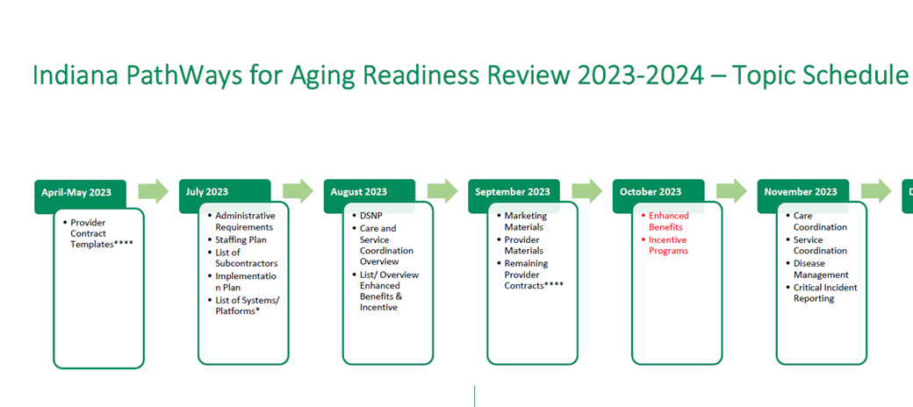
Notes:
My apologies as I know this is difficult to see, however we wanted to share with the group that we have made updates to the readiness review schedule.

Slide 29
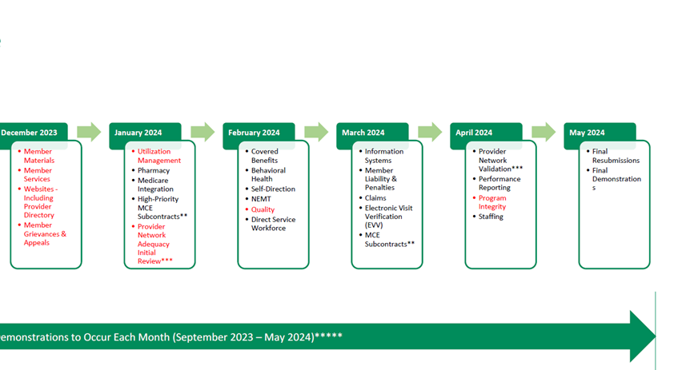

Slide 30
Future Stakeholder Engagement
Commercials
Promotional Kits based on different intercessors
Fall community activities
Member notices
Ongoing HCBS and Nursing Facility engagement
Member engagement (spring, 2024)
Notes:
Darcy

